Slide 1
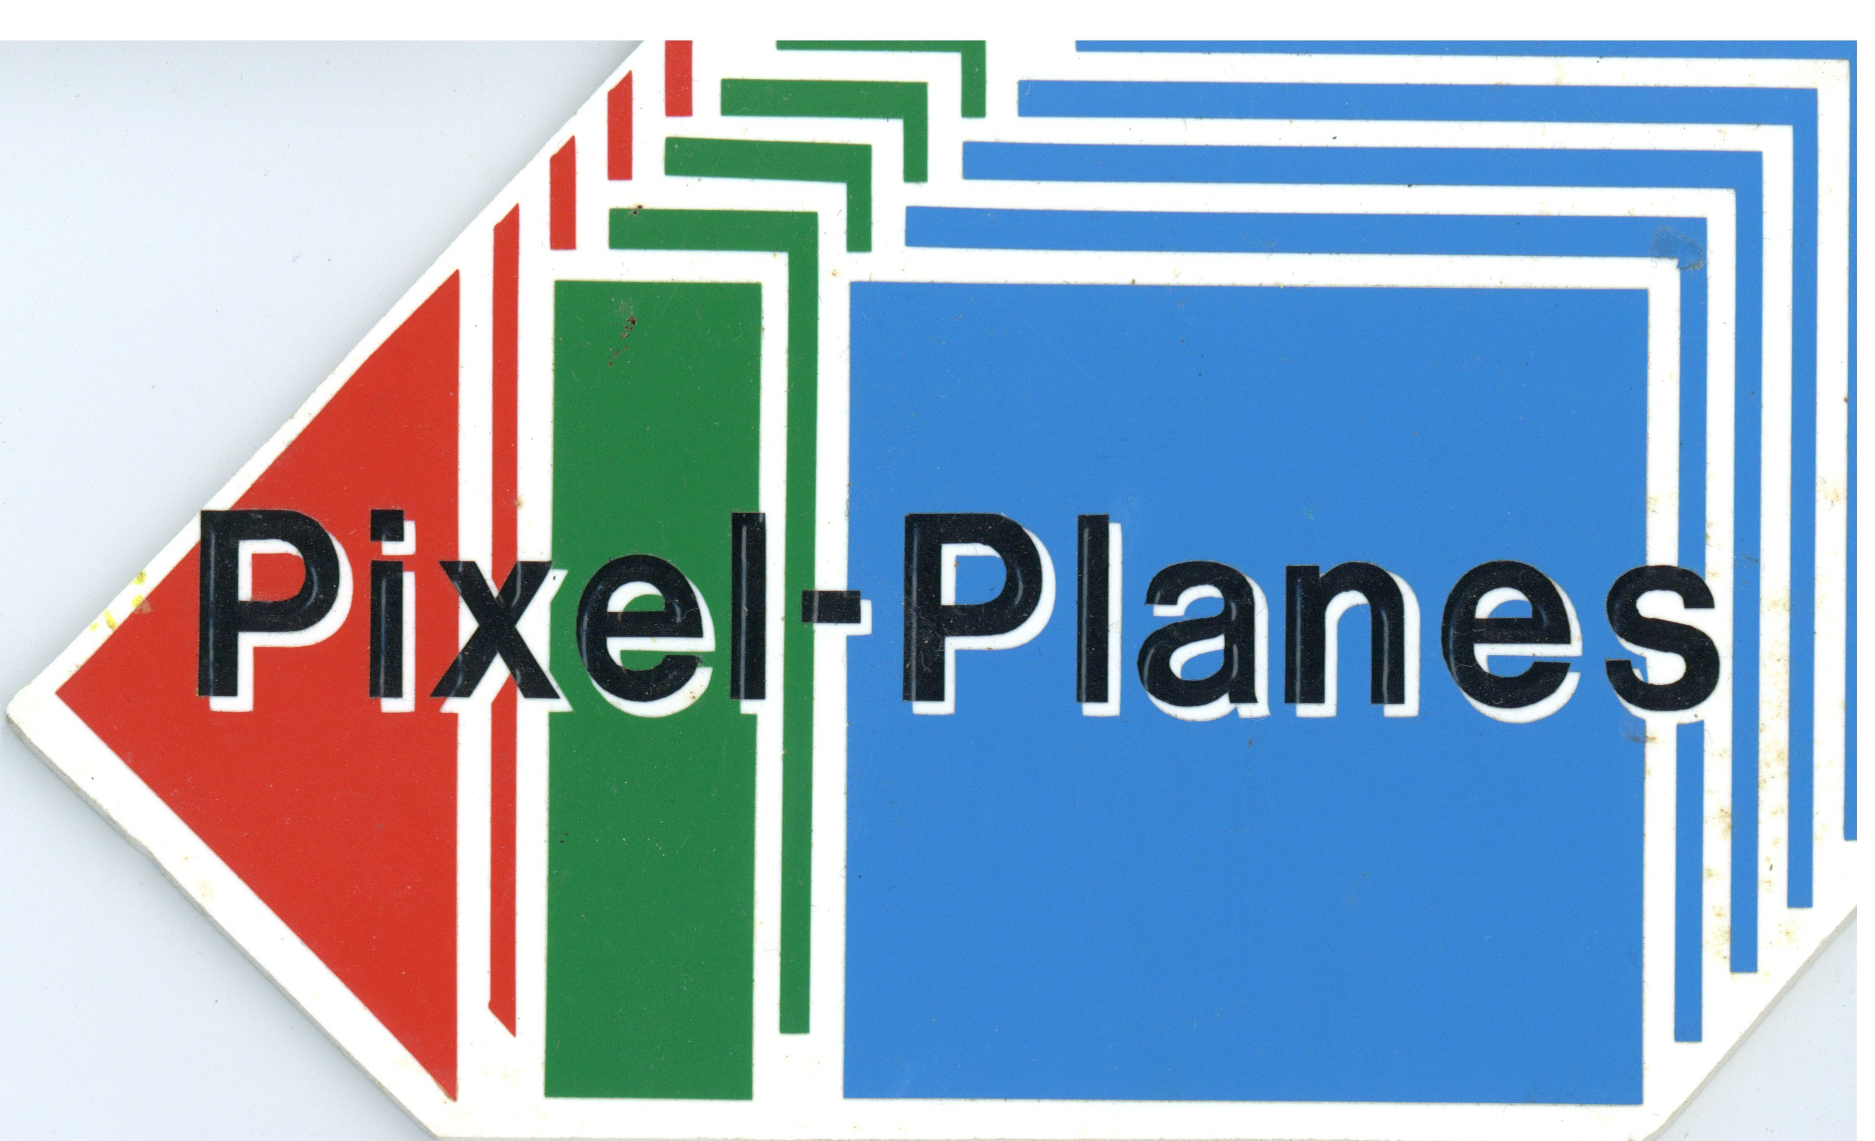
Pixel-Planes 4—The Year We Grew Up
Our adventures between Siggraph 85 and Siggraph 86
Many thanks to Jim Mahaney, John Austin, Trey Greer, and John Eyles for photos and help!

Slide 2
Prehistory 1980-1981
Mead and Conway revolution
UNC’s first VLSI Design Course (Fall 1980)
Henry has an epiphany during a boring talk
Linear expressions
Efficient bit-serial plane equation evaluation
Simple logical op’s to do rendering
Shared with great excitement at the next class meeting
Signed up to design pxpl as a class project..
The top of a very slippery, very long slope

Slide 3
Pixel-Planes 1
Implemented some logic for 2x2 pixels
Designed on big piece of gridded velum with colored pencils, and digitized using ED text editor
Finished late.. Took an incomplete!
Fab at Xerox PARC Spring 1981, 5µ NMOS
Back from fab Summer 1981
Half-hearted attempts to test
But mainly on to other things!

Slide 4
Pixel-Planes 1 Era (1981-82)
MSL (Microelectronic Systems Lab) founded in 1981
..using state funding for μelectronics faculty, along with MCNC
Vern Chi hired as lab director
First hires: John Thomas, Dan Berglund, and me!
Began to have real design tools (e.g., Berkeley Caesar, Spice)
Collaborated on several other VLSI projects in the Triangle

Slide 5
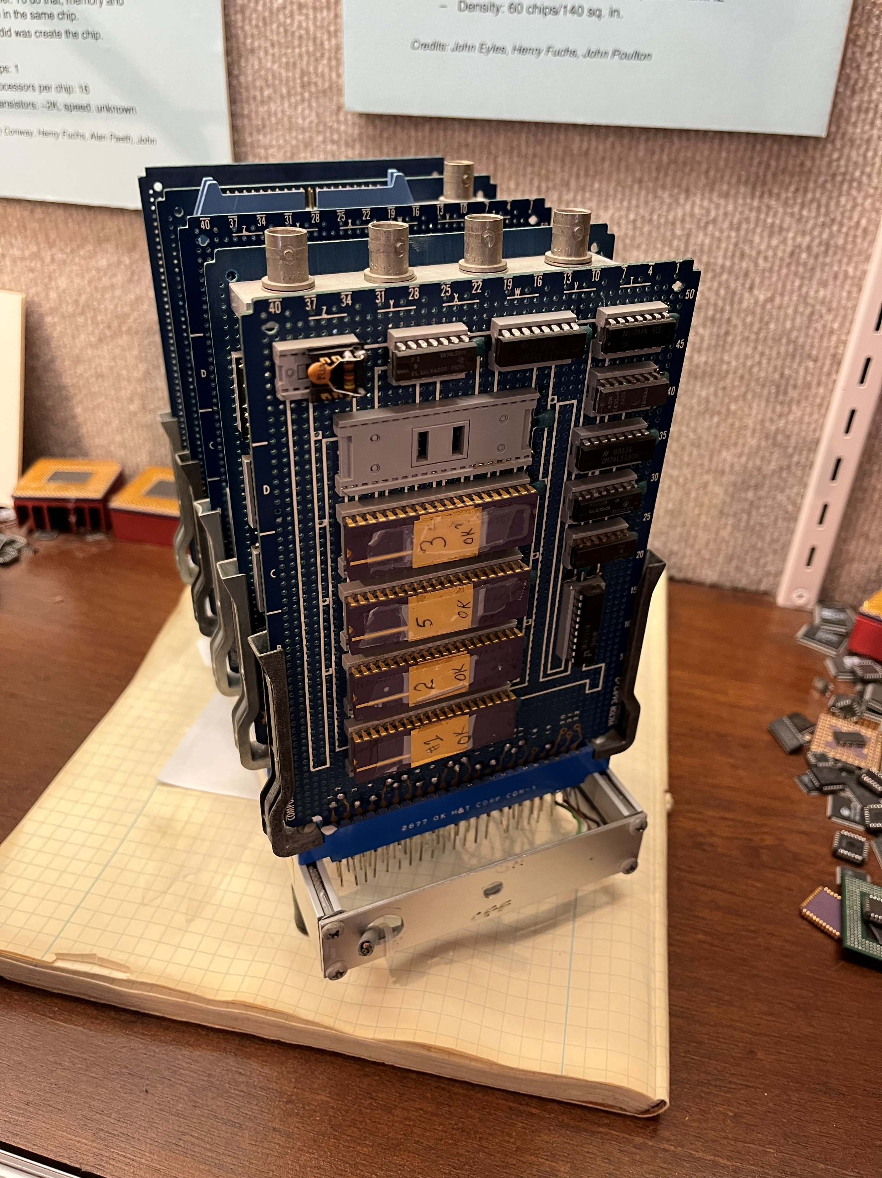
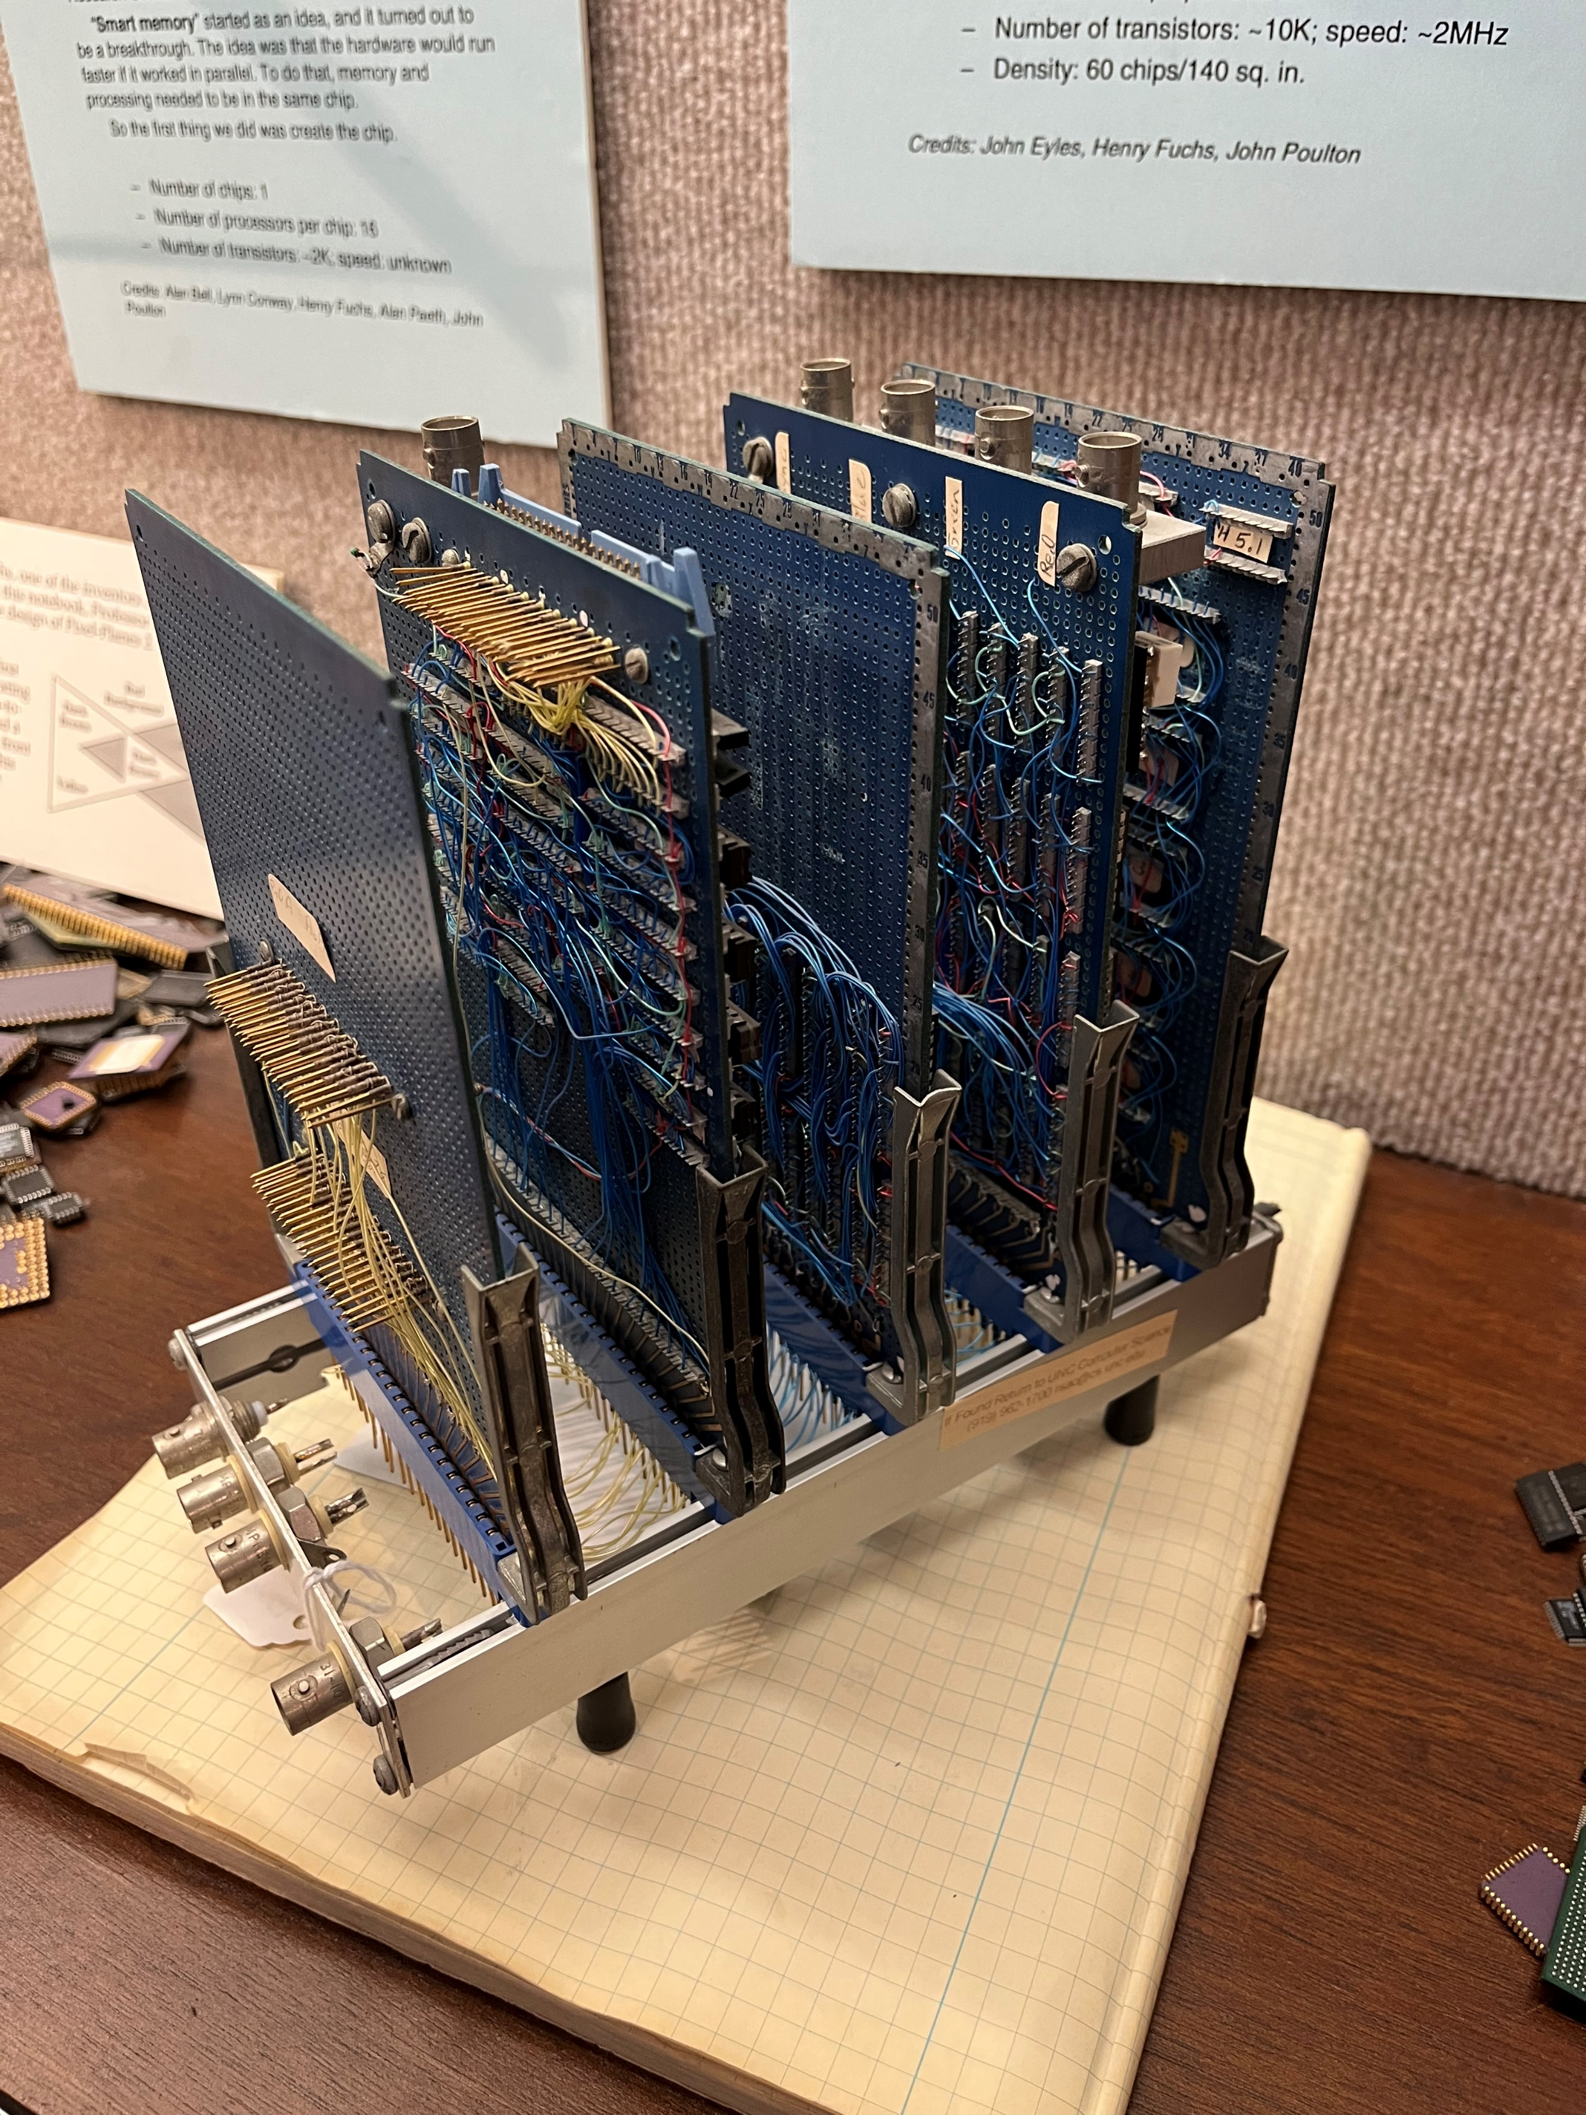
Pixel-Planes 2 (1982-83)
Visit to Lynn Conway’s lab at Xerox PARC, spring 1982
Lynn kindly “loaned” Al Paeth and Alan Bell to help us with silicon design
Paeth only had time for part of linear expression tree, simple ALU, few bits of memory
Chips fabbed at Xerox PARC, arrived Fall 1982
4 chips worked
Augmented with external circuits to do video scanout and display

Slide 6
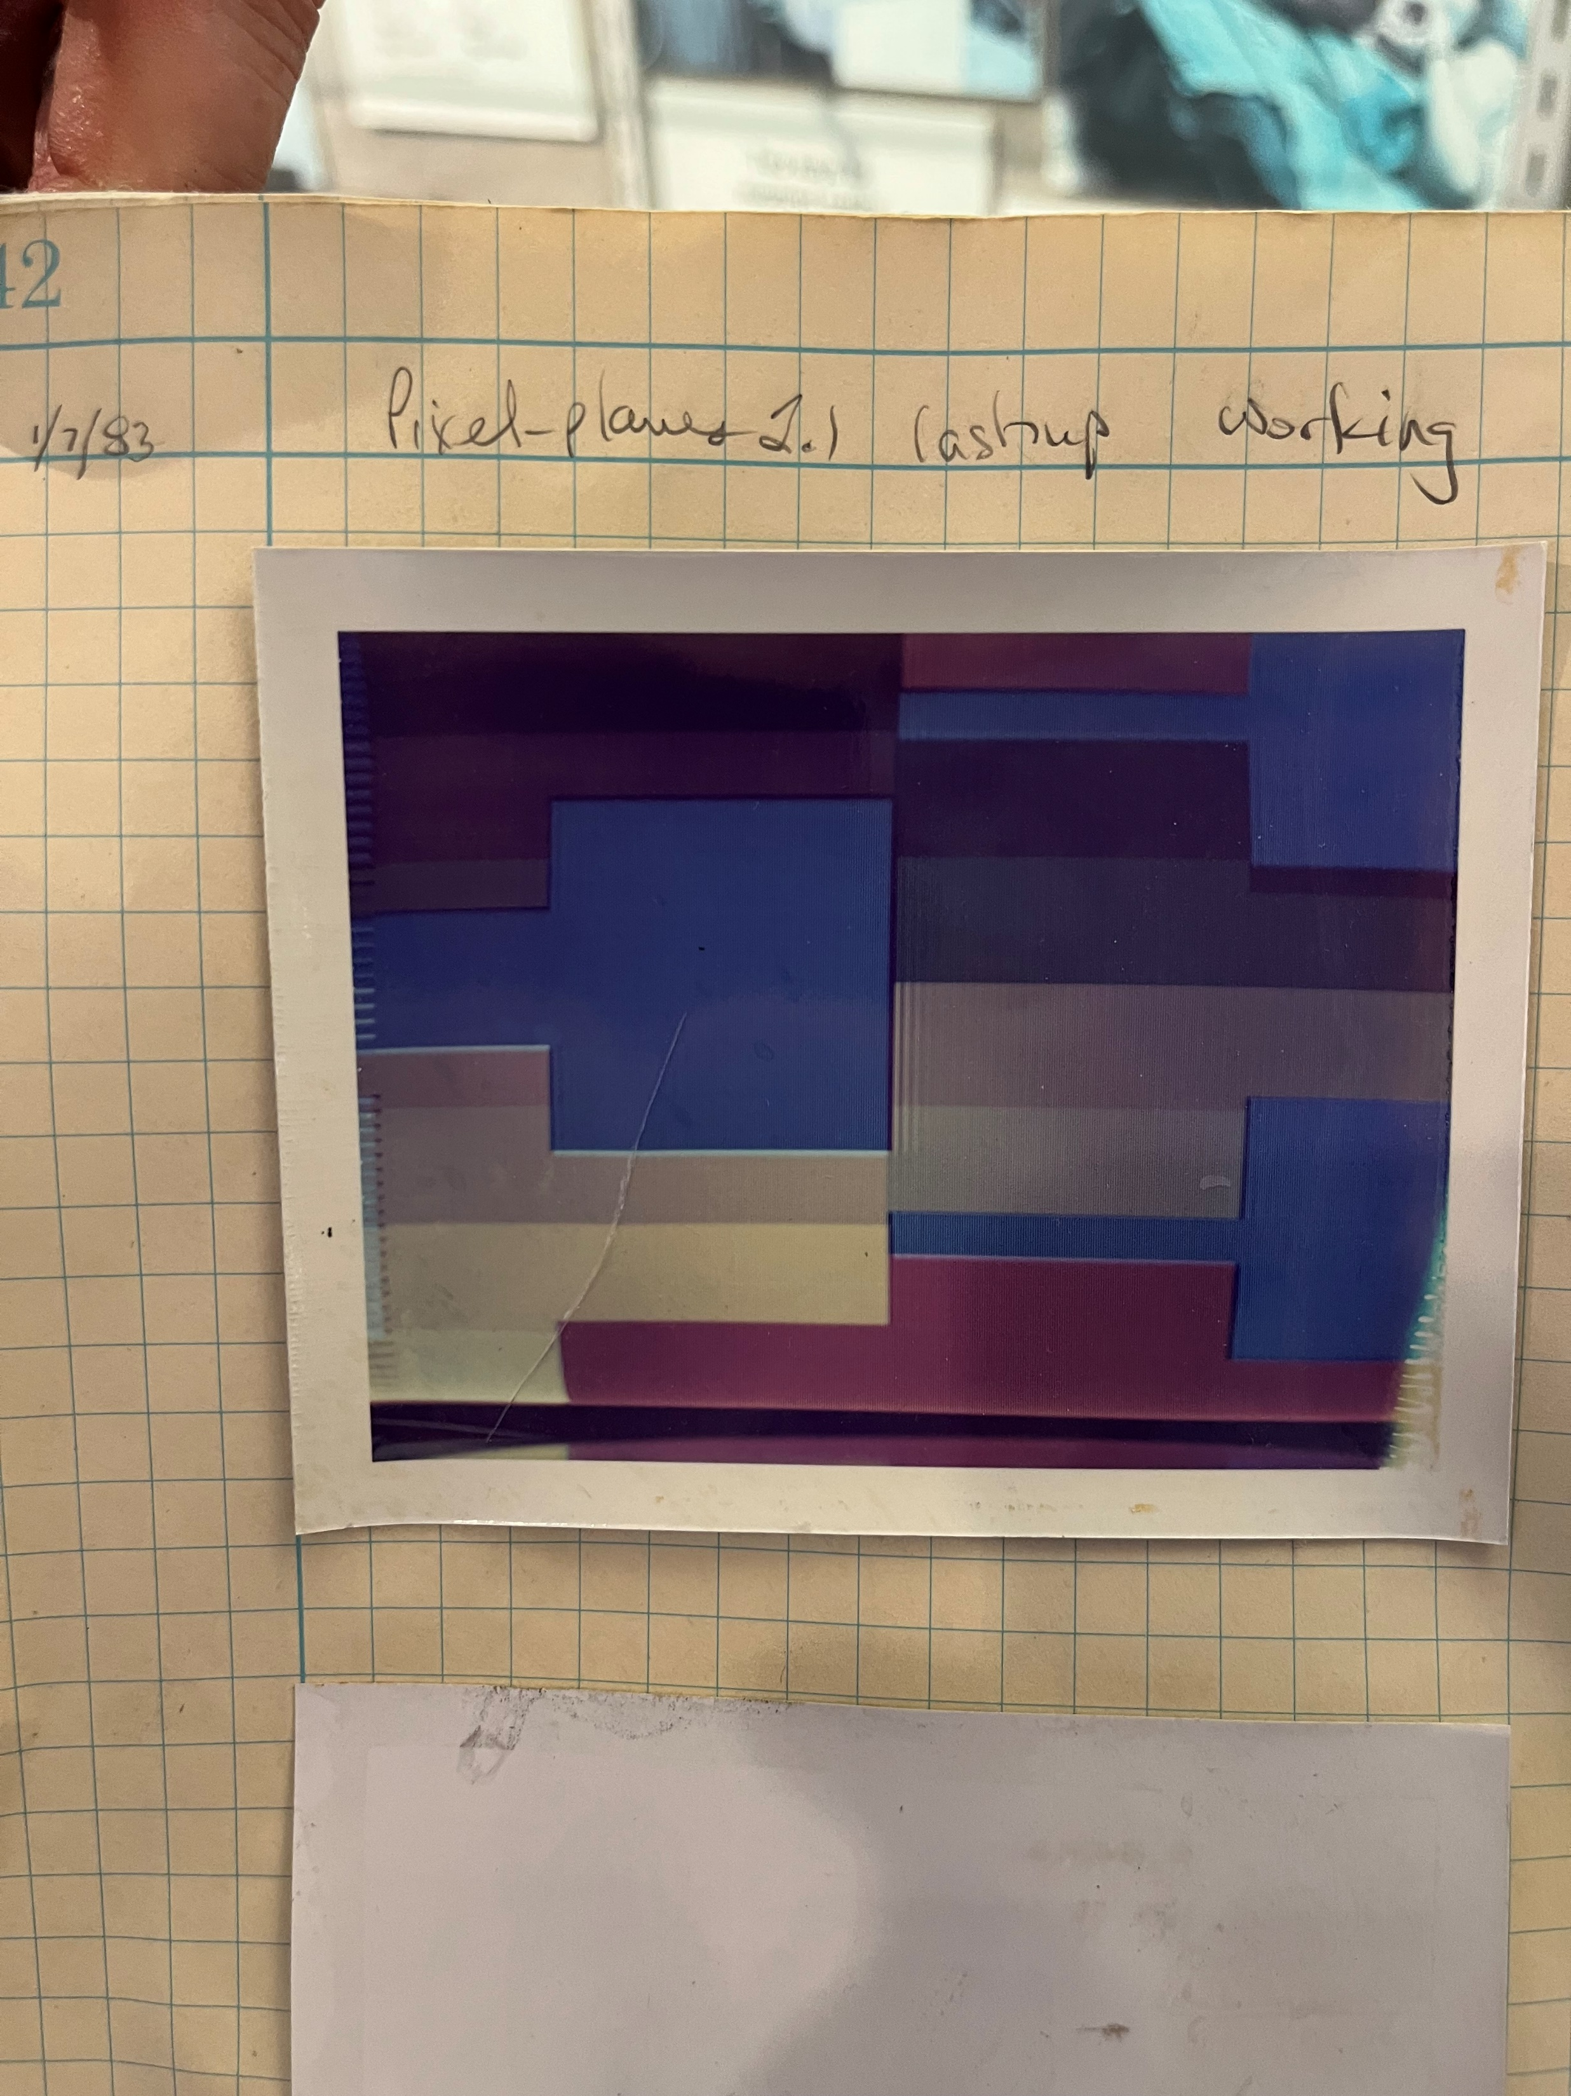
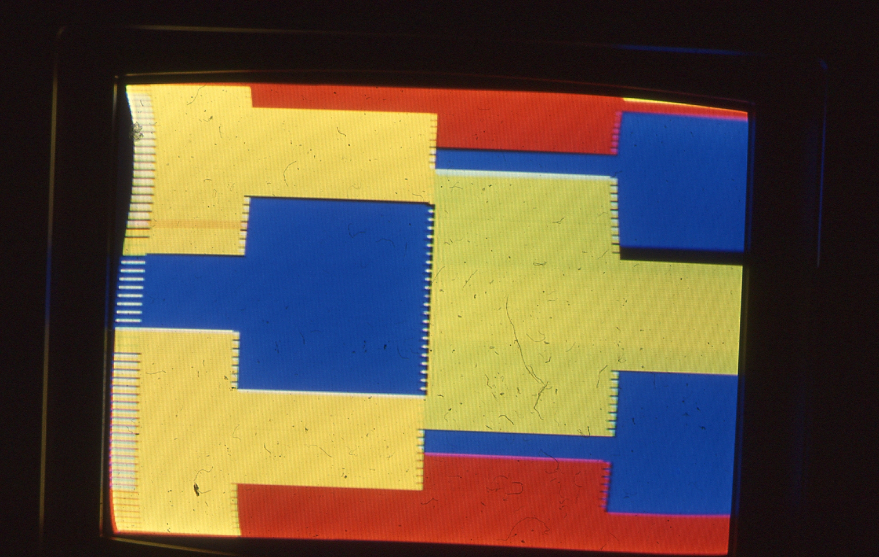
Pixel-Planes 2
The “lashup” made this image on 1/7/83
Birthday of Pixel-Planes!
4 x 16 image (3 interpenetrating polygons)
.. needed a model to explain!
Demonstrated 3 basic rendering steps:
Scan conversion
Smooth shading
Hidden surface removal
Convinced people this could work.. ..including funding agencies
1982-83: persuaded NSF and DARPA to fund project

Slide 7
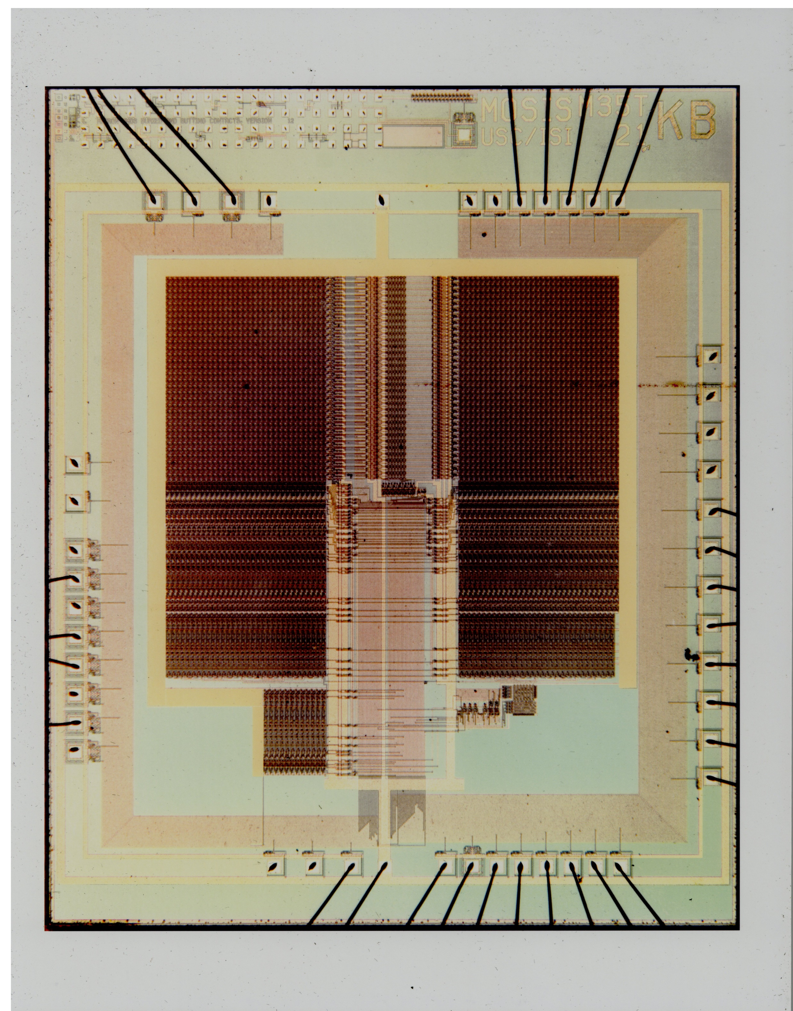
Pixel-Planes 3 (1983-1984)
New tools and much learning led to..
Pxpl3 memory chip: 64 pixels x 32 bits of memory
Full X-Y linear expression tree
Token based video output system
4μ NMOS, fabbed thru new MOSIS service
Project gained joint NSF/DARPA funding
Hired key people (John Eyles, John Austin, Mark Monger)
Moved into New West 1rst floor

Slide 8
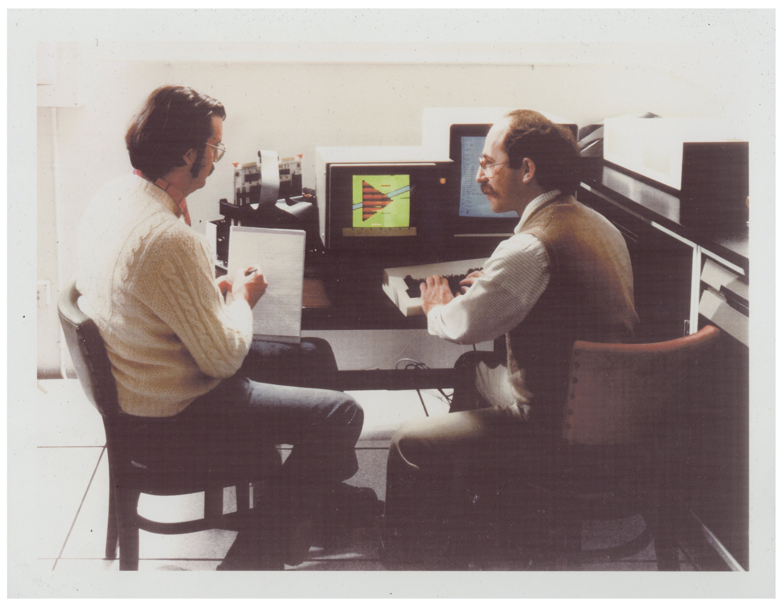
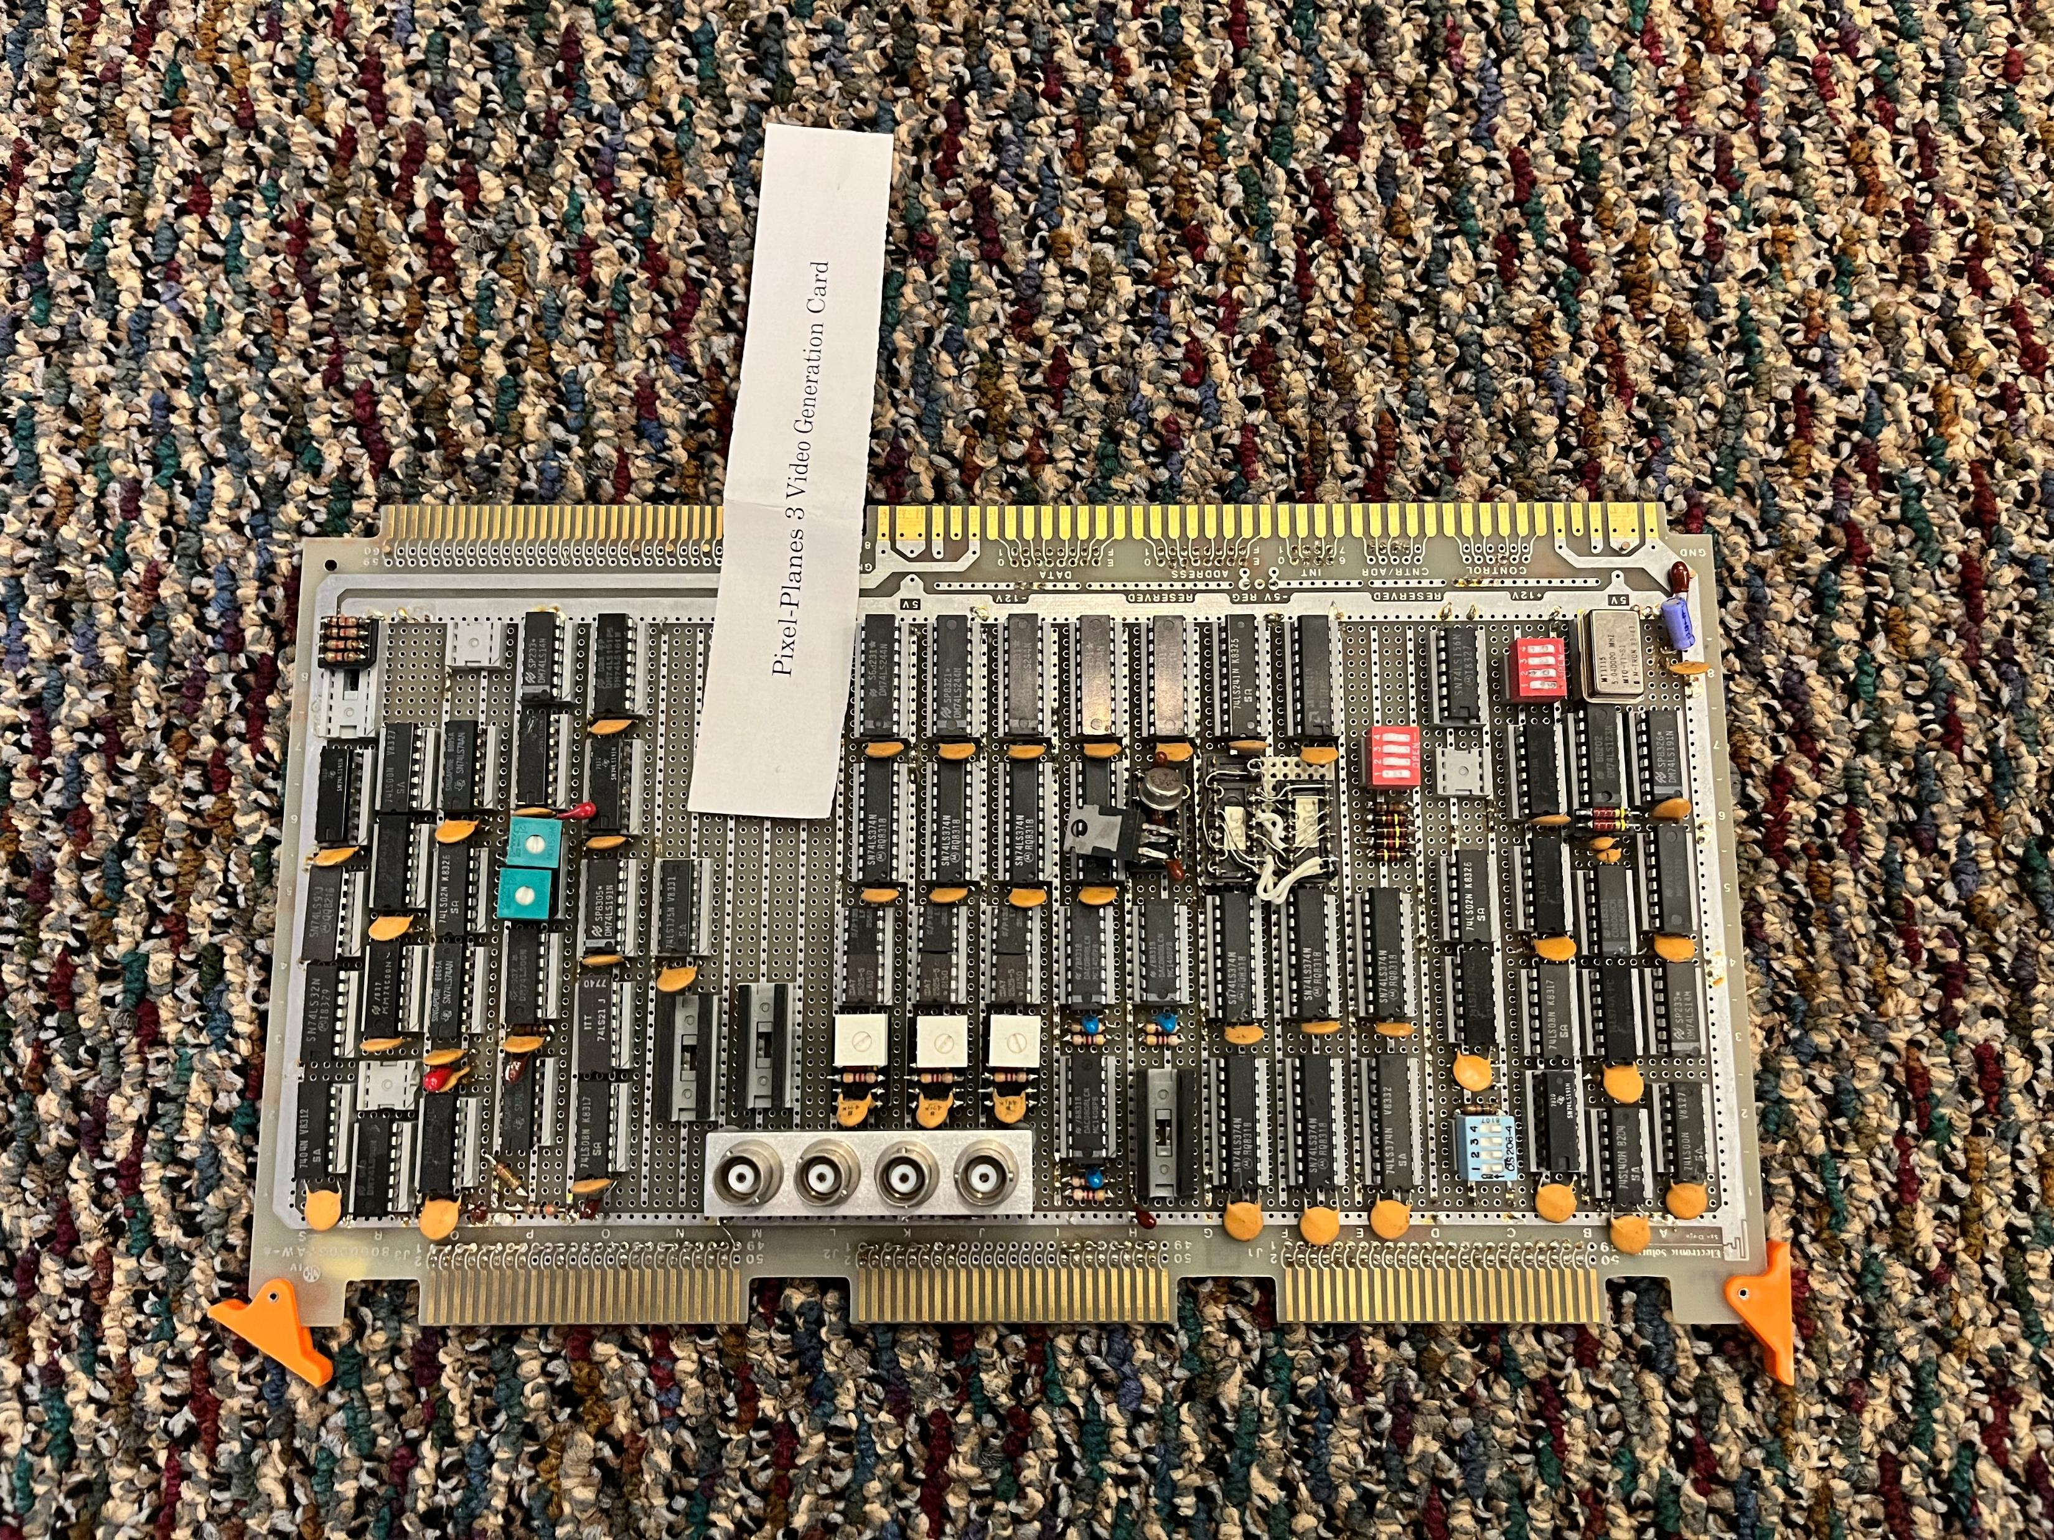
Pixel-Planes 3 System
Chips (mostly) worked.. Workarounds for flaws
Pxpl3 prototype could render polygons at speed limited by host computer
Began to develop serious board-design chops
..and learn how to get chips (almost) right on 1st silicon
John Austin’s Video Controller

Slide 9
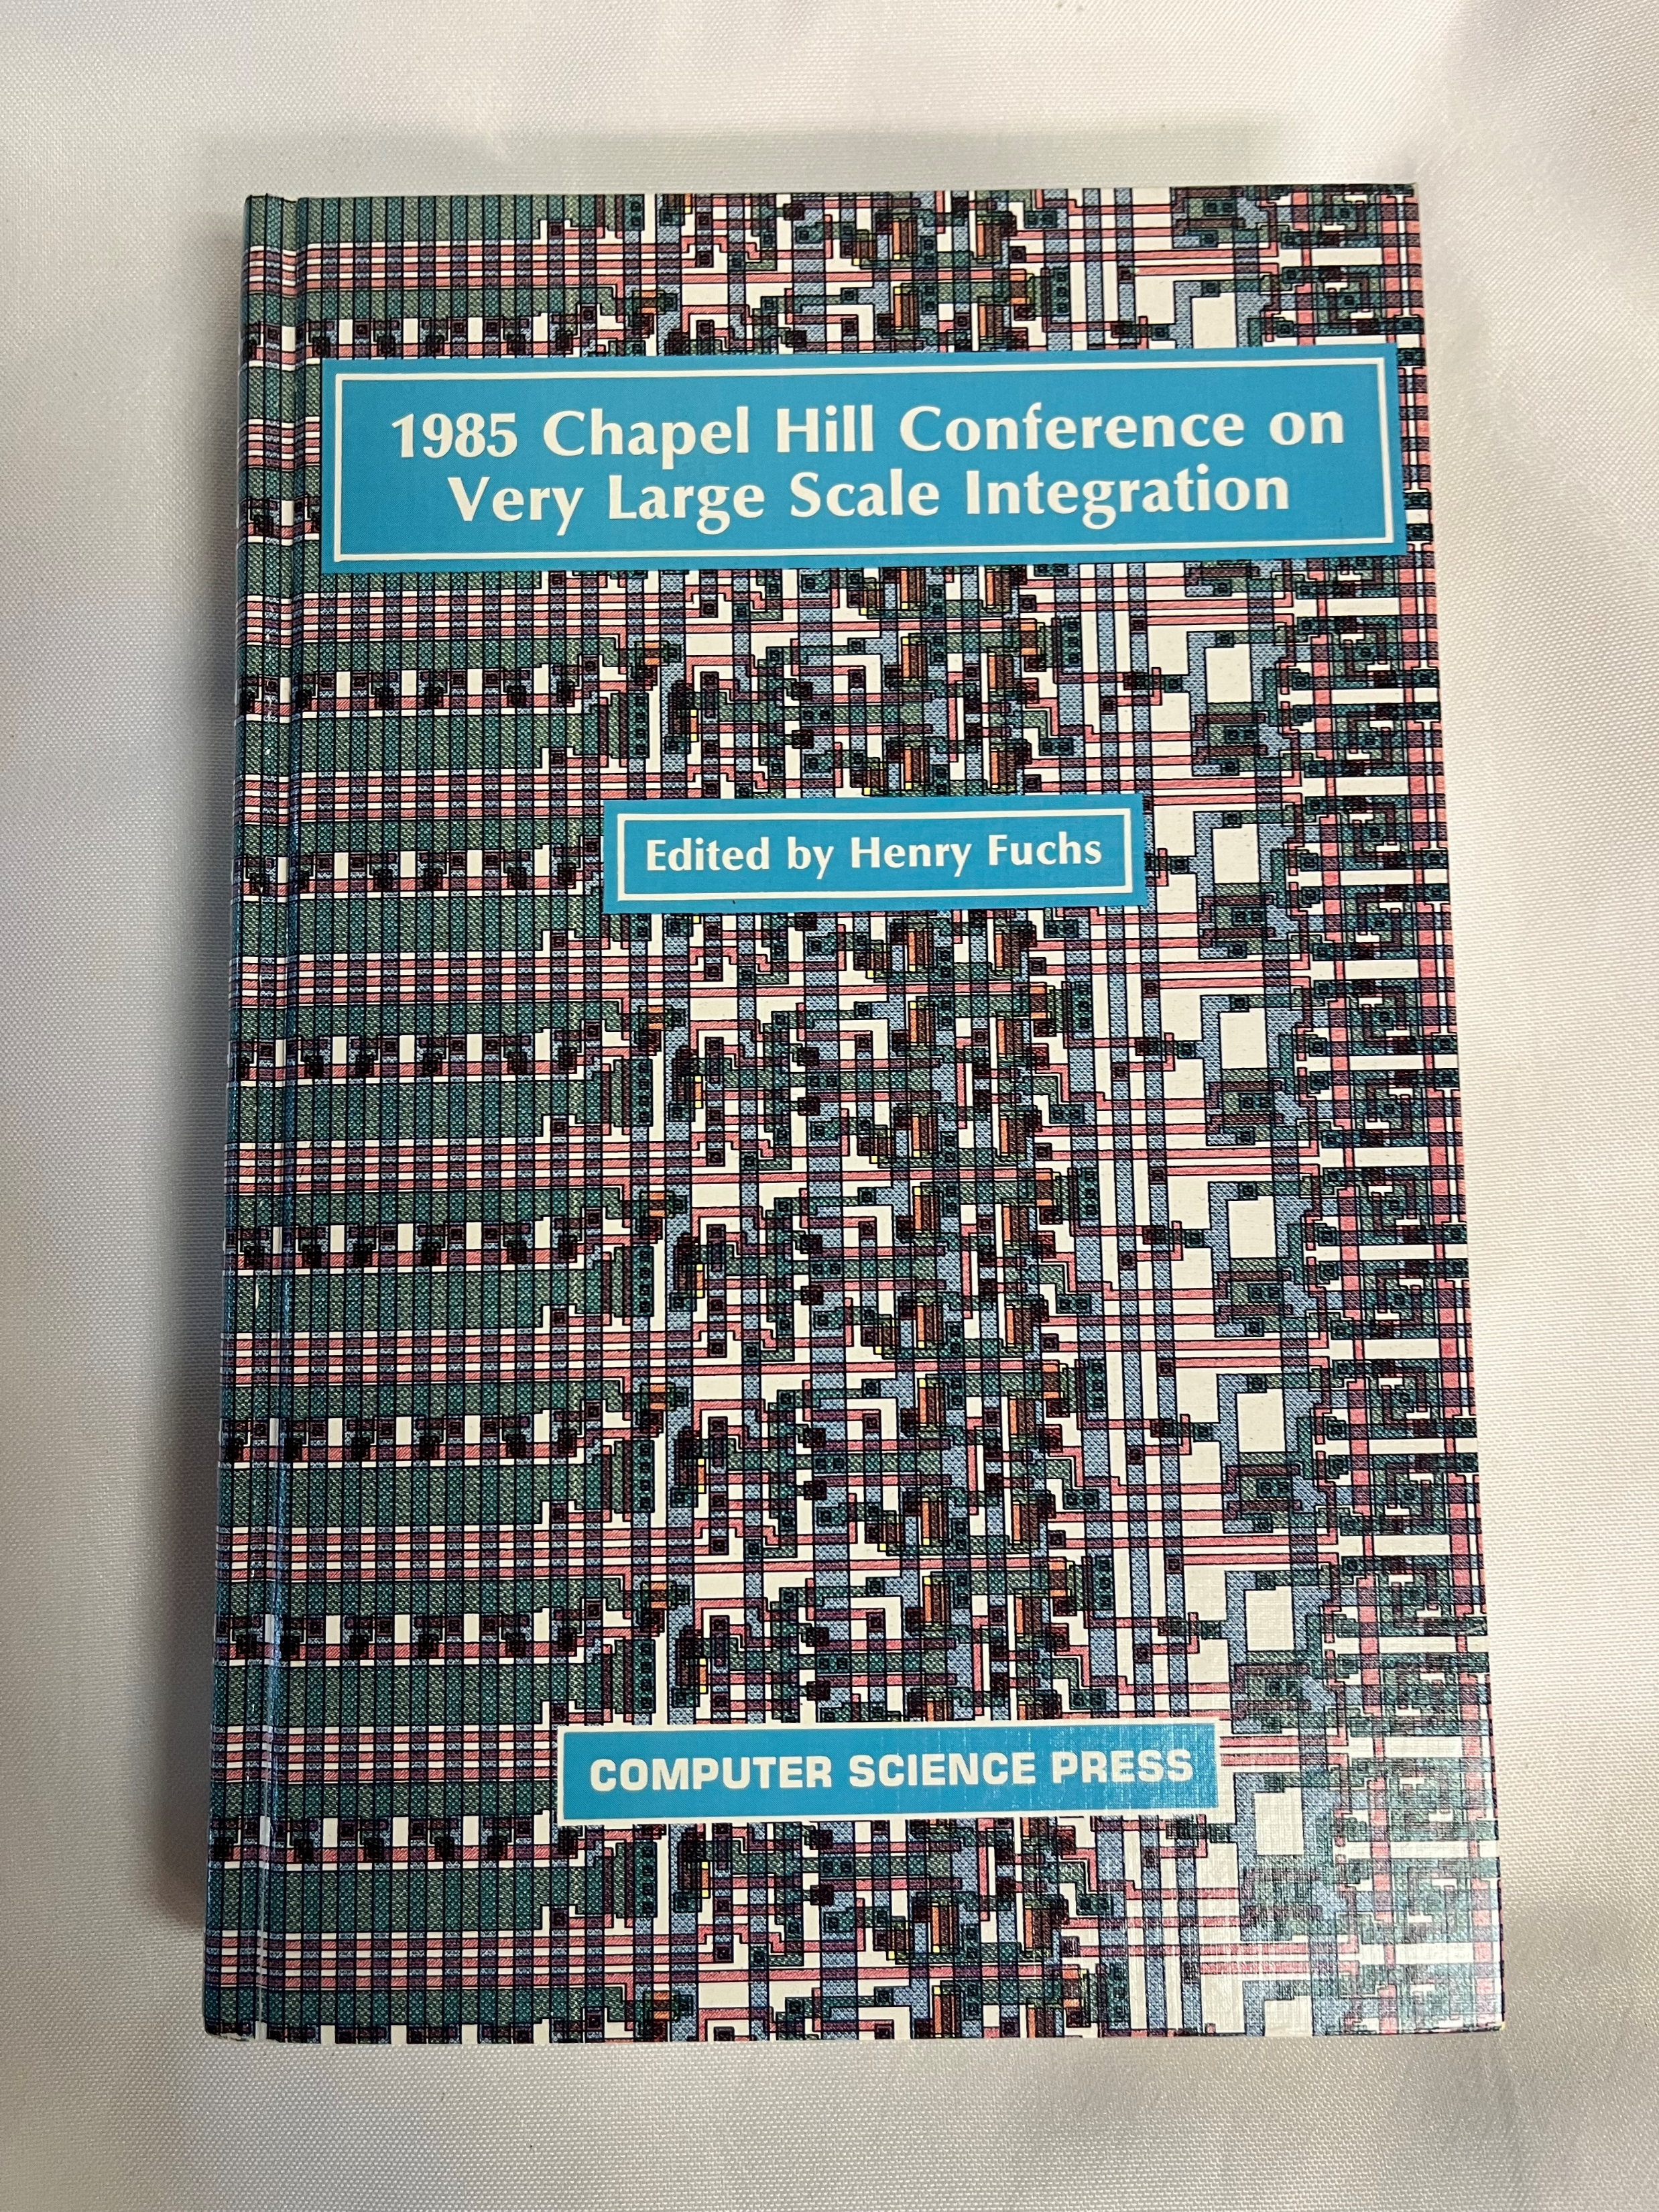
Pixel-Planes 4 (1985)
Pixel-Planes group join DARPA VLSI ‘club’
Henry persuades MIT and Caltech to allow UNC to host annual academic VLSI conference
Pxpl3 demonstrated at ‘85 VLSI
Several talented graduate students join group
Began work on Pxpl4 Enhanced Memory Chip (EMC)
Lambda-based port of Pxpl3
128 pixels x 72 bits/pixel, 3μ NMOS
“Shadow Register” for async video scan out
Full X-Y tree with programmable “super-tree”
10MHz operation planned

Slide 10
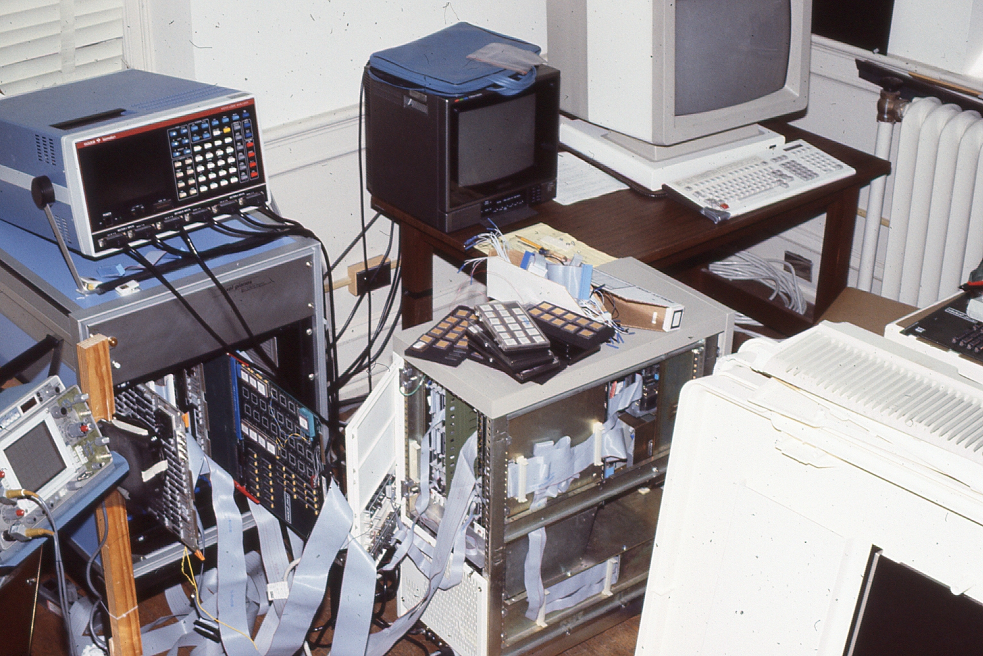
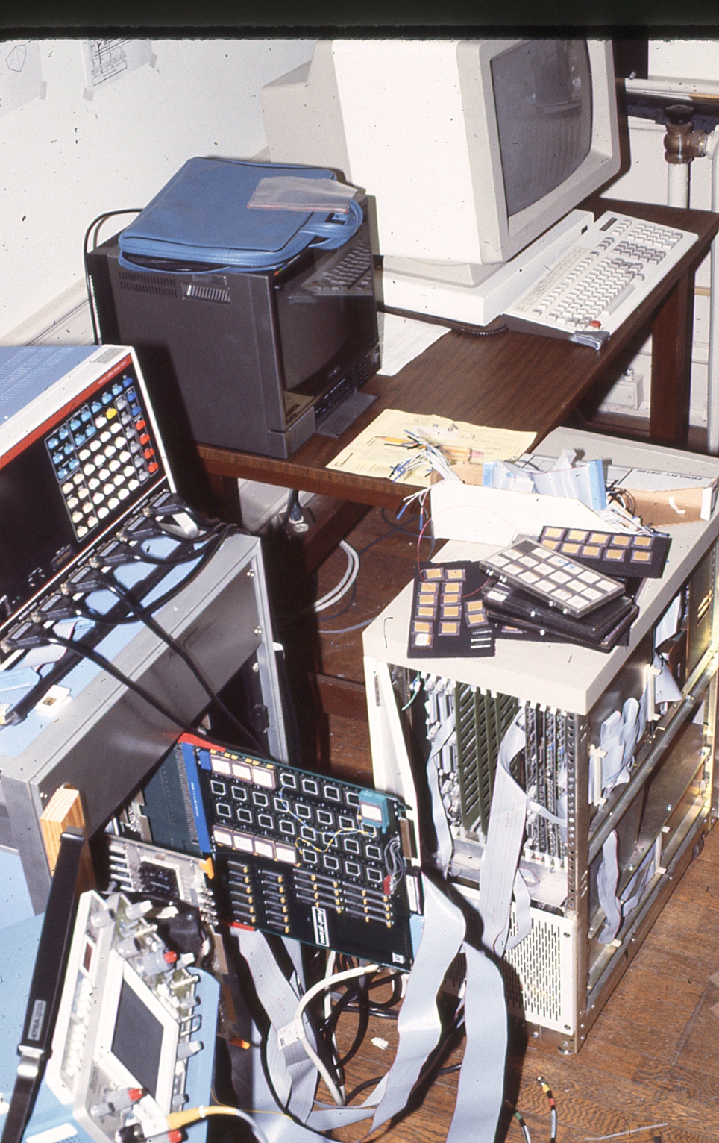
Early Pxpl4 System
Built late spring 1985..?
No one remembers much about it.. ☺

Slide 11
Siggraph ‘85
Jeff Hultquist presented our latest paper, last day of the conference, ~3000 attendees:
Fast Spheres, Shadows, Textures, Transparencies, and Image Enhancements in Pixel-Planes
Timing estimates indicate that 30,000 smooth shaded triangles can be generated per second, or 21,000 smooth-shaded and shadowed triangles can be generated per second, or over 25,000 shaded spheres can be generated per second. Image-enhancement by adaptive histogram equalization can be performed within 4 seconds on a 512x512 image.
Jeff read this… loud guffaw from back of the packed house
We (Henry, Fred, John Eyles, several others) caucused after the talk..
..and resolved to build a full-scale machine to answer the doubters!

Slide 12
Full-Scale Pixel-Planes 4
What would it take to move beyond “science fair” projects?
Most serious problems:
‘Smart’ frame buffer (2,048 custom chips for 512x512 display!)
“Front end” transformation engine: how to get enough Mflops?!
Host of other problems:
System packaging, power, cooling
Custom PCB’s for frame buffer & backplane
Custom logic boards for host interface, video, SIMD μcontroller
Software!

Slide 13
Pxpl Memory Chips
For 2,048 chips for 512x512 display, we’d need ~ 50-60 wafers
No budget for this much silicon, so..
Pitched full system to John Toole (DARPA PM) @ Fall ‘85 VLSI meeting
Amazingly, he was convinced.. devoted most of that year’s MOSIS wafers to us!
MCNC also offered to pitch in. Delivered a few Pxpl4.1’s by early summer 1986
Pxlp4.0 had minor flaw—tho fully testable with workaround
Quick re-design to Pxpl4.1
New design went straight to wafer fab

Slide 14
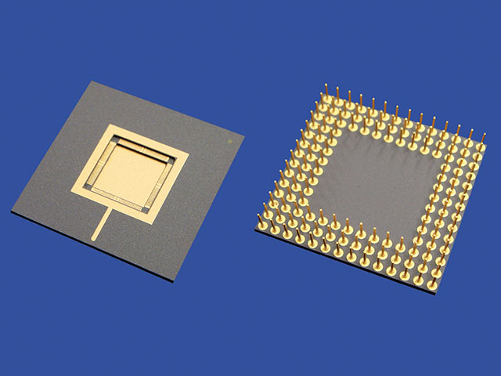
Chip Testing
Wafer Test
Package Test
Packaging
(MOSIS)
84-pin PGA
Good chips to FB Boards
Re-test packaged chips
Wafers from MOSIS (VLSI Technology)
Tested wafers (bad chips marked) to packaging

Slide 15
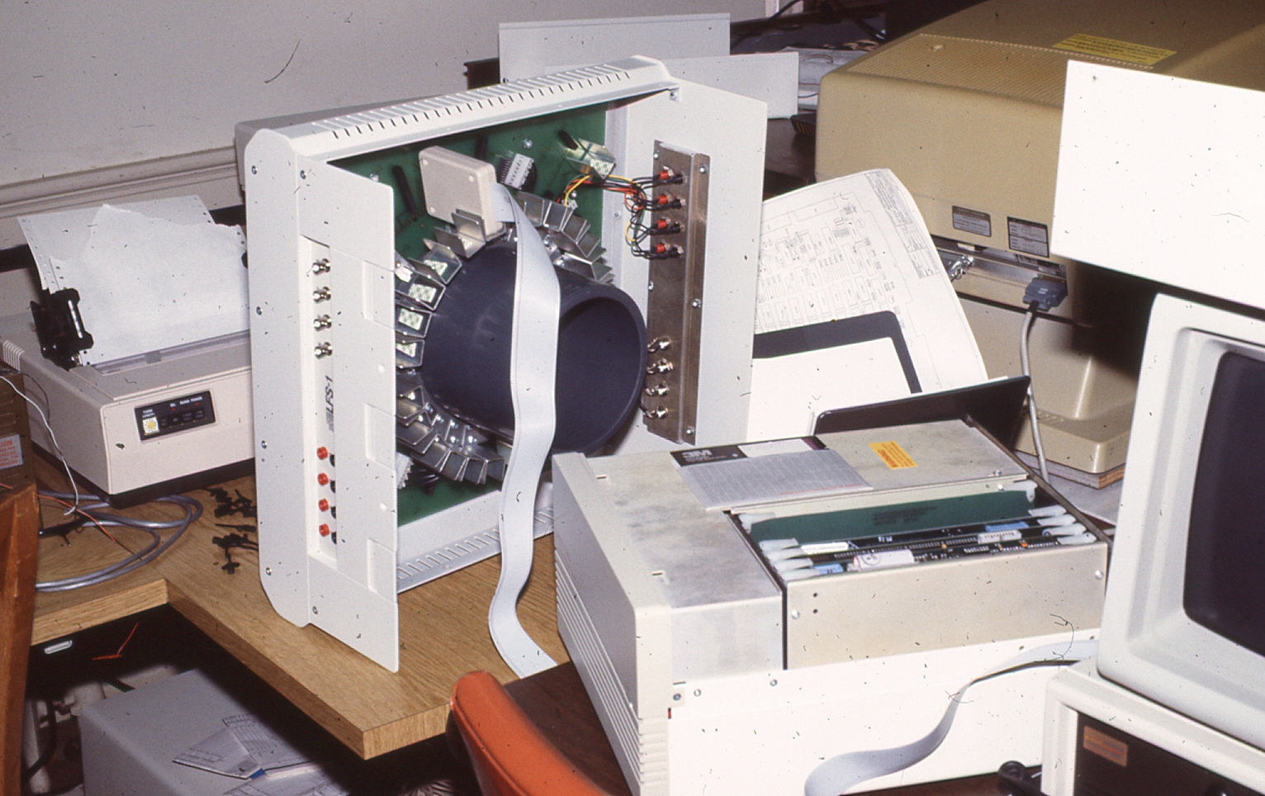
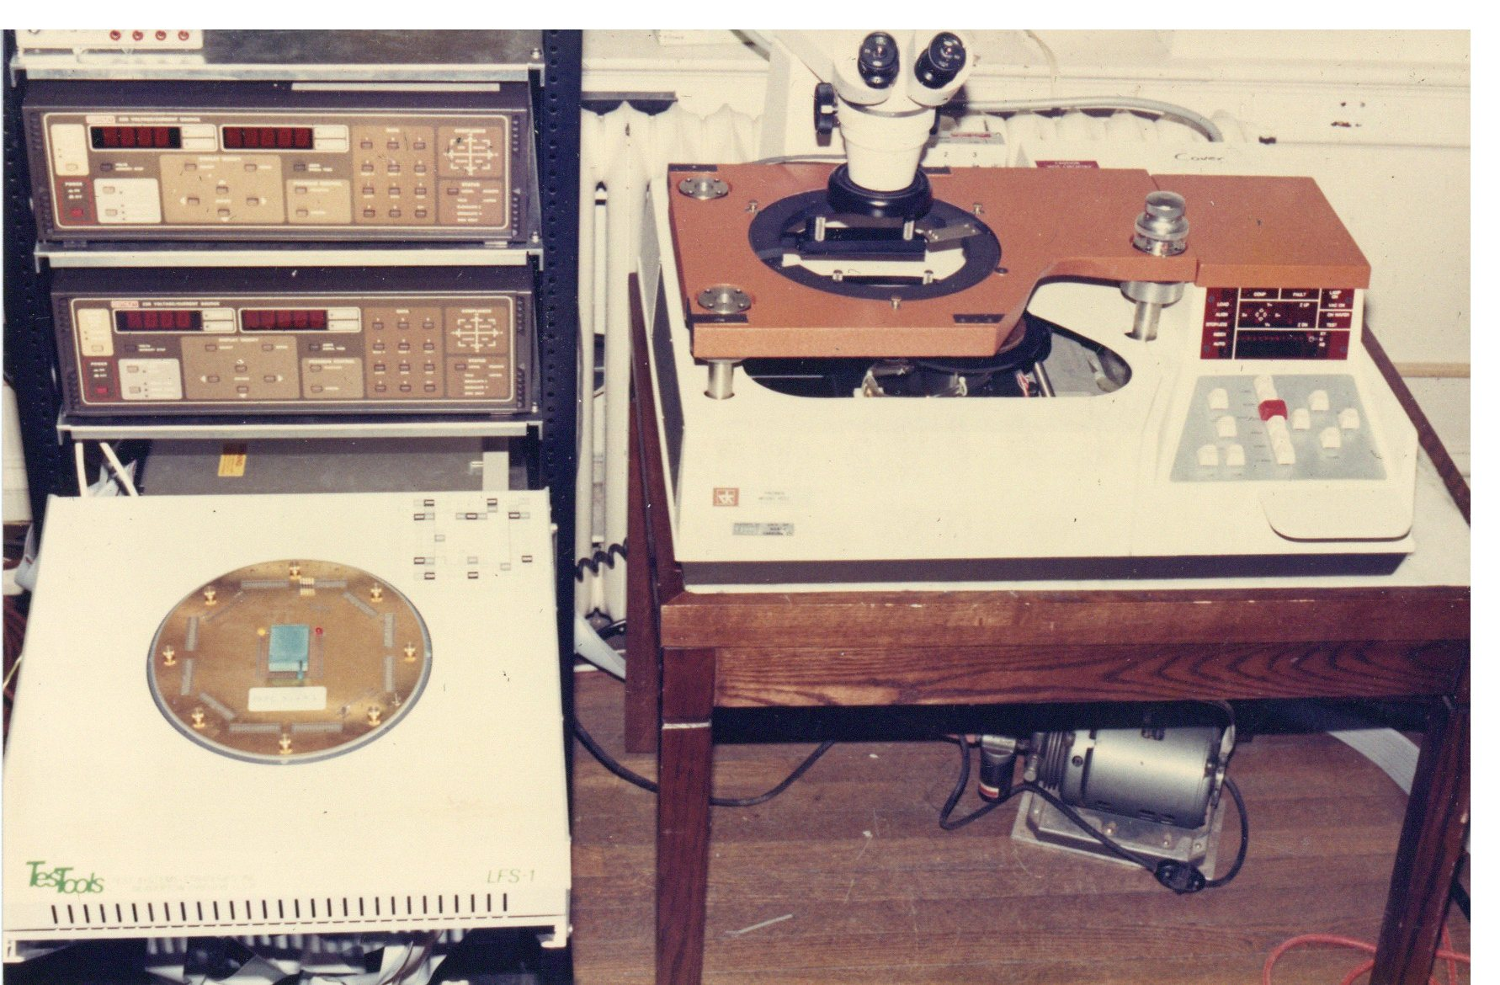
MSL Chip Tester
Wafer Prober
Test Socket Fixture
Tester Mainframe
Pkg Chip Test Socket
Building a tester from scratch and testing 1000’s of chip..
..major project in any other year, but just one of many in ‘85-’86
Had expert help: Wayne Dettloff from MCNC did most of the wafer testing
Got lucky on yield: > 50% chip, and 95%+ package, so plenty of pxpl4.1 chips!

Slide 16
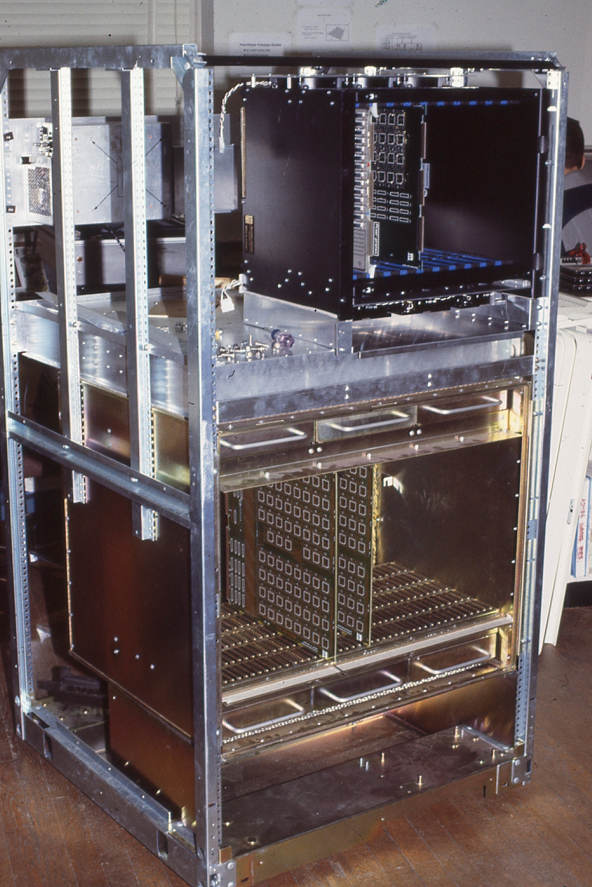
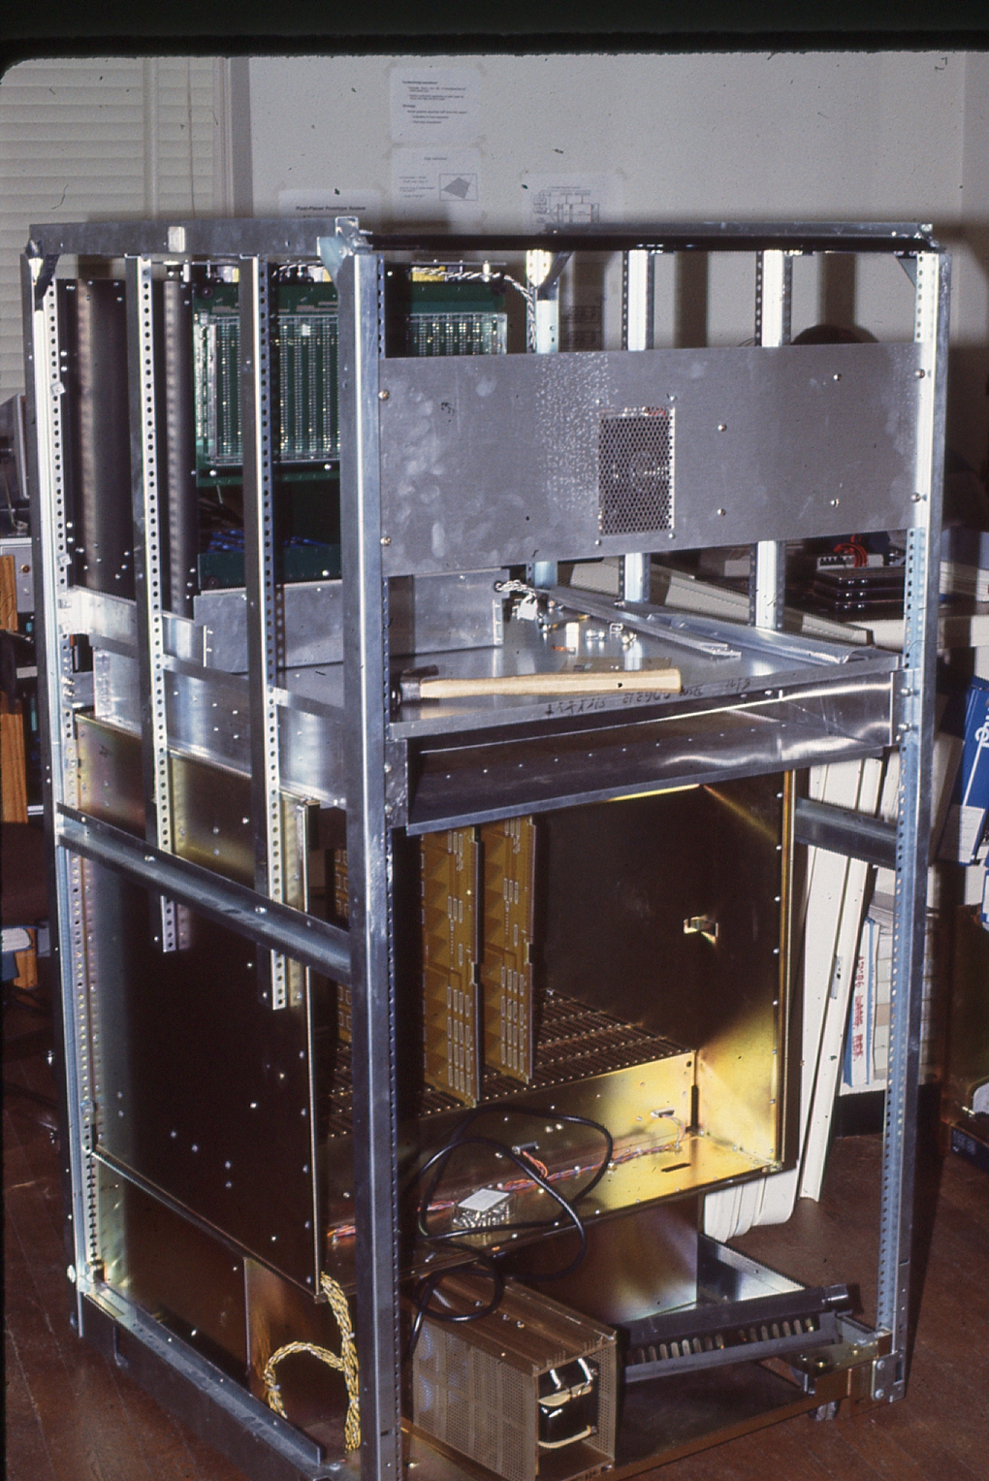
Pxpl System Enclosure
Upper Card Cage
System wouldn’t fit in 19” rack
30” enclosure needed
Got lucky again:
Data General donated a tall 30” enclosure with an ideal card cage, fans, power supplies
Great start..
.. John Thomas & I spent weeks doing sheet metal work in Physics Shop
Frame Buffer Card Cage
fans

Slide 17
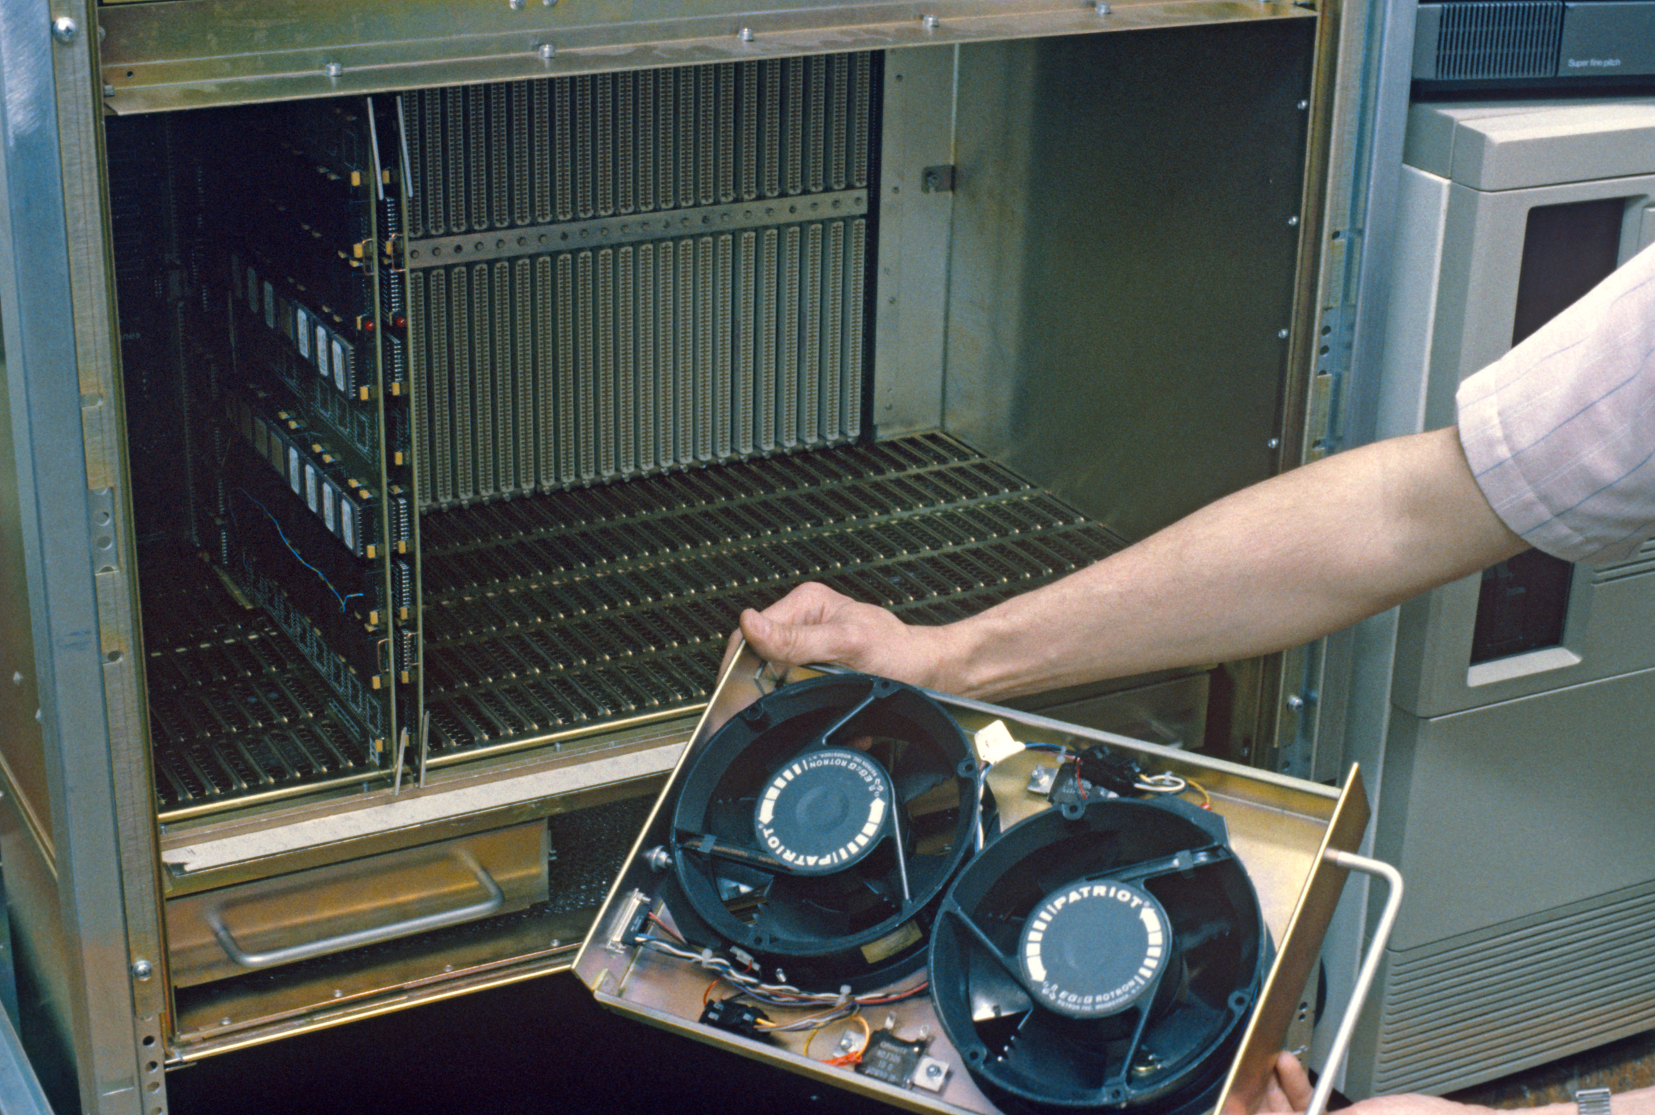
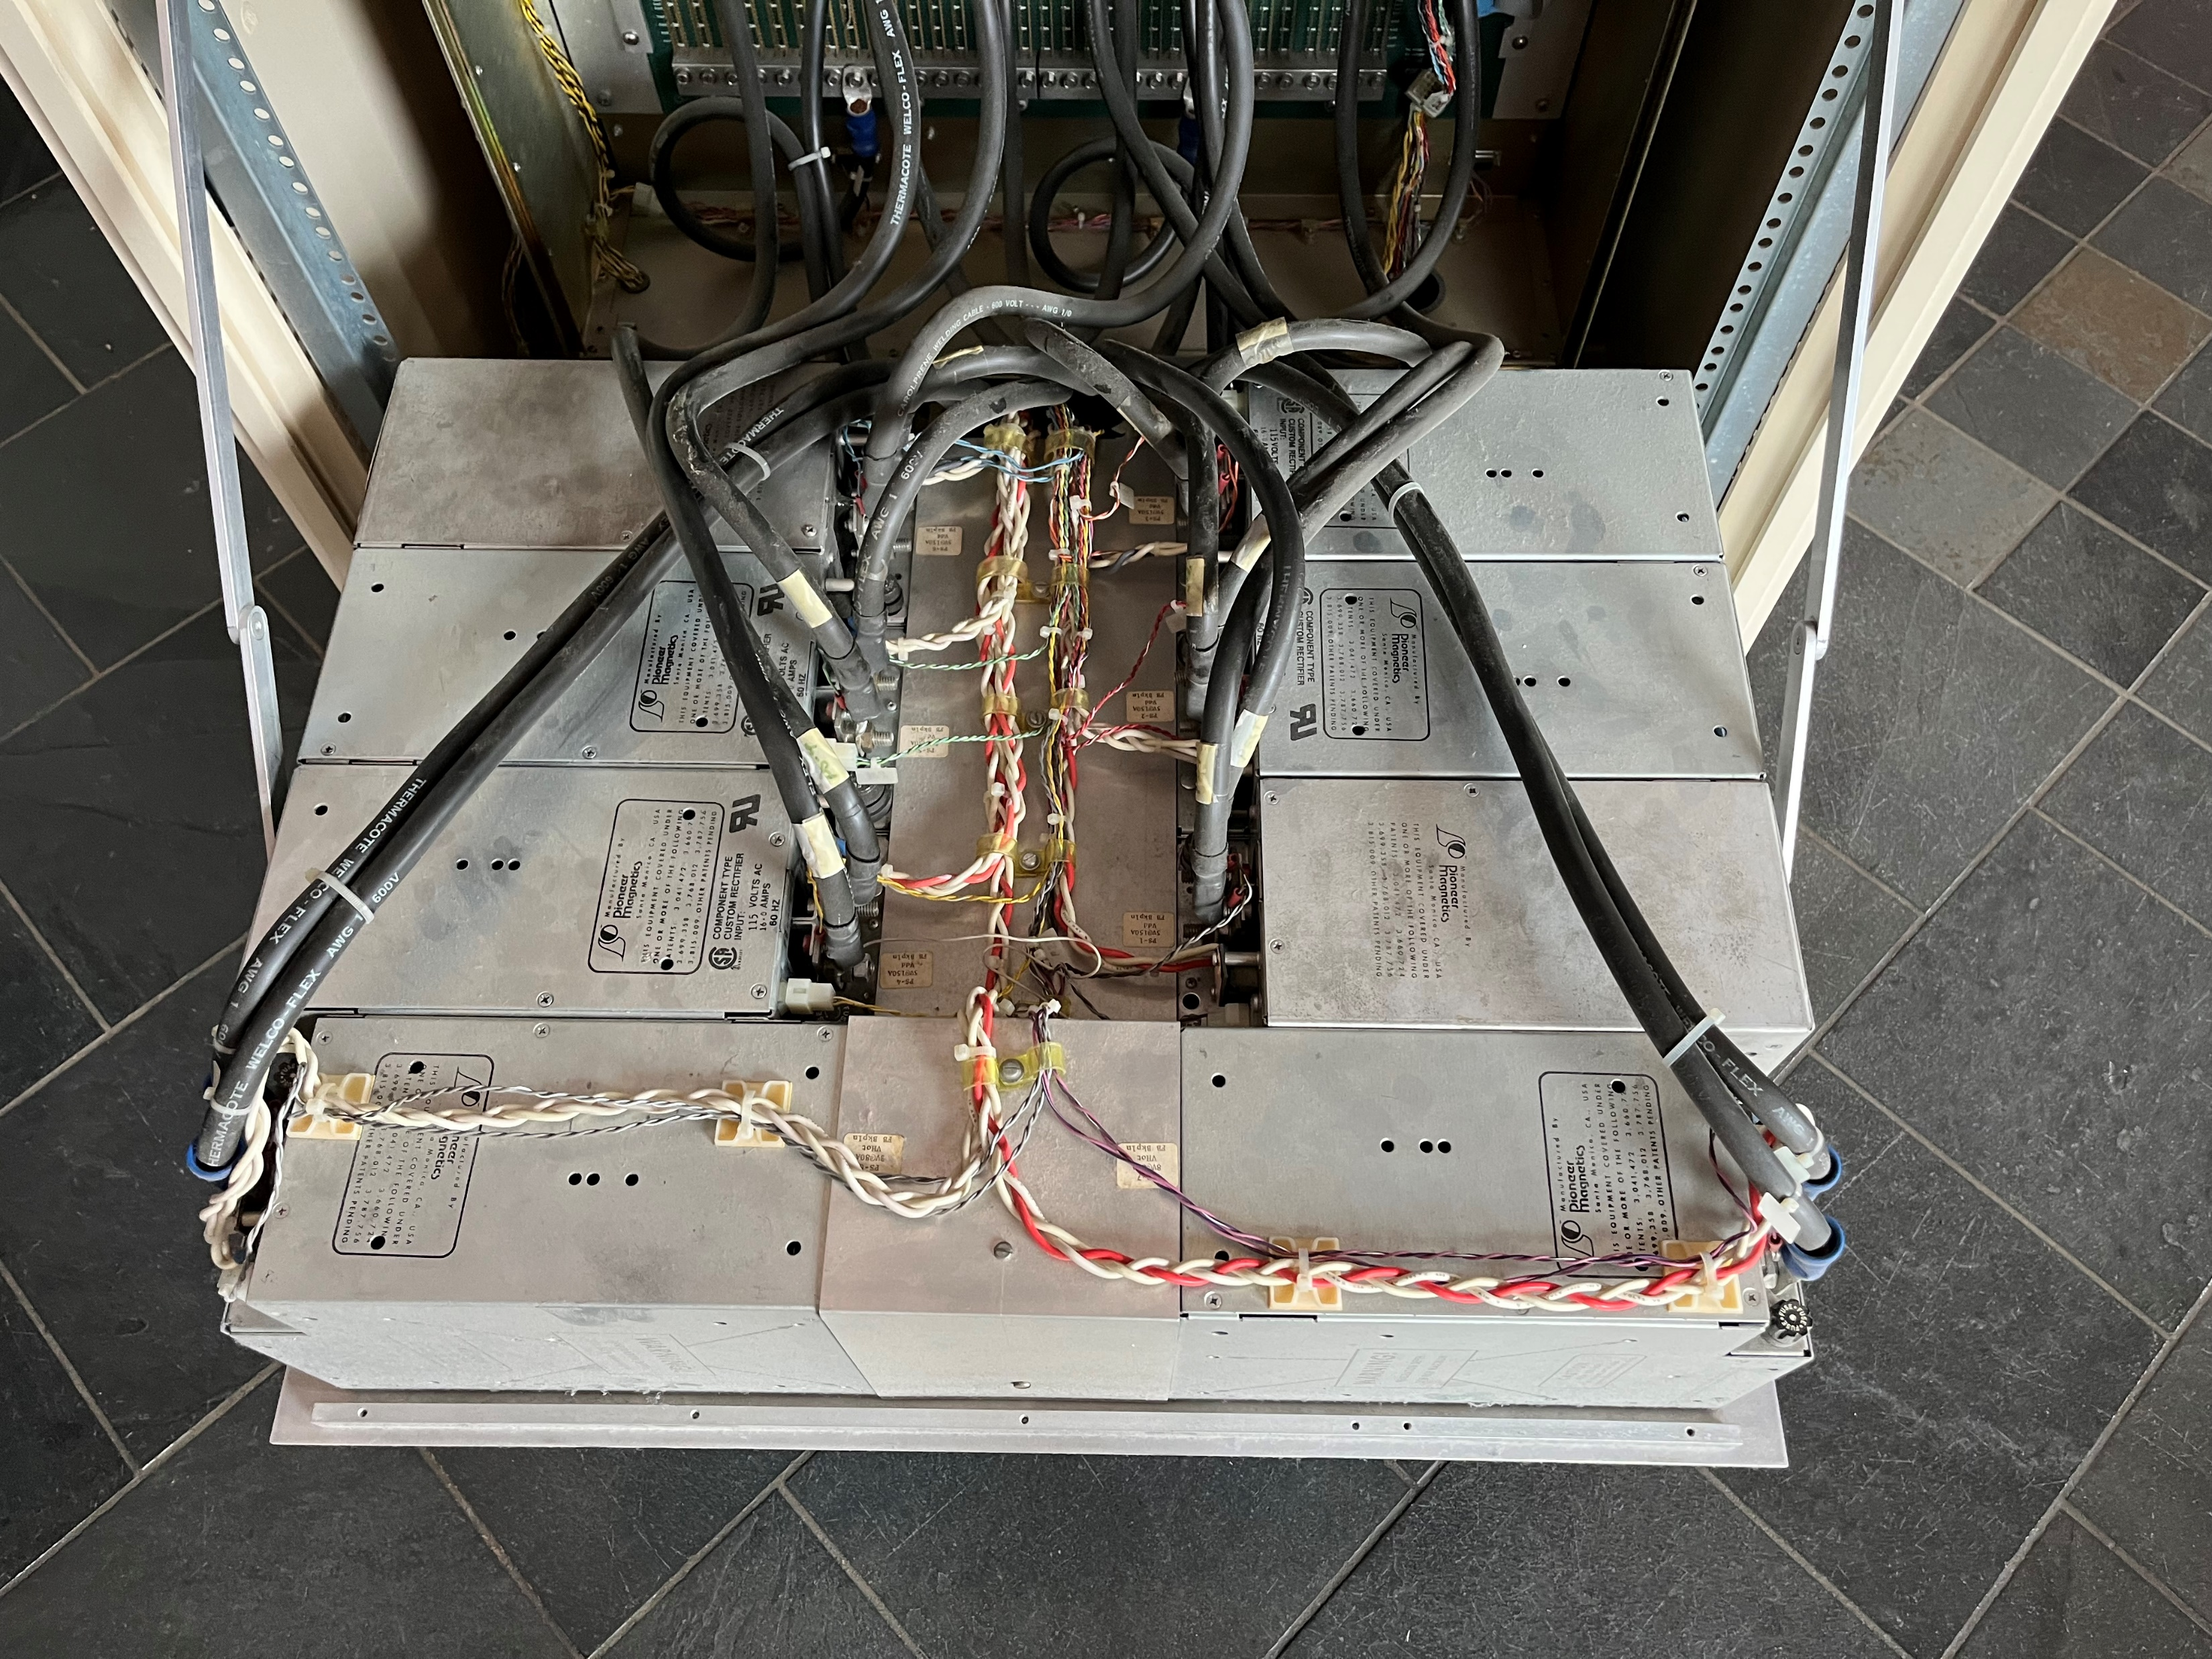
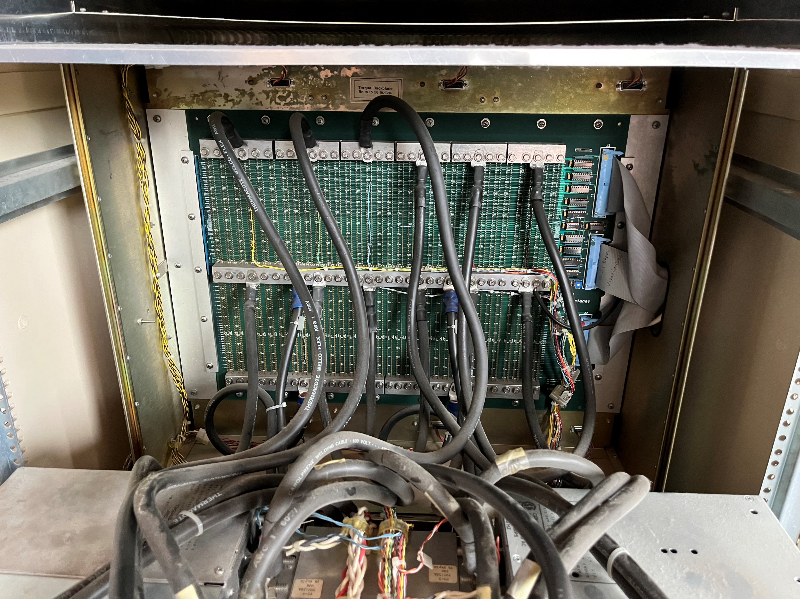
Pxpl System Power & Cooling
Fan Tray
8x 750W Power Supplies
Cabling & Backplane Busbars
Pxpl Smart Frame Buffer consumed ~ 6,000W of power
~8,000W for entire machine

Slide 18
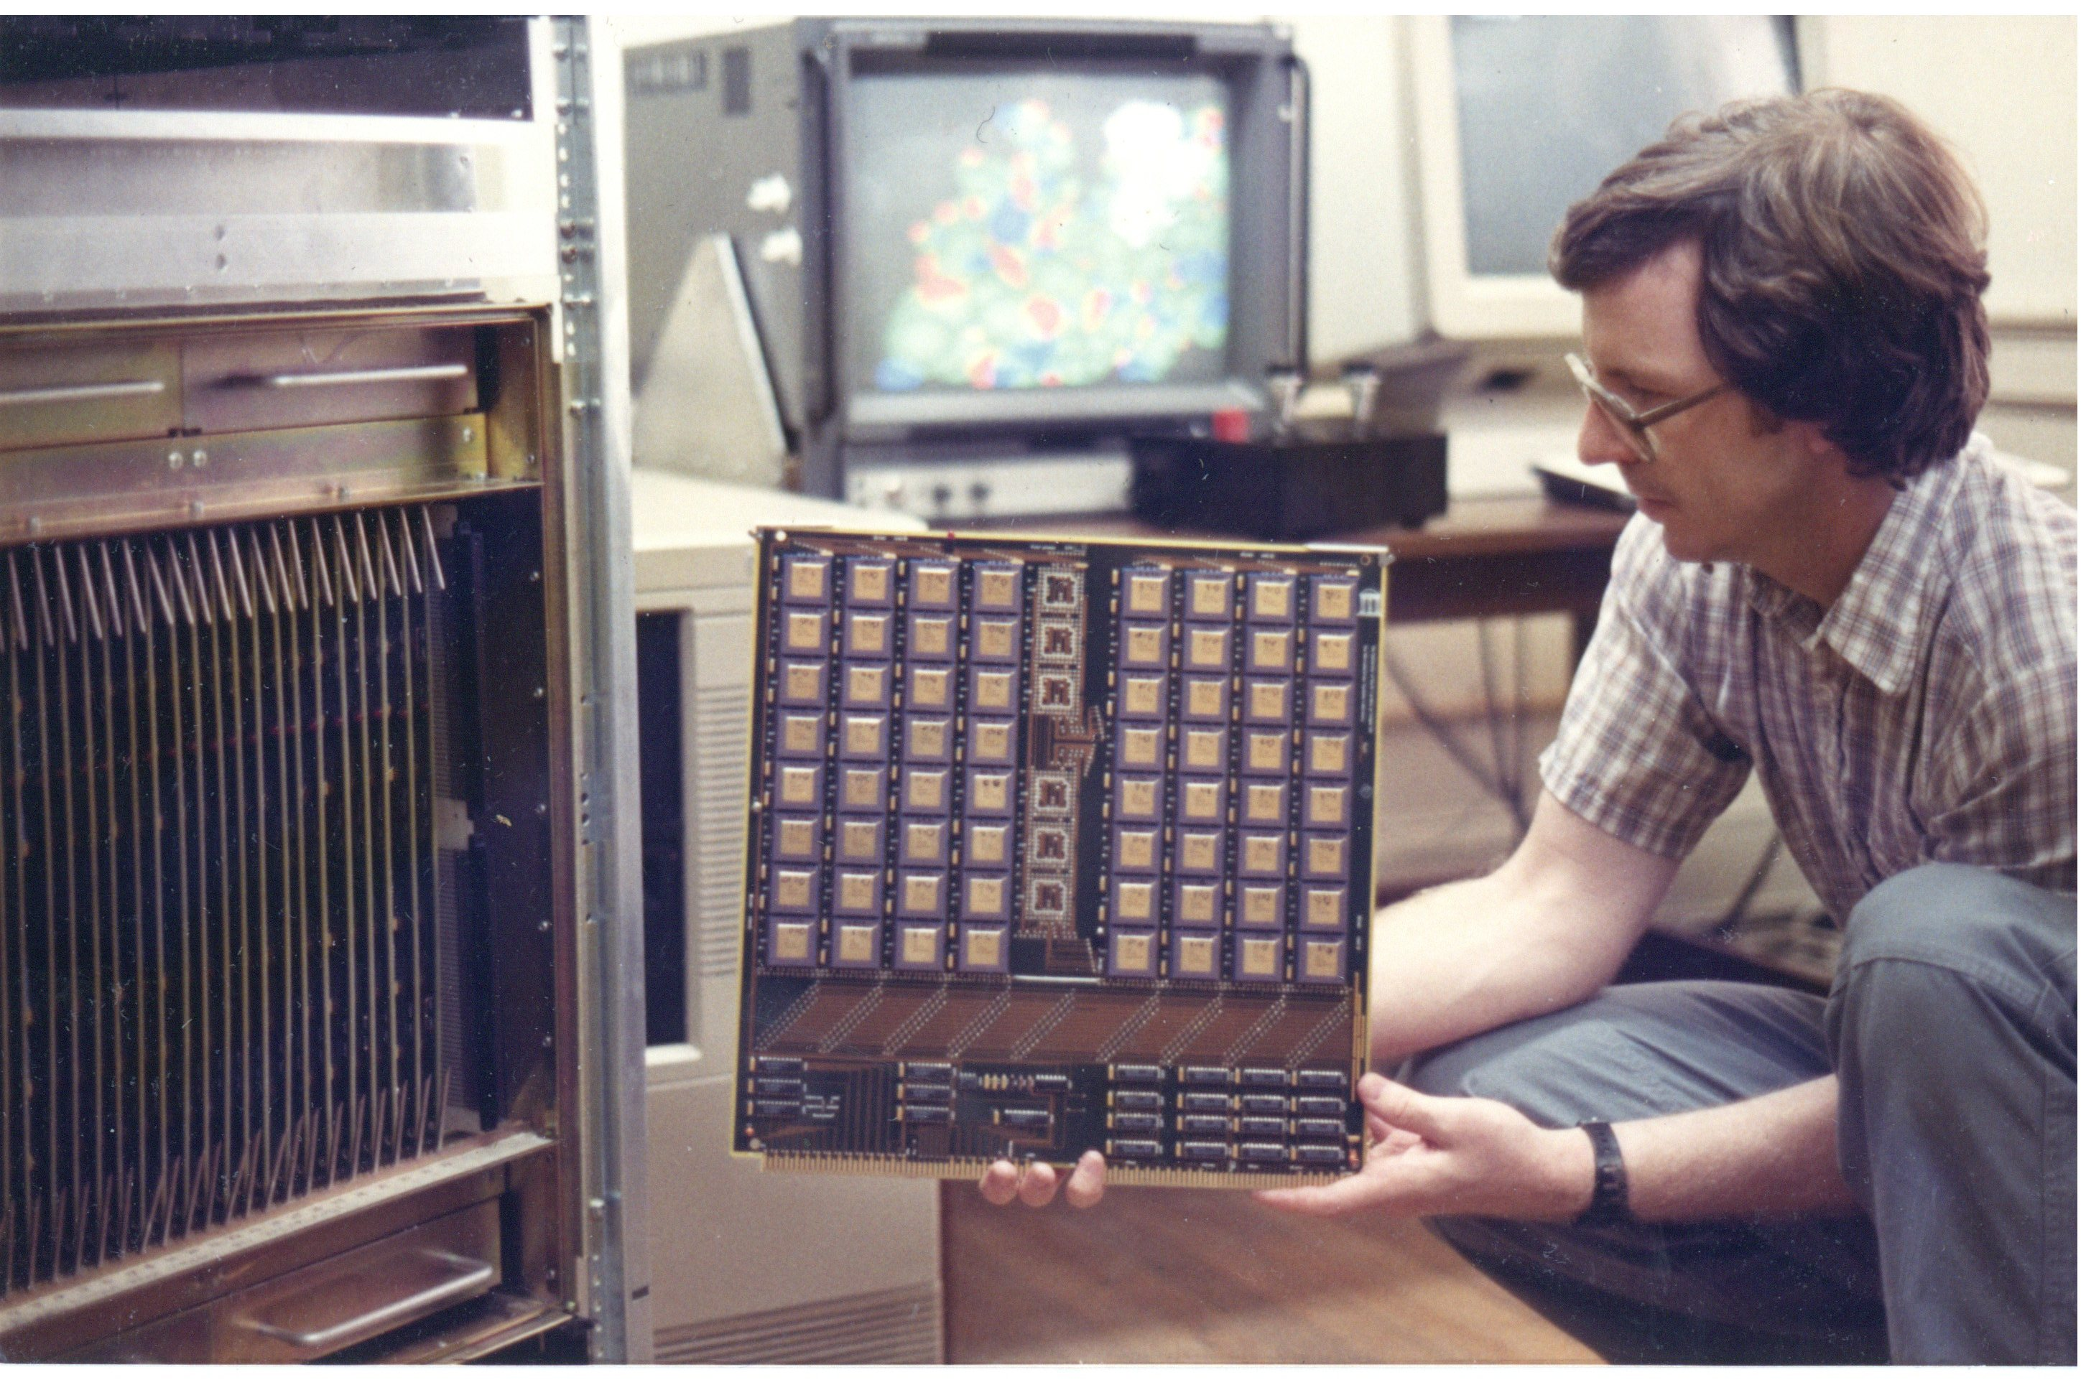
Pxpl PC Boards
PC Boards designed using CAESAR IC layout software, fabbed by MOSIS
No Schematic Capture in 1985..! Paper schematic -> Layout.
Frame buffer backplane is huge (30” x 24”) and thick (1/8”) to deal with mechanical stress and ~1000 amps of supply current
FB Boards 100% correct, first spin
Wave soldering adventure..

Slide 19
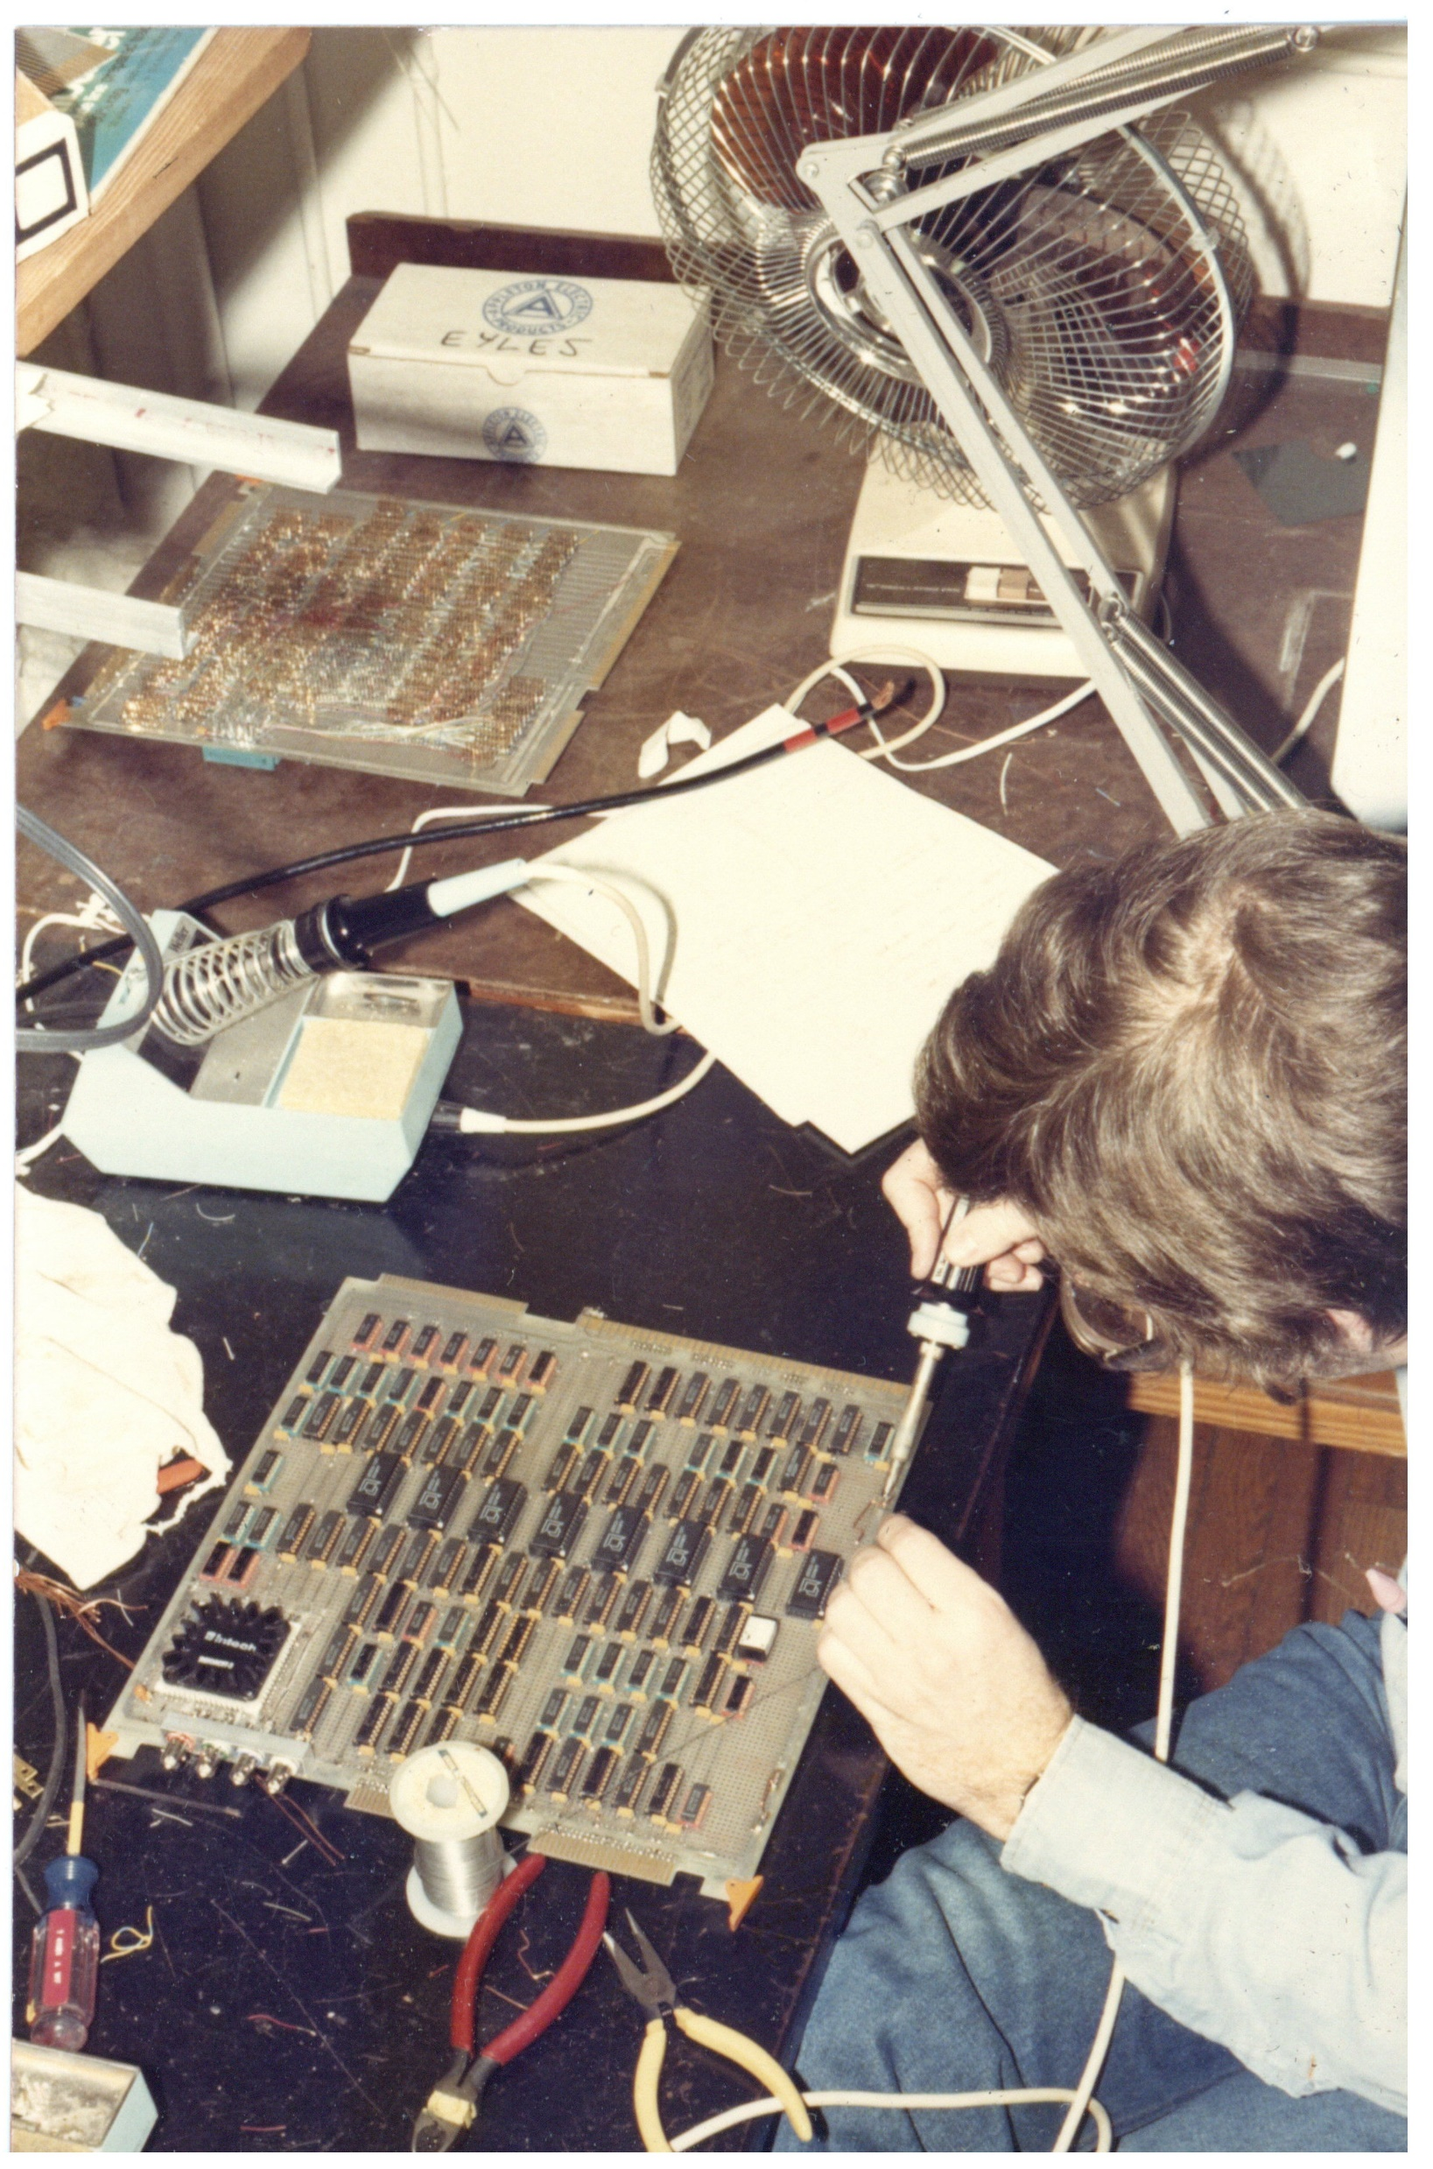
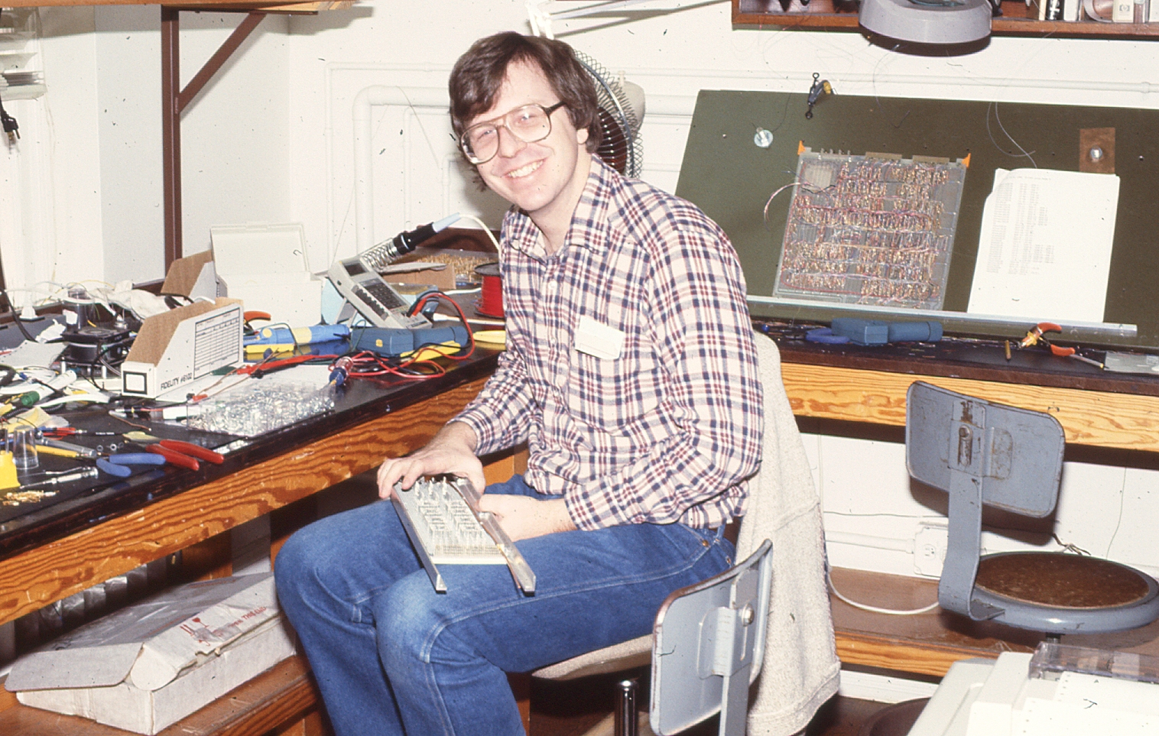
Pxpl IF and Video Boards
Other boards in system were wire-wrapped
Standard production method for 1-offs
J. Austin working on Pxpl4 Video Controller

Slide 20
Transformation Engine
By spring ‘86 chips, boards, and enclosures were coming together
We’d been in denial about the transformation engine.
Pxpl4 would require 15-20MFlops, at least.
Best available commercial product: Mercury Systems “Zip” boards
2 of them had been ordered, languishing in boxes since Fall ‘85
January ‘86: Trey Greer asked Henry for an RA.
Henry said “Sure!”
.. Good decision!

Slide 21
Mercury ZIP Boards
One board wasn’t fast enough. How to couple 2 together..?
External bus connector, but no documentation.
Mercury: “It’ll take you to the year 2000 to figure that out!”
Trey figured it out in 2 weeks, sent Mercury the documentation.
Next: Trey and John Eyles designed and built inter-ZIP board to pipeline the two processors
Eyles designed and fabricated the 3μ NMOS “Serializer Chip” to make the wire-wrapped Image Generation Controller simpler.

Slide 22
Software
Apart from host functions (joystick, database download, etc),
ALL Pxpl4 software ran on the ZIP’s.
They were really, really hard to program!
Task divided into two parts:
ZIP #1: display list traversal, lighting, transformation to eye coordinates
ZIP #2: screen-space transformation, calculation of linear-expression A,B,C’s
Trey (ZIP-Master One) programmed ZIP #1
John (ZIP-Master Two) did the rest
Everything you saw on Pxpl4 in mid-1986 programmed by 2 people

Slide 23
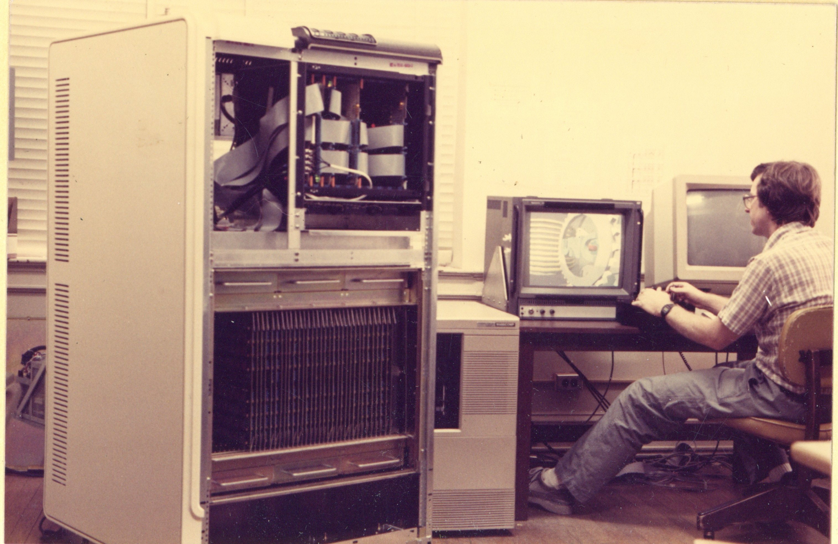
Pixel-Planes 4 Alive!
Chips, boards, mechanicals, software all came together!
Full 512x512 Pixel-Planes 4 running late spring ‘86
..with demos painfully programmed by John and Trey
Demo reels on YouTube

Slide 24
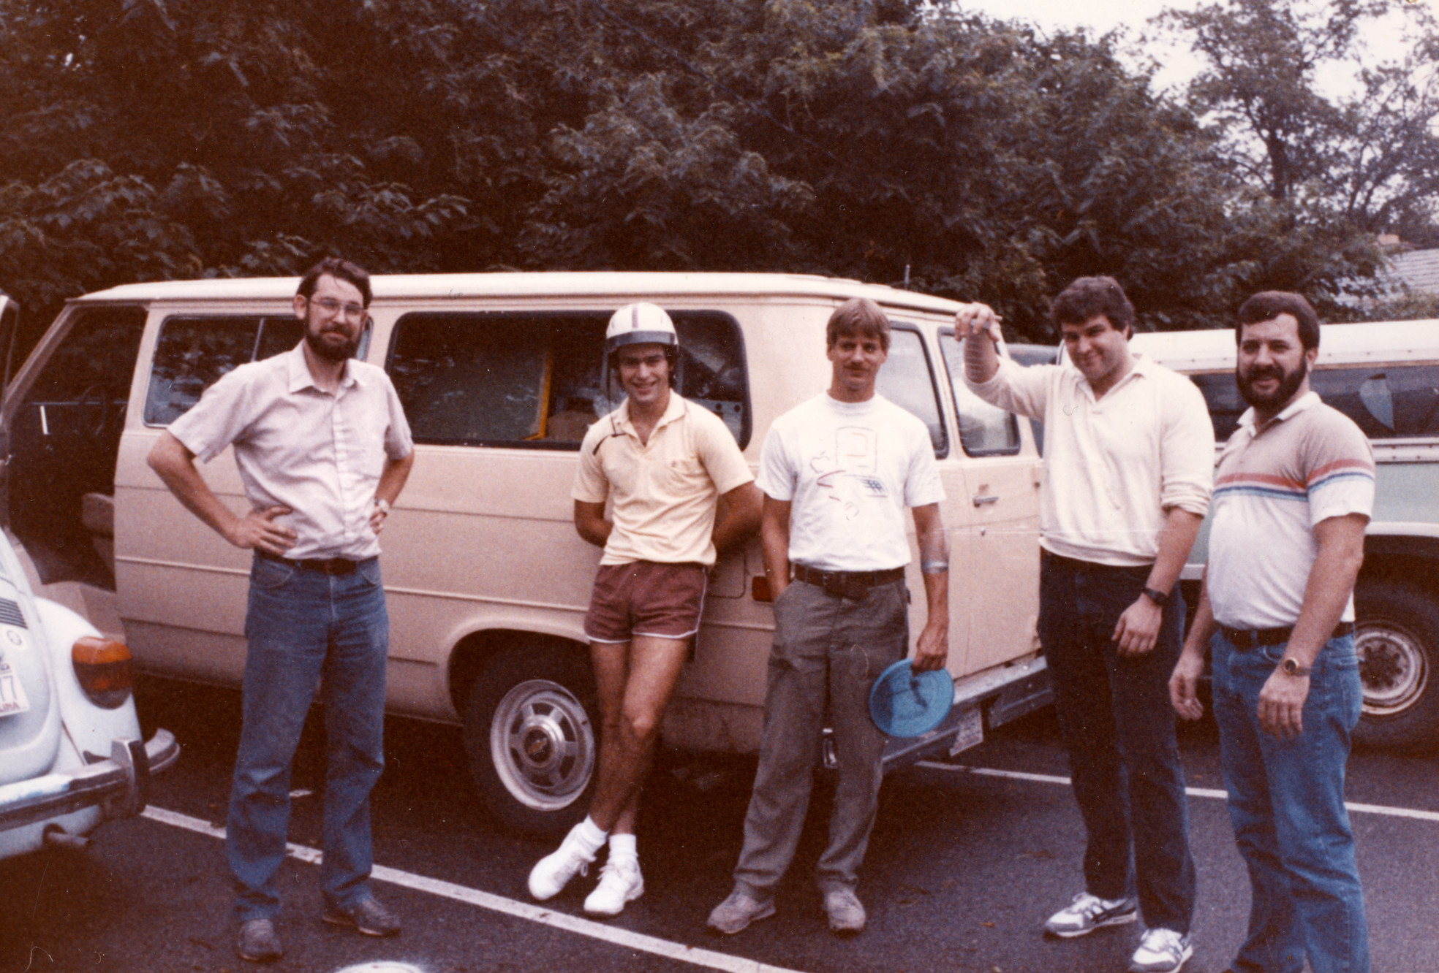
Pixel-Planes 4 Hits the Road
Henry got approval from SIGGRAPH for a “room” to show machine
Spent the last grant money on plane tix and a rental van
The machine fit (just!) in the van, and we were off to Dallas..
But.. Not without some drama!
John Austin’s holding the camera!

Slide 25
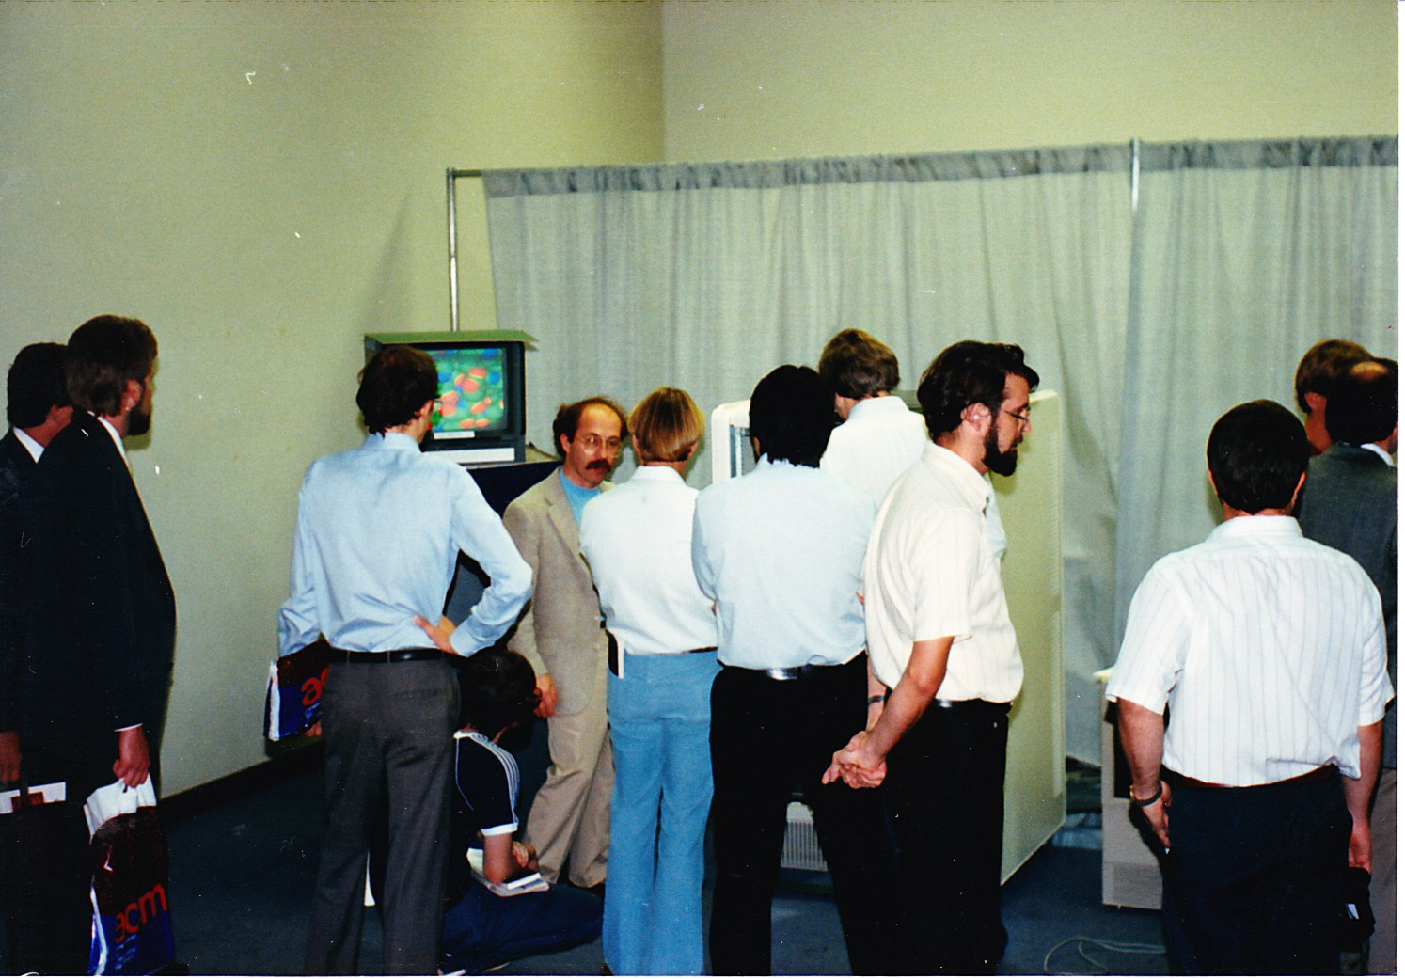
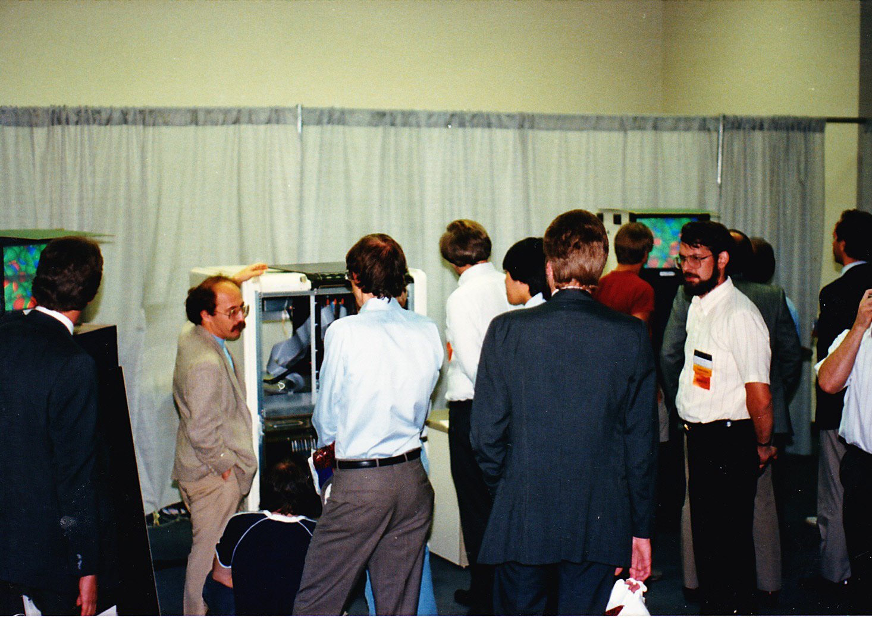
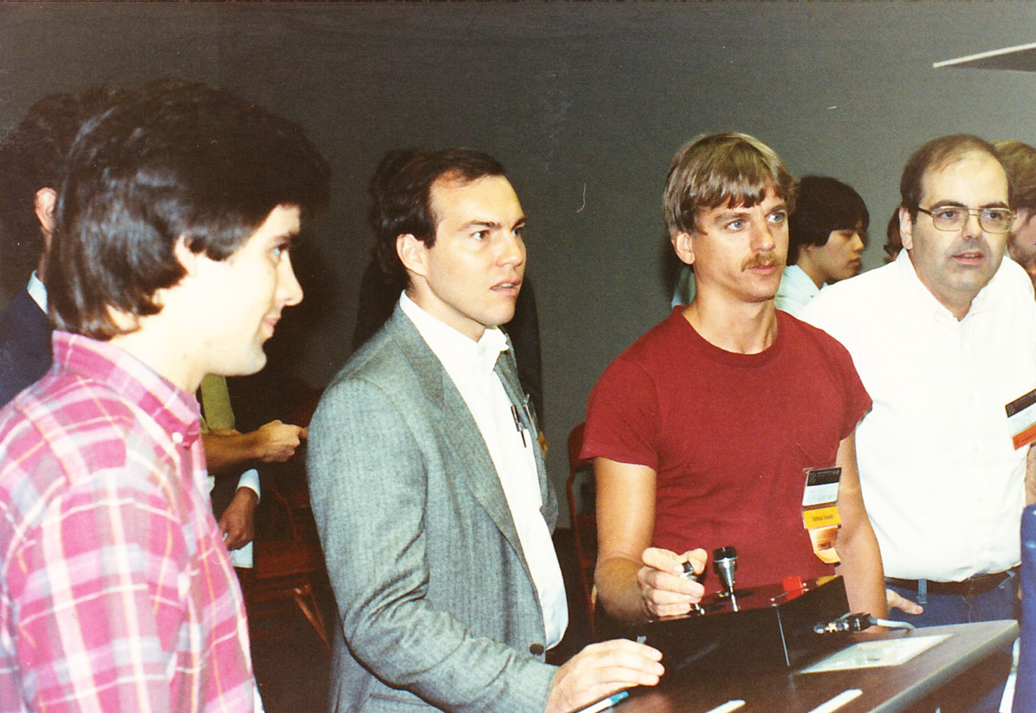
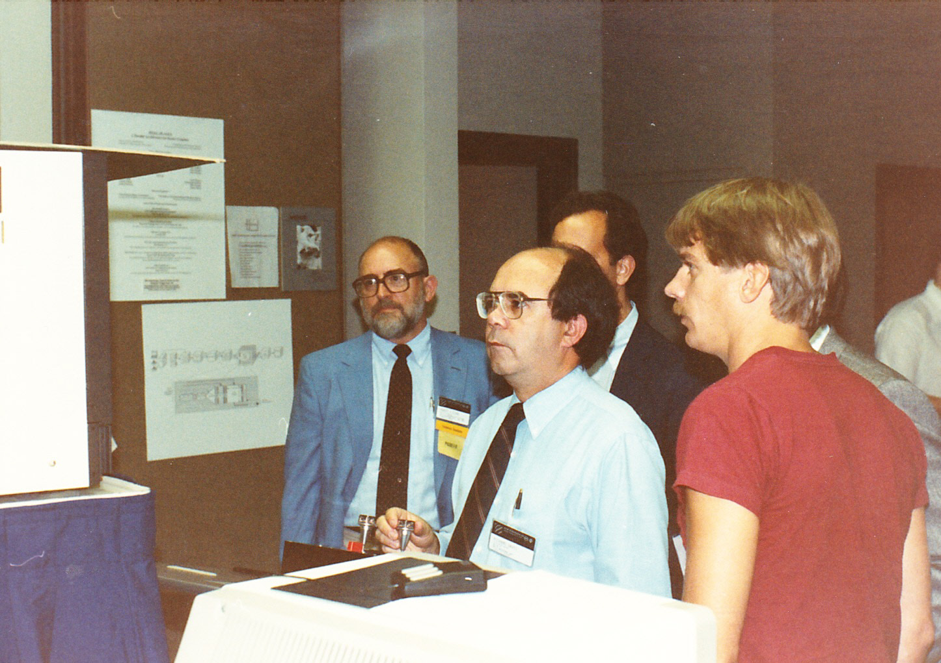
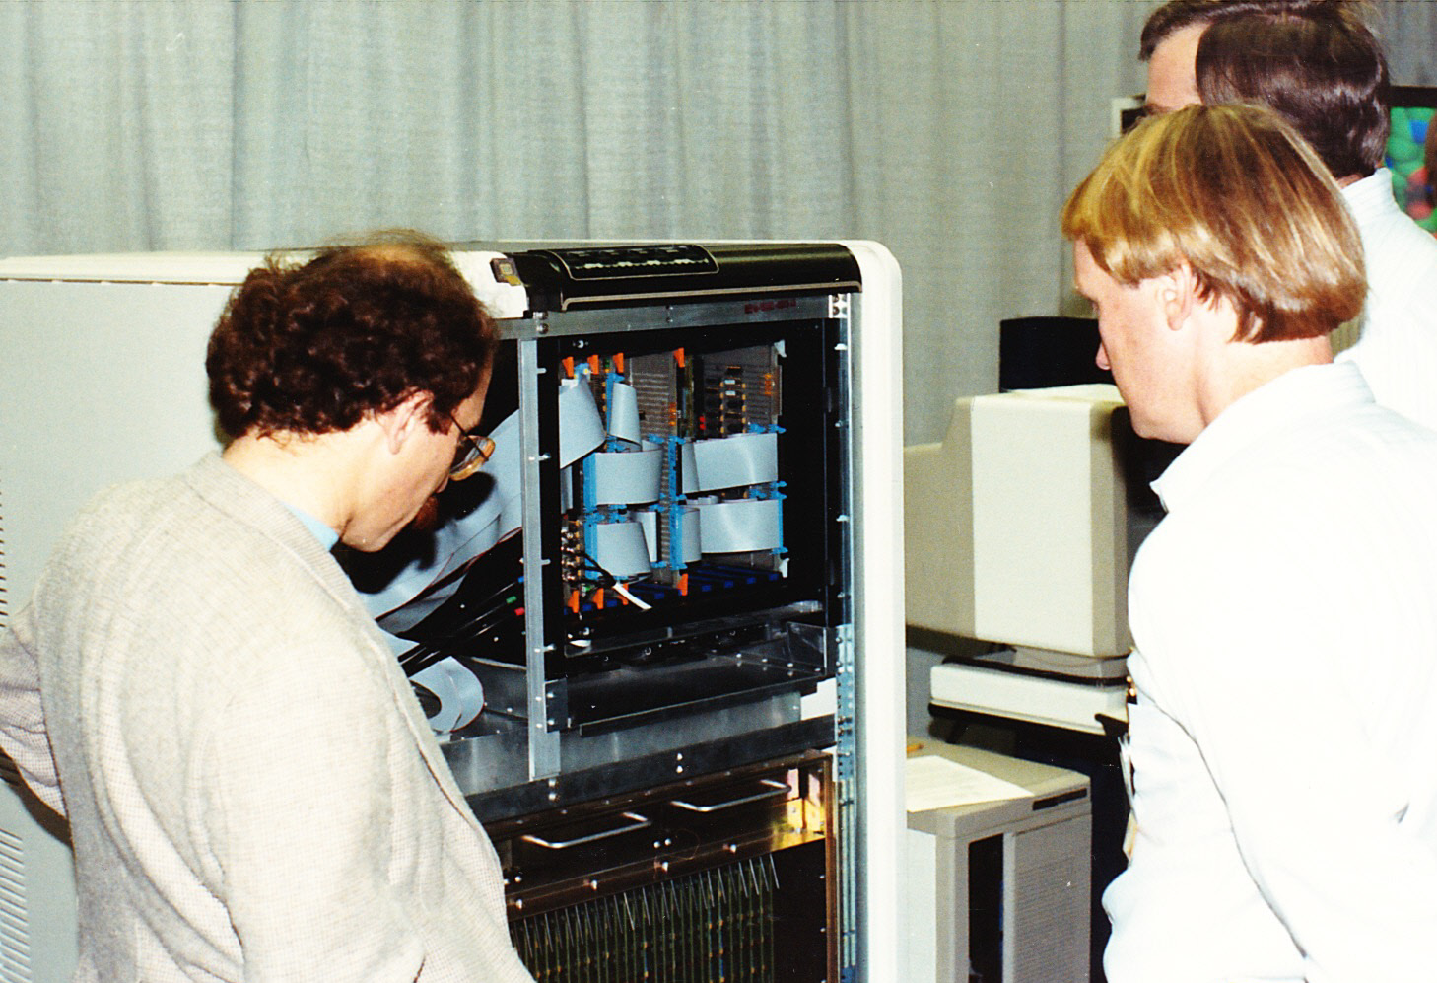
Pixel-Plane 4 at SIGGRAPH 86

Slide 26
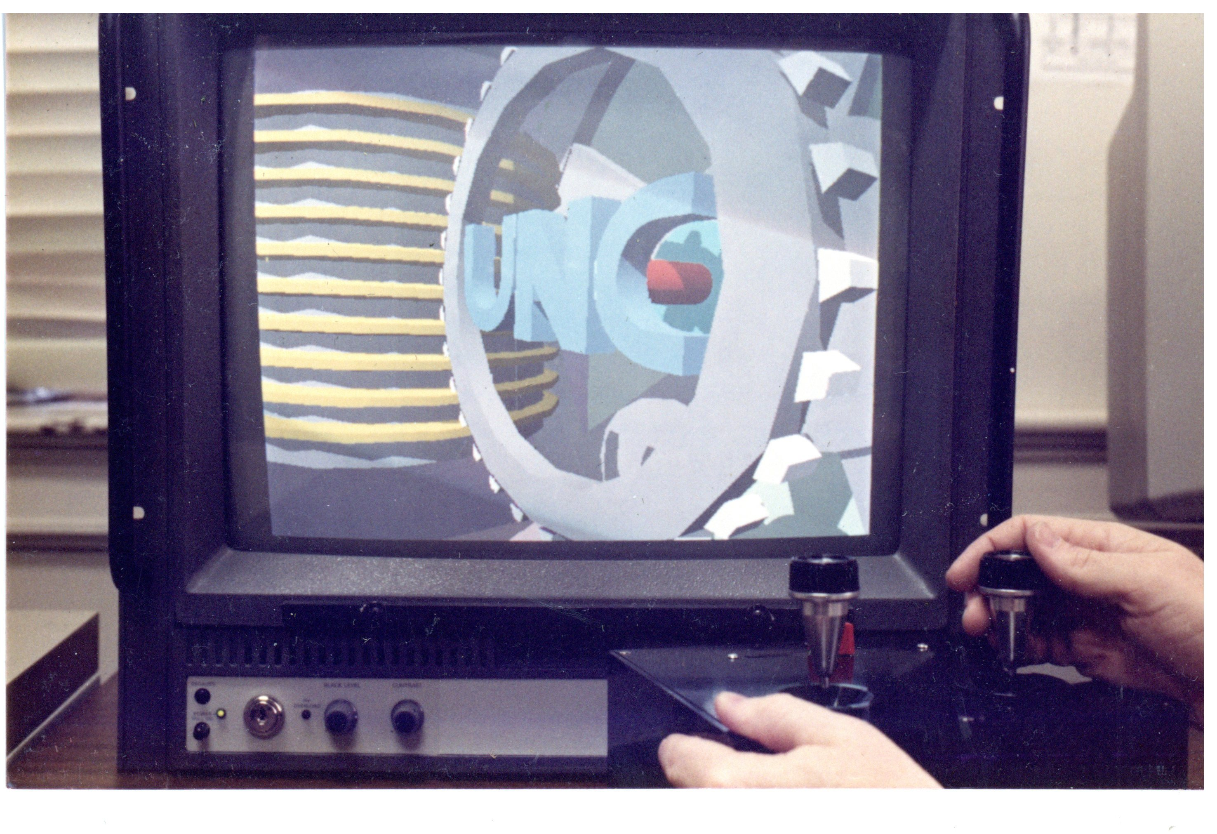
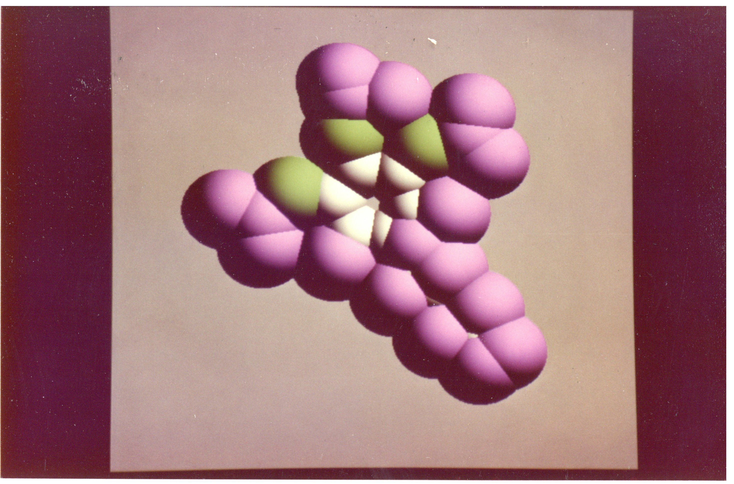
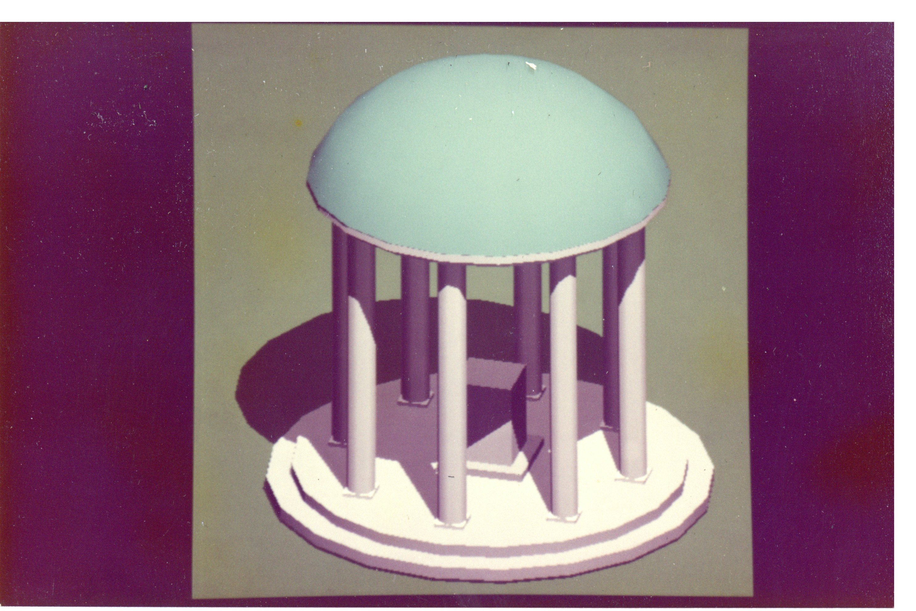
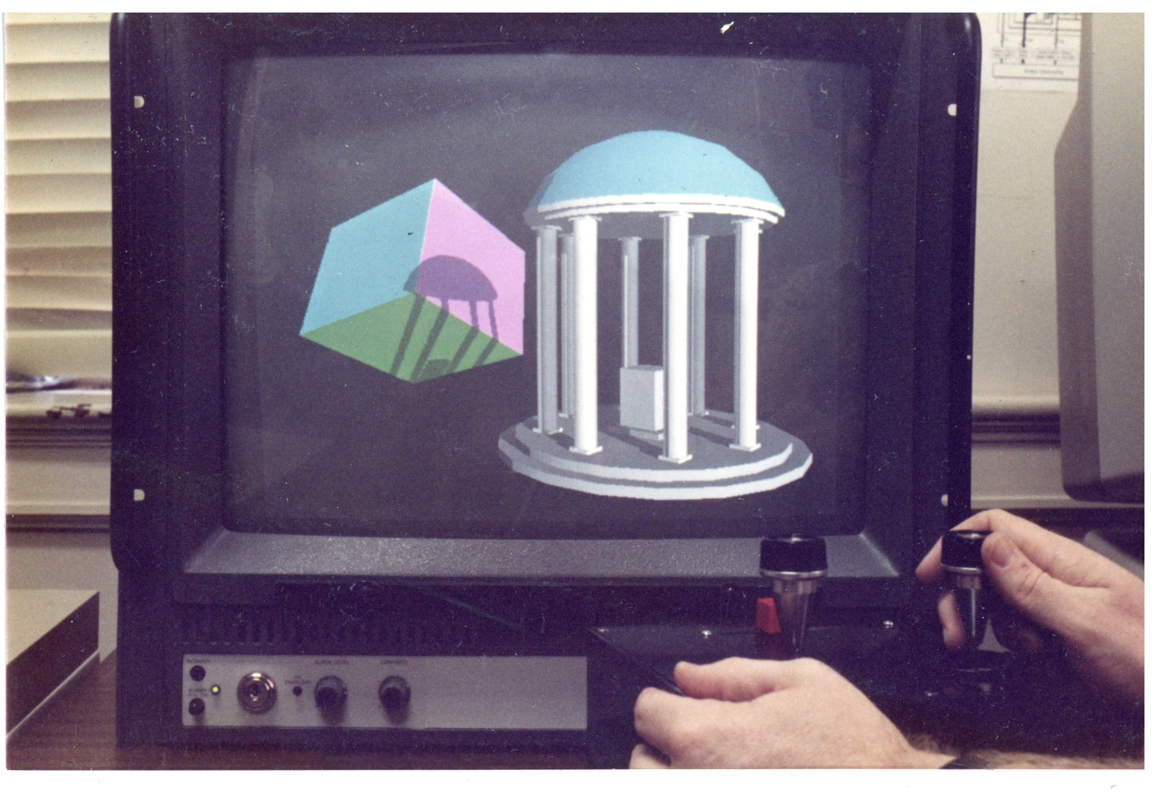
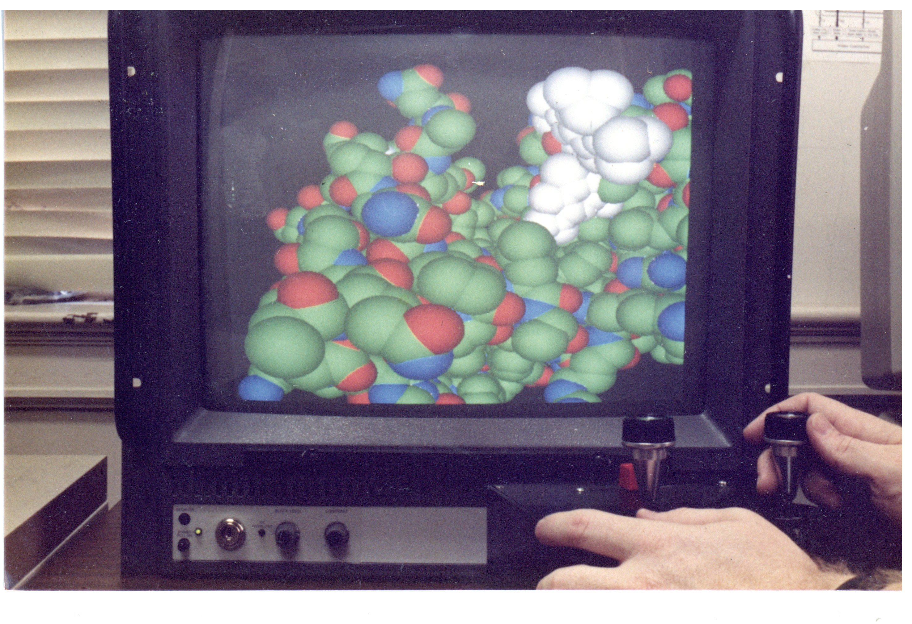
SIGGRAPH ‘86 – What They Saw

Slide 27
Aftermath
In early ‘87, Trey returned from cabinet-making and..
Built a new C-programmable transformation engine..
..based on Weitek 16MFlop FP Chip Set
Anyone could now program machine; it became research workhorse
Pxpl4 was powered on and running for ~ 5 years
..until supplanted by Pxpl5
I visited Henry’s office in 1987. Suggested “Incomplete” could become an “H”. So it was.

Slide 28
So.. How did this happen?
How did a bunch of folks at a southern university with no engineering school end up building some of the more impressive experimental systems of the M&C revolution?

Slide 29
We Had a Lot of Help!
Henry – A couple of stunning ideas; also possibly the most persuasive person in the world
Lynn Conway – her deceptively simple ideas were remarkably powerful
State of NC – miraculously, spent serious money on μelectronics
Fred Brooks – Spent his μE money on MSL and saw the value of ‘performance art’
MCNC and local VLSI design community – exciting place to be in the 80’s
Lynn Conway again: help with Pxpl2, Al Paeth
MOSIS and inexpensive fab – made VLSI accessible to universities
Bernie Chern (NFS) & John Toole (DARPA) -- Our PM’s were incredibly supportive!
Vern Chi – MSL director, an engineer’s engineer
But mostly: smart people are everywhere (not just MIT, Stanford, Berkeley). They just need some encouragement.. ☺

