Slide 1
The Technical Materiel Corporation
A Brief History
&
Introduction to TMC Collecting

Slide 2
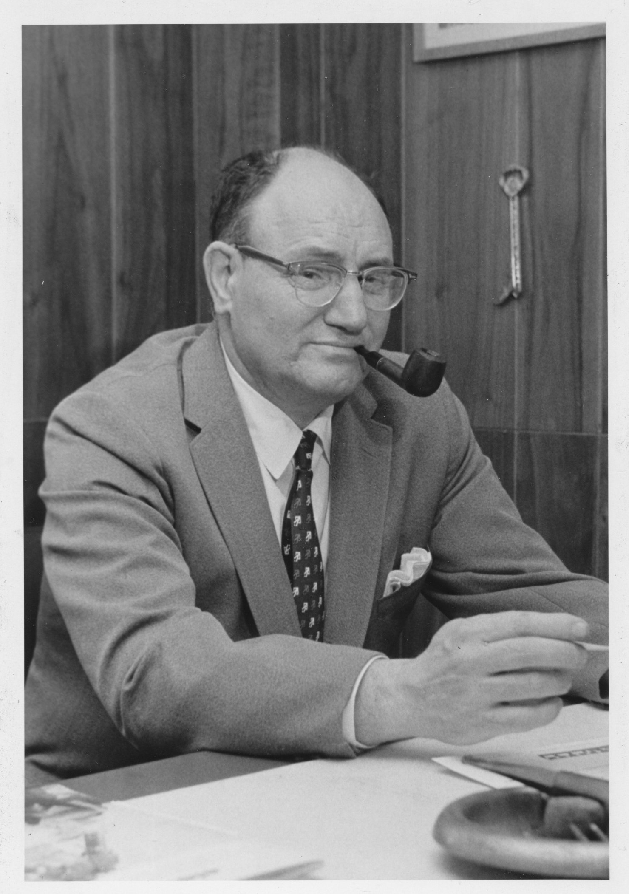
Founder: Ray H. dePasquale
Born Manhattan 1905
Export manager, Silver Marshall Co. (1930-34)
Founder, Technical Products International (1934-42)
VP and Dir Manufacturing, Press Wireless (1942-47)
Founder, Prez, TMC 1947-1994
Lifelong ham W2DCO (QCWA #1200, DXCC)

Slide 3
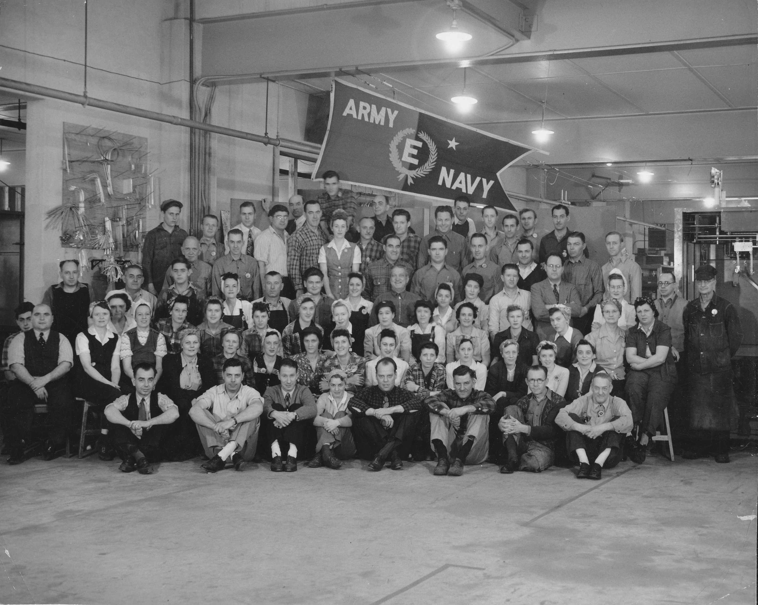
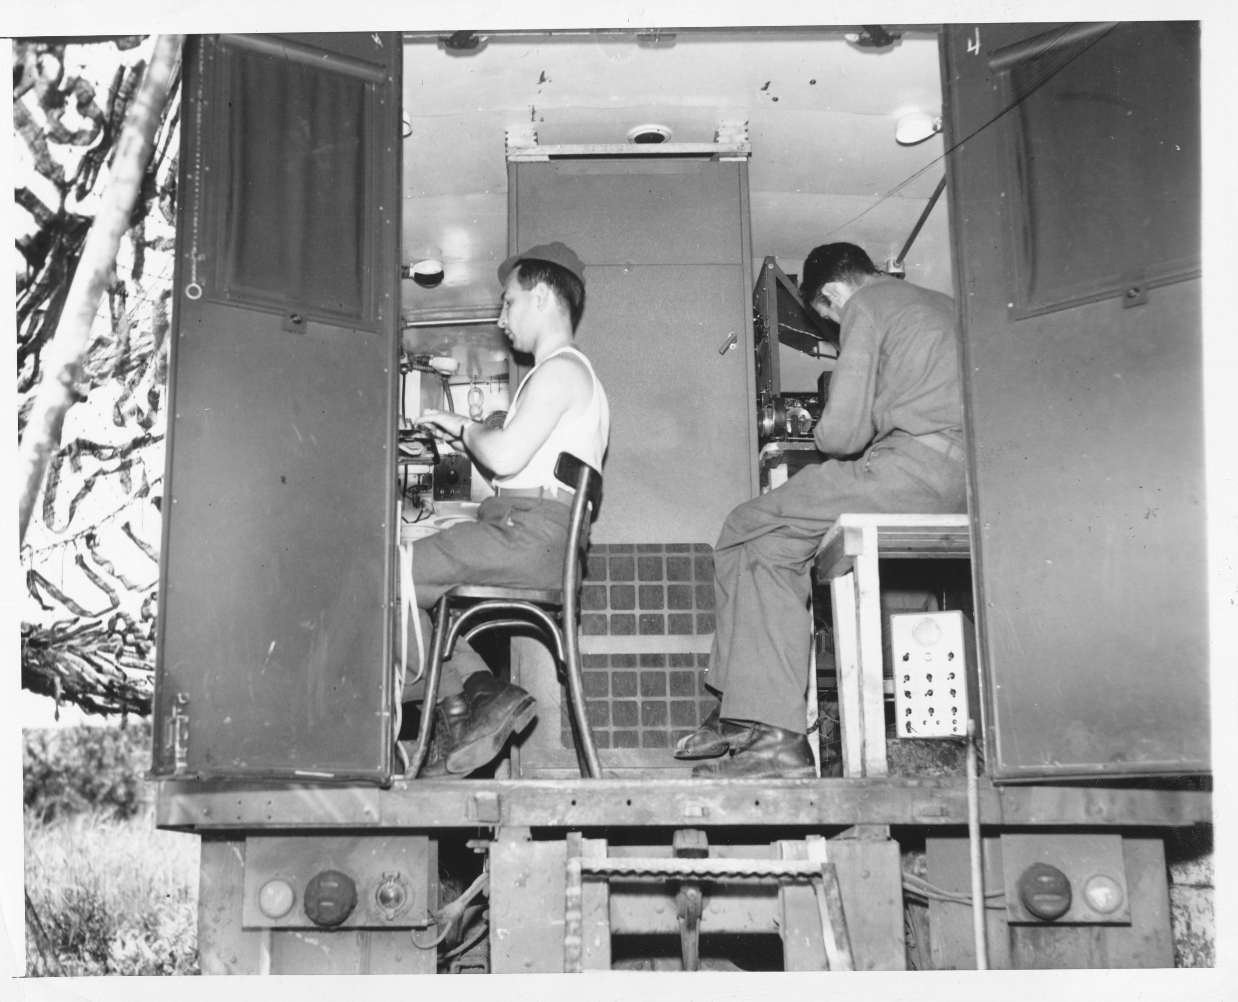
Press Wireless
Founded 1929 by newspaper consortium
News traffic in both Europe and Pacific theatres during WW2
Major supplier of military radio equipment
3-time winner of E-award during war

Slide 4
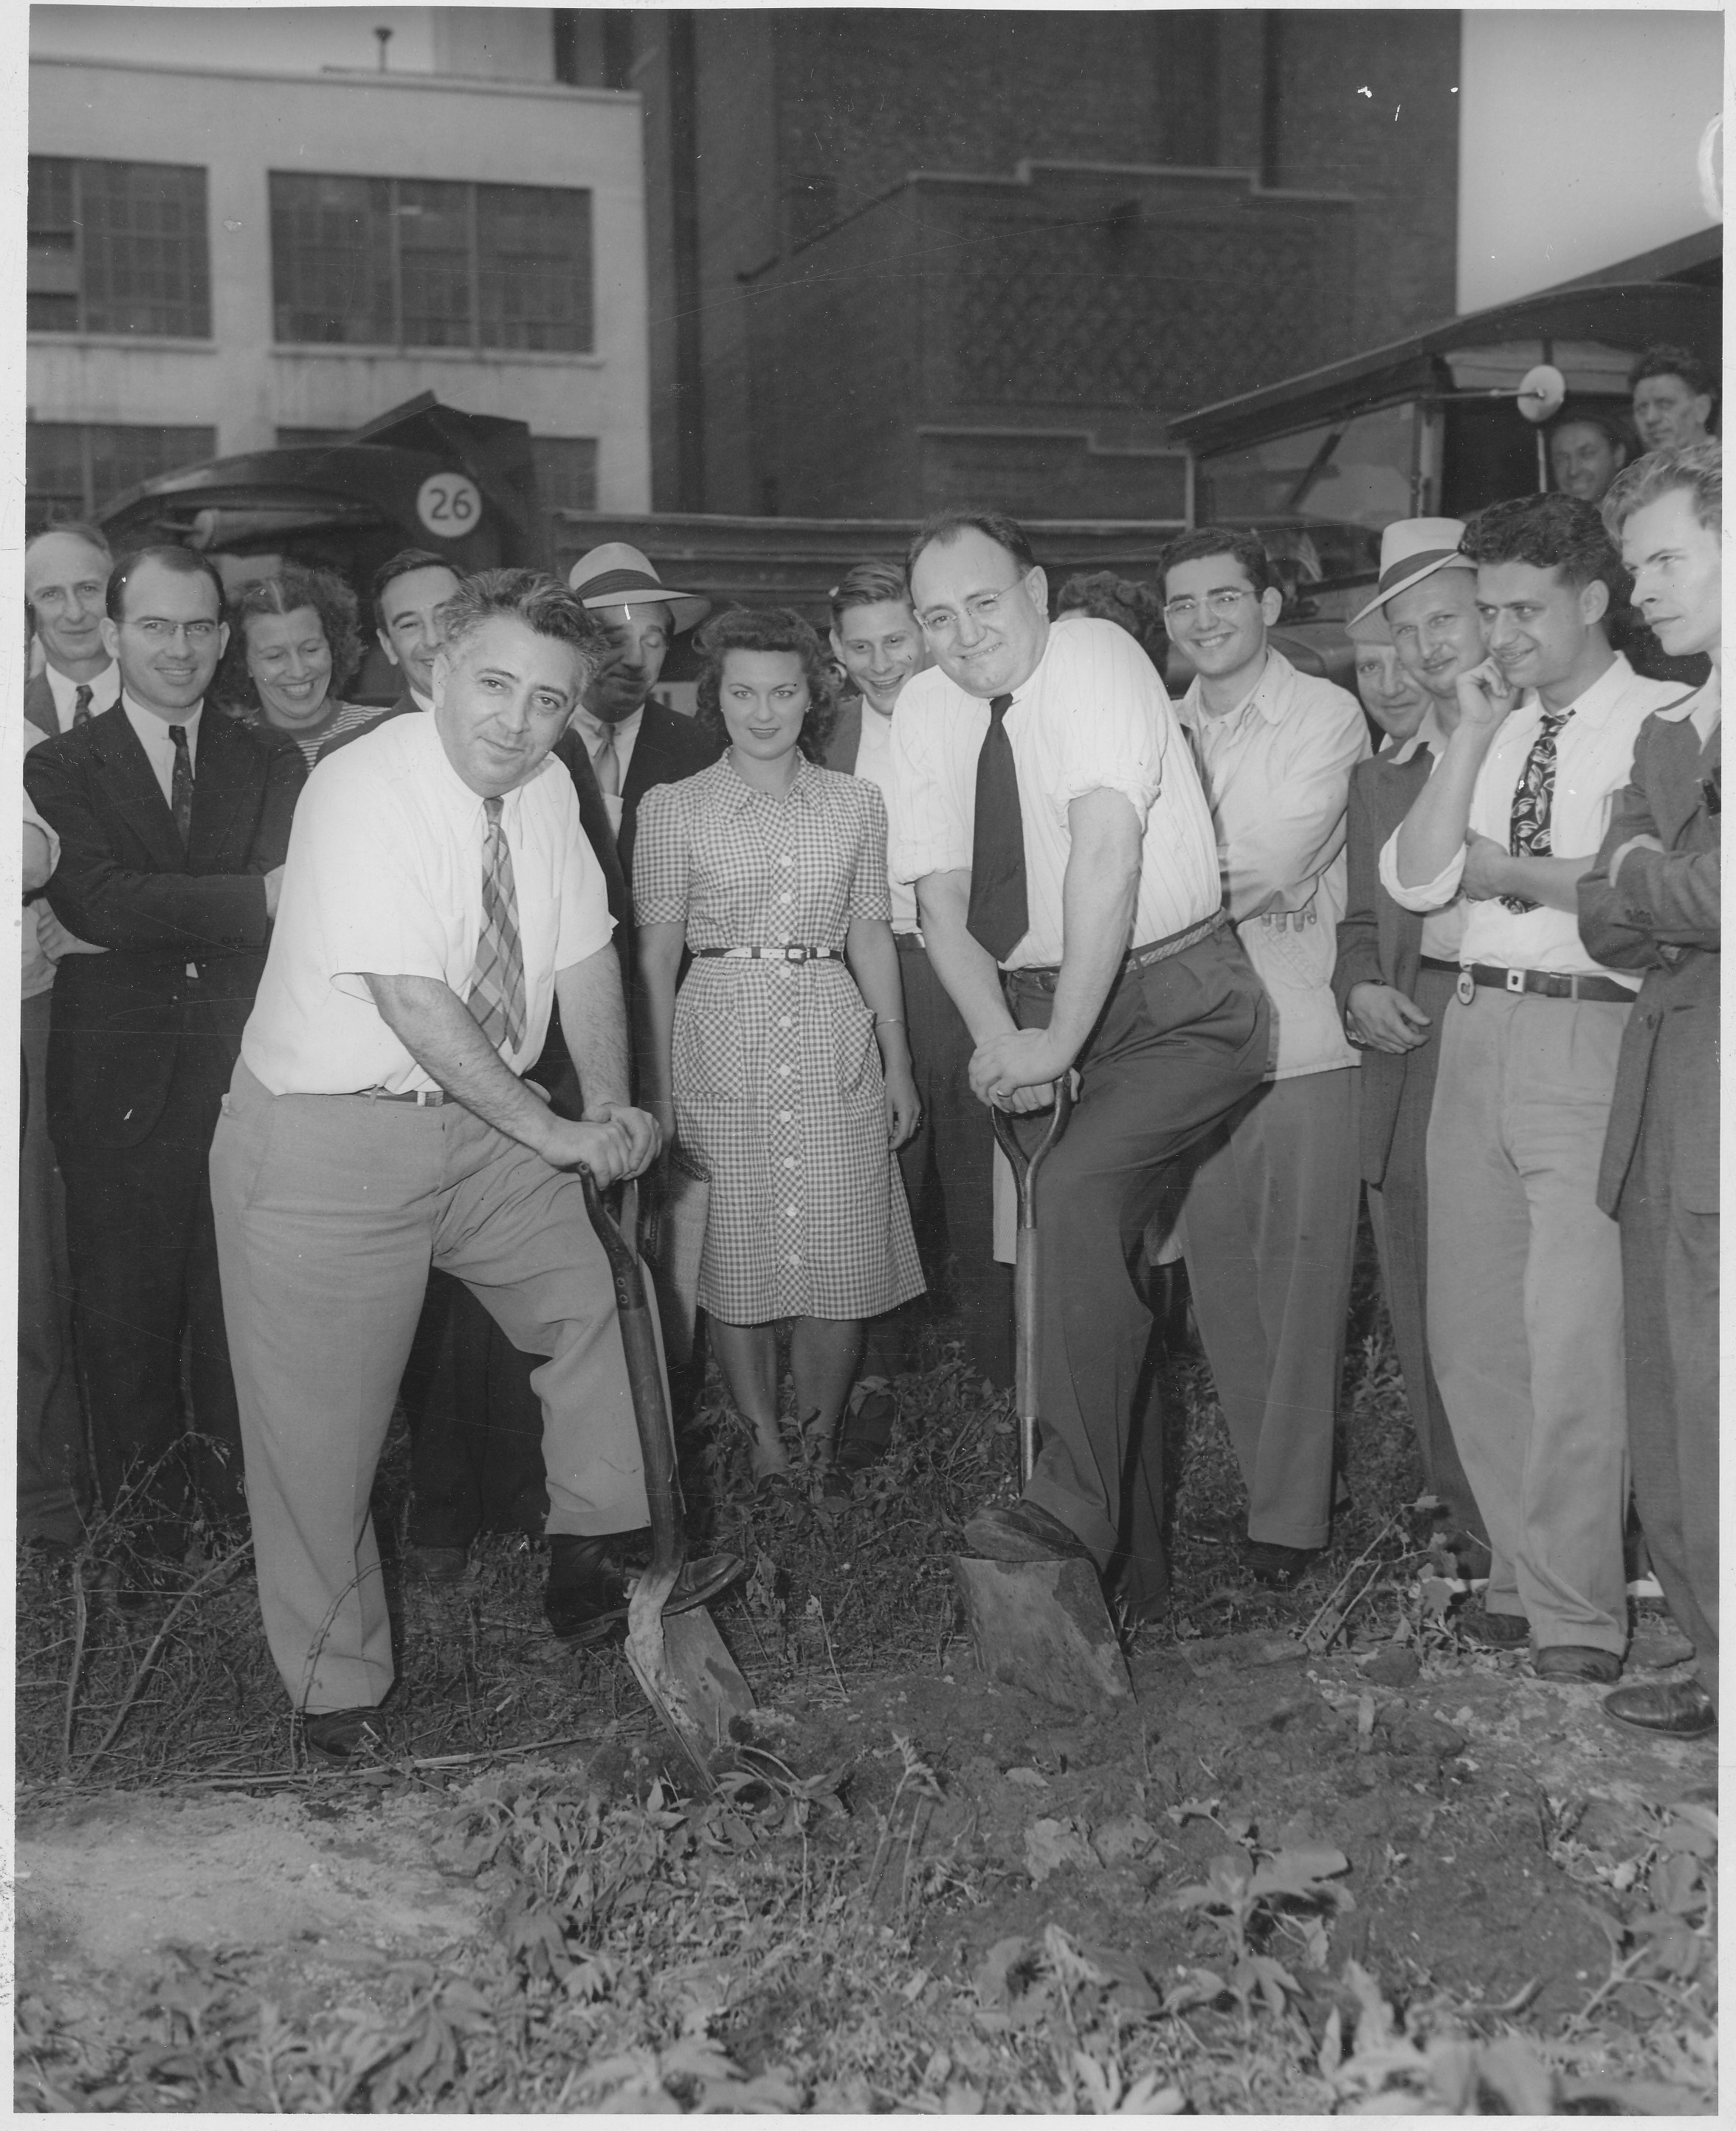
Press Wireless
Groundbreaking, Pre-Wi transmitter plant in Long Island City, 1945

Slide 5
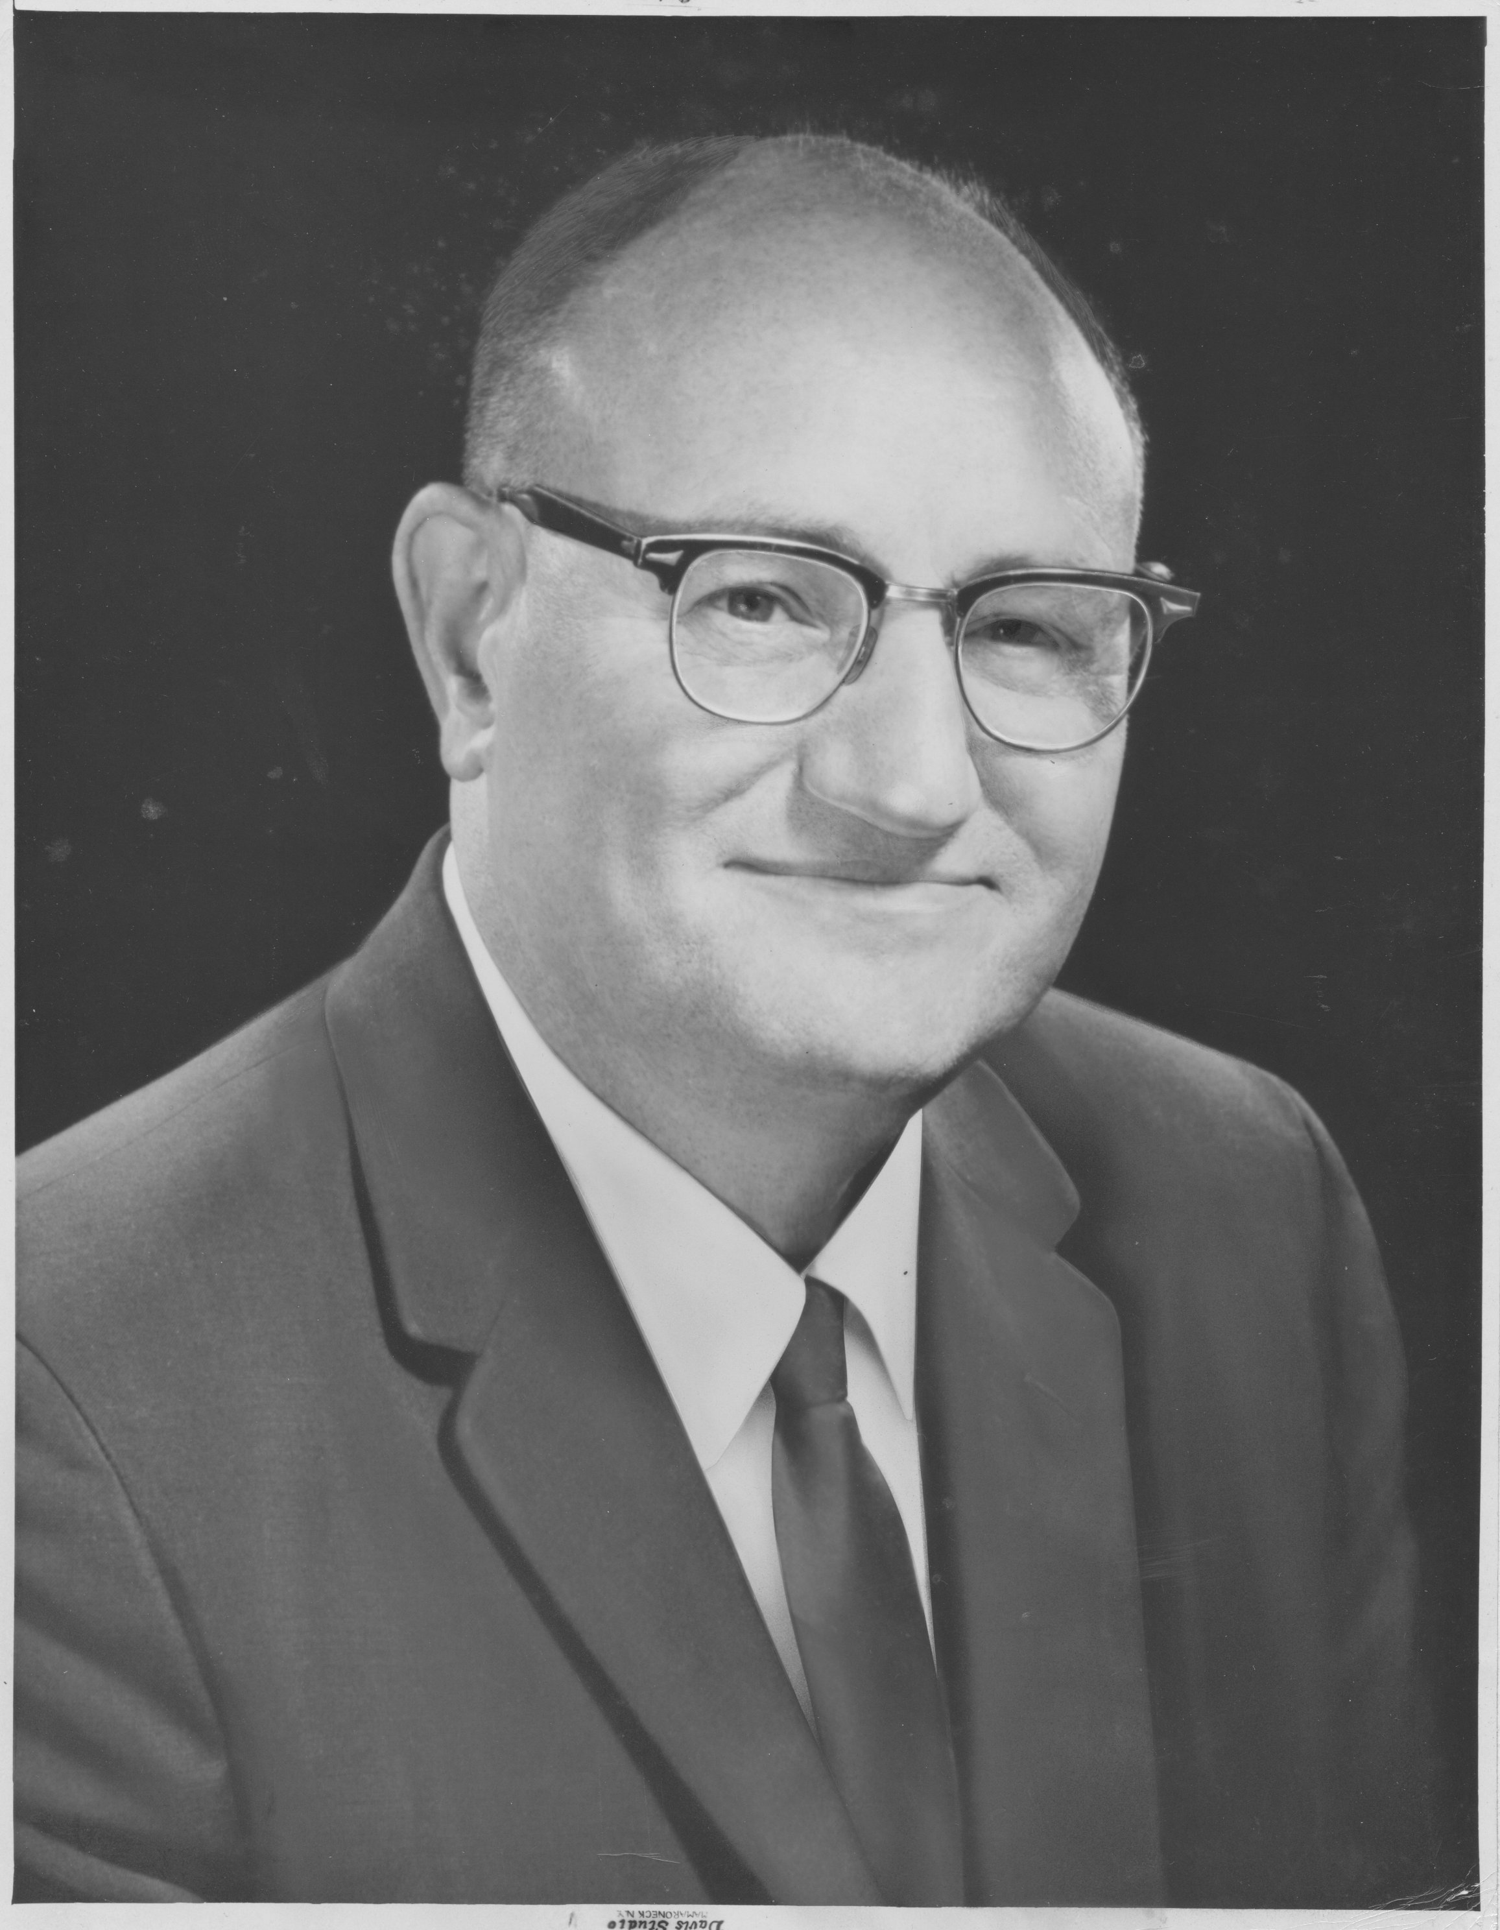
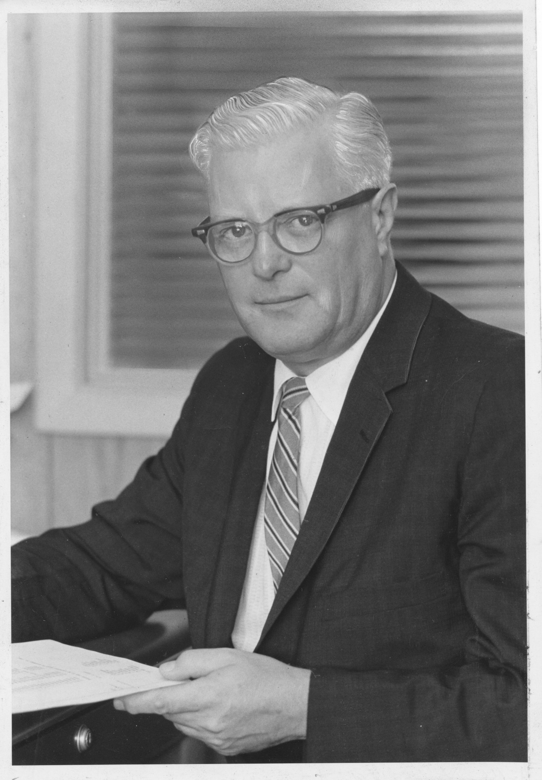
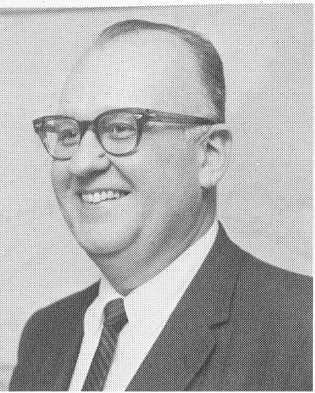
TMC Founding
Following collapse of Press Wireless..
Founded 1947 by 3 Pre-Wi colleagues
Initially, a resurrected Technical Products (mfg’s rep)
Soon turned to manufacturing
TMC Canada founded 1949
Ray de Pasquale
William Deans
William Gallione

Slide 6
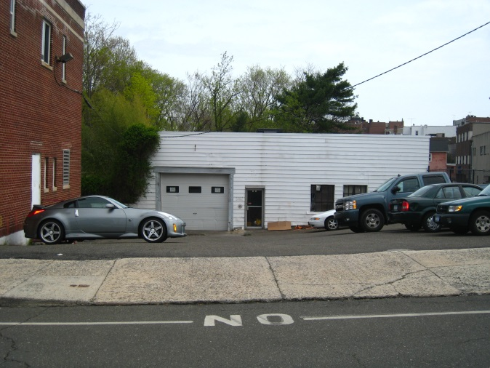
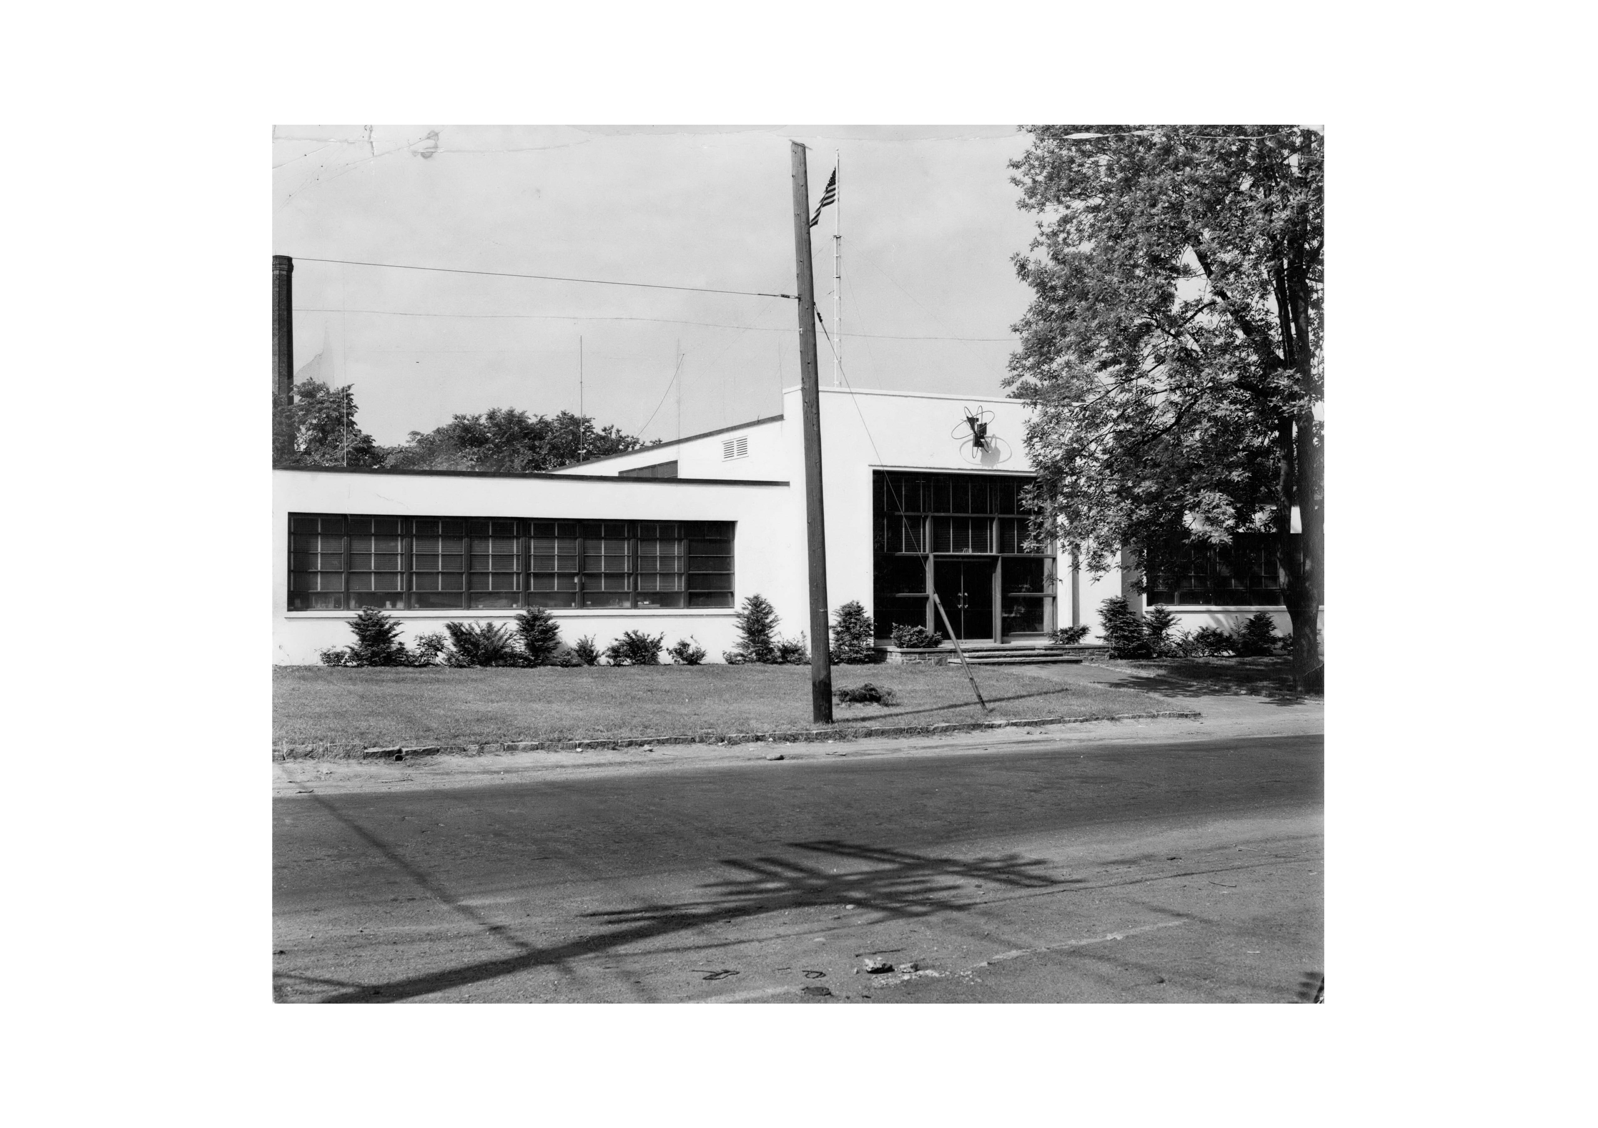
Early Plant Locations
Spencer Place
Mamaroneck, NY
1948-1952
700 Fenimore Road, Mamaroneck--1952-present

Slide 7
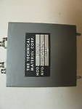
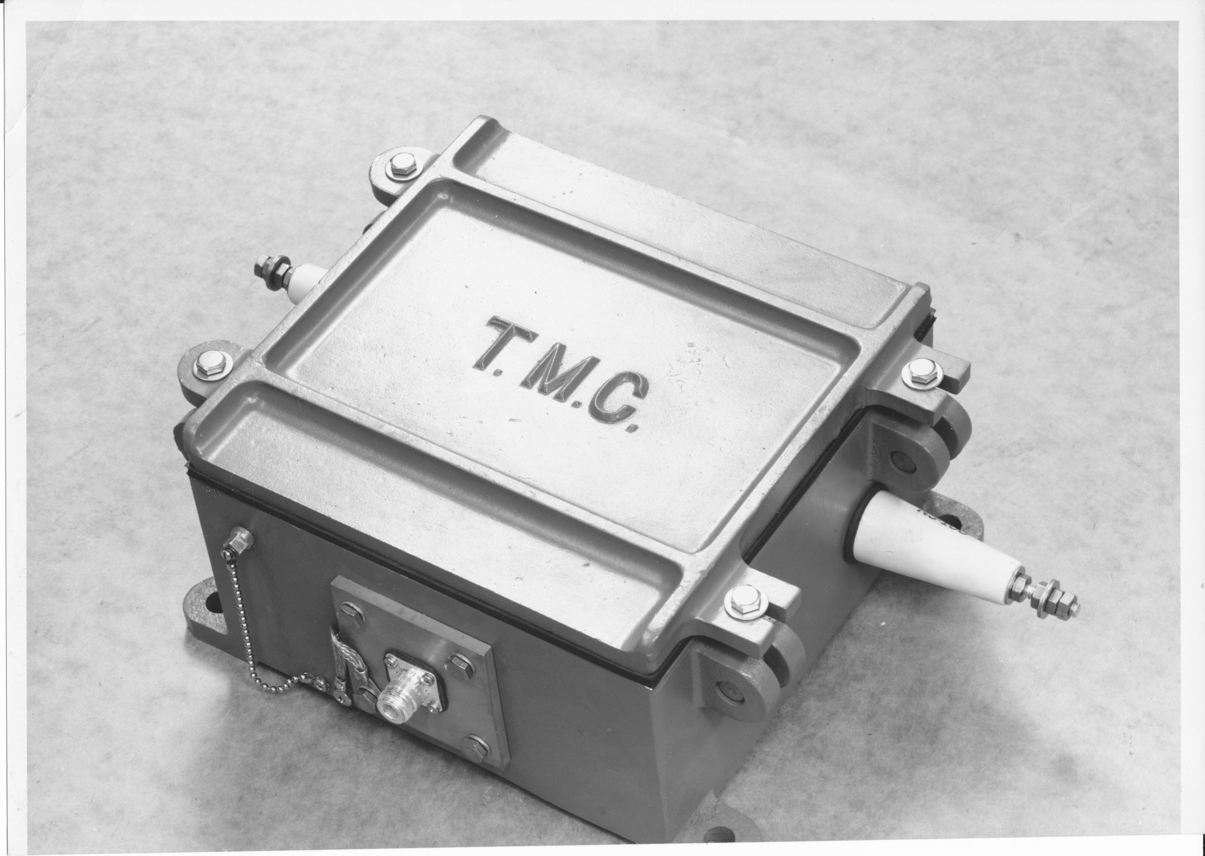
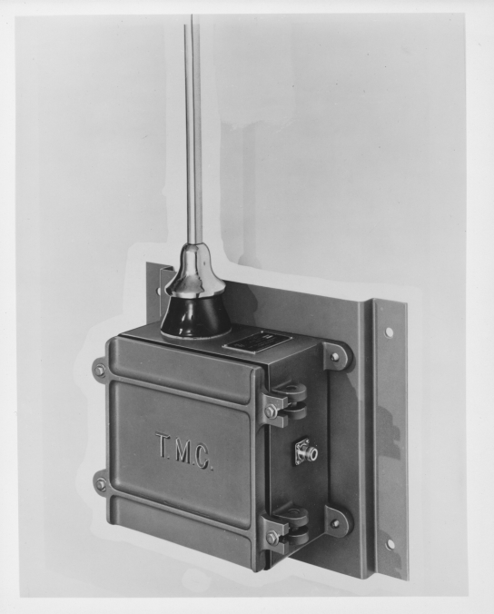
Early Products
Antenna Terminations and Matching Transformers

Slide 8
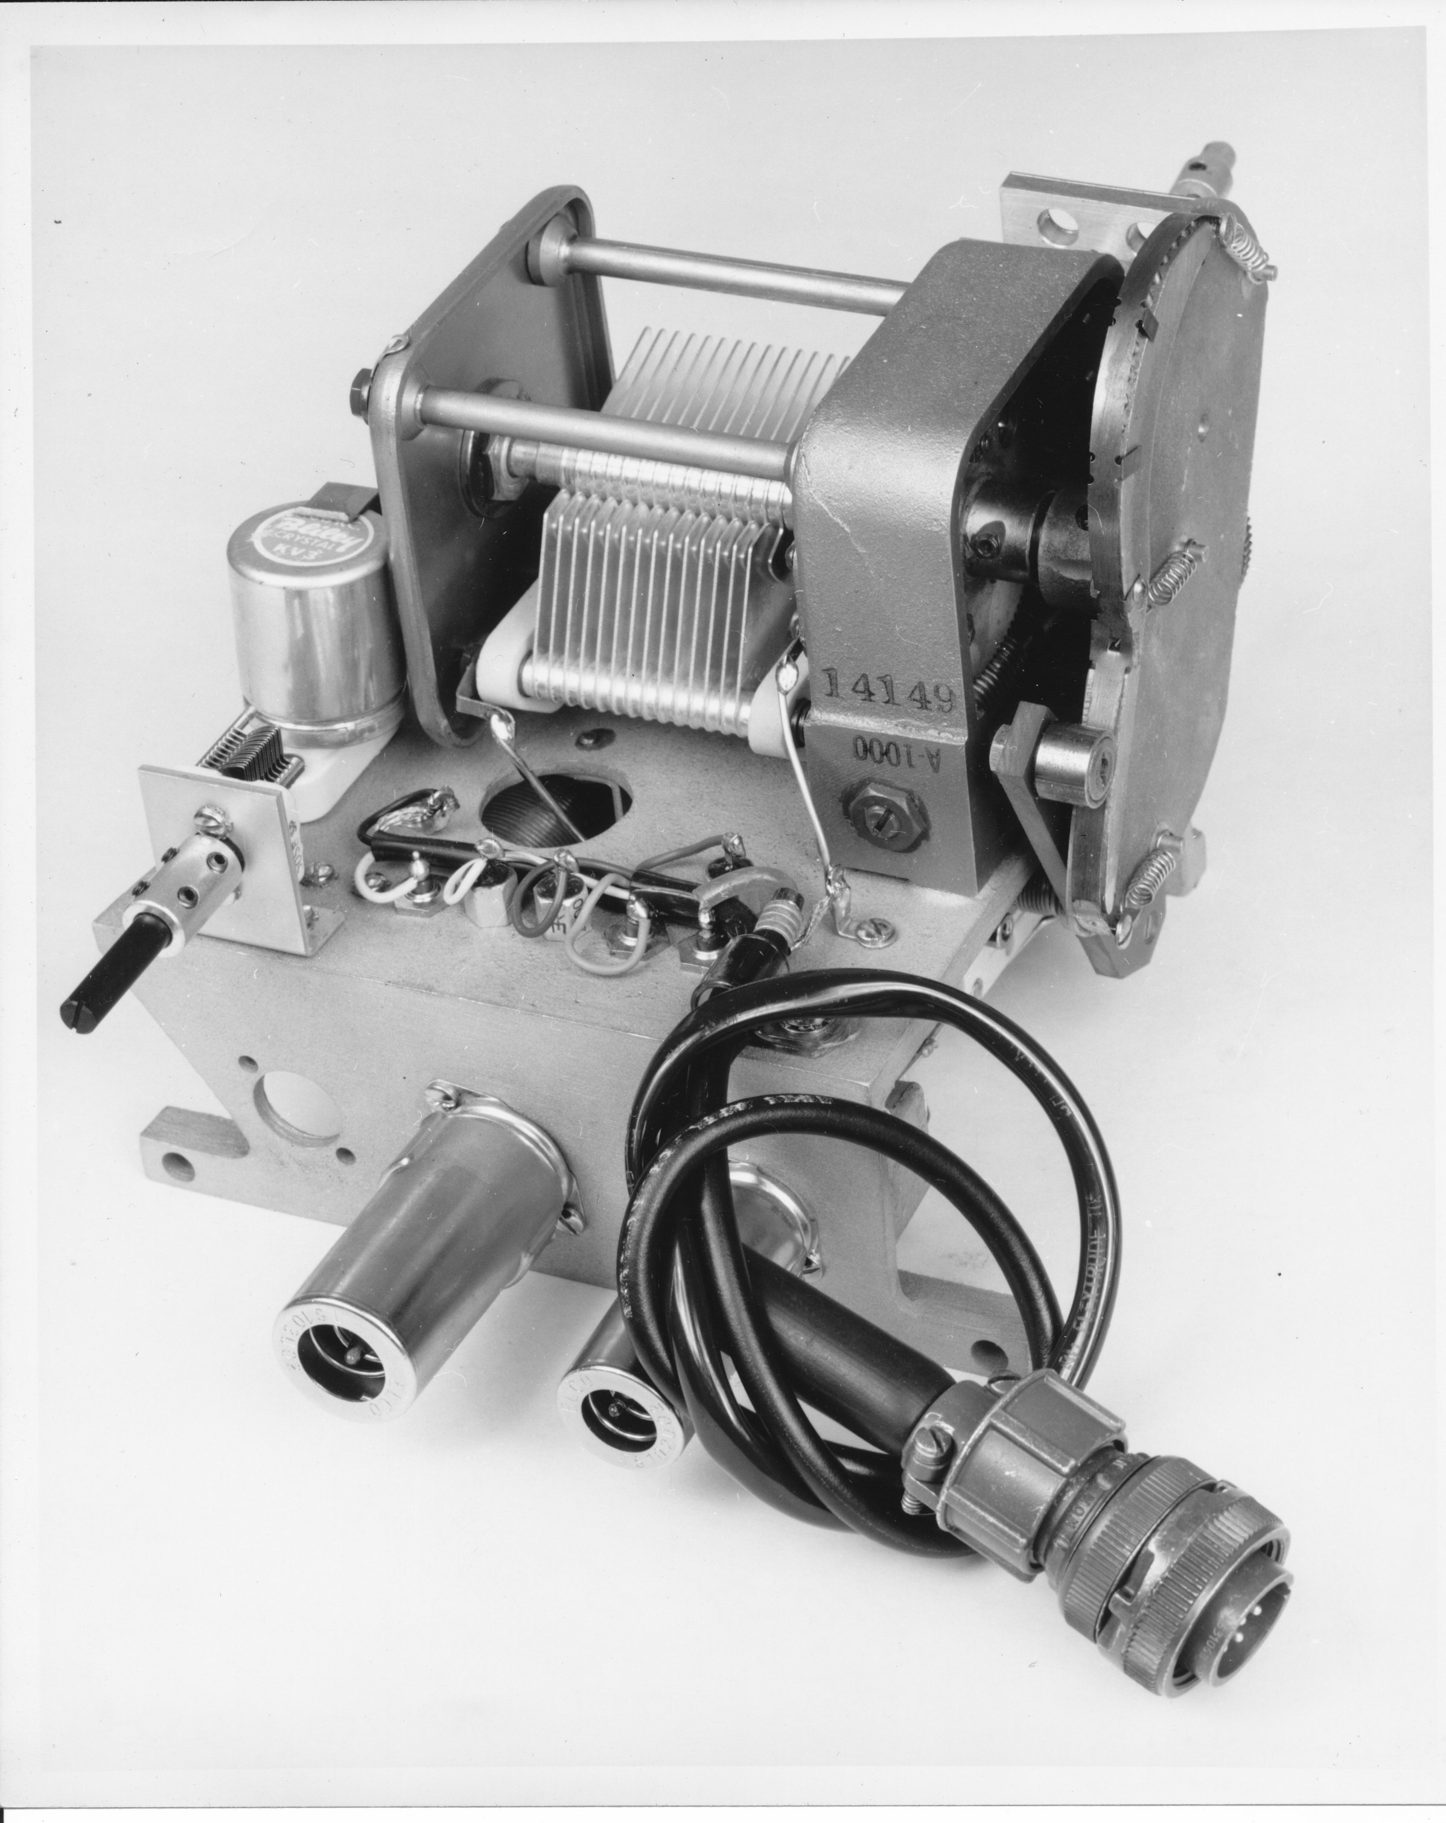
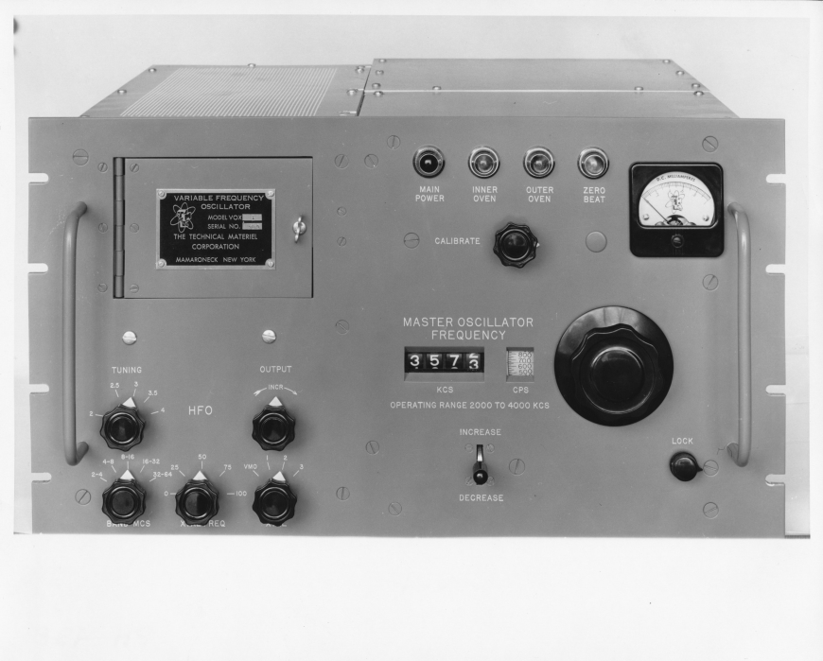
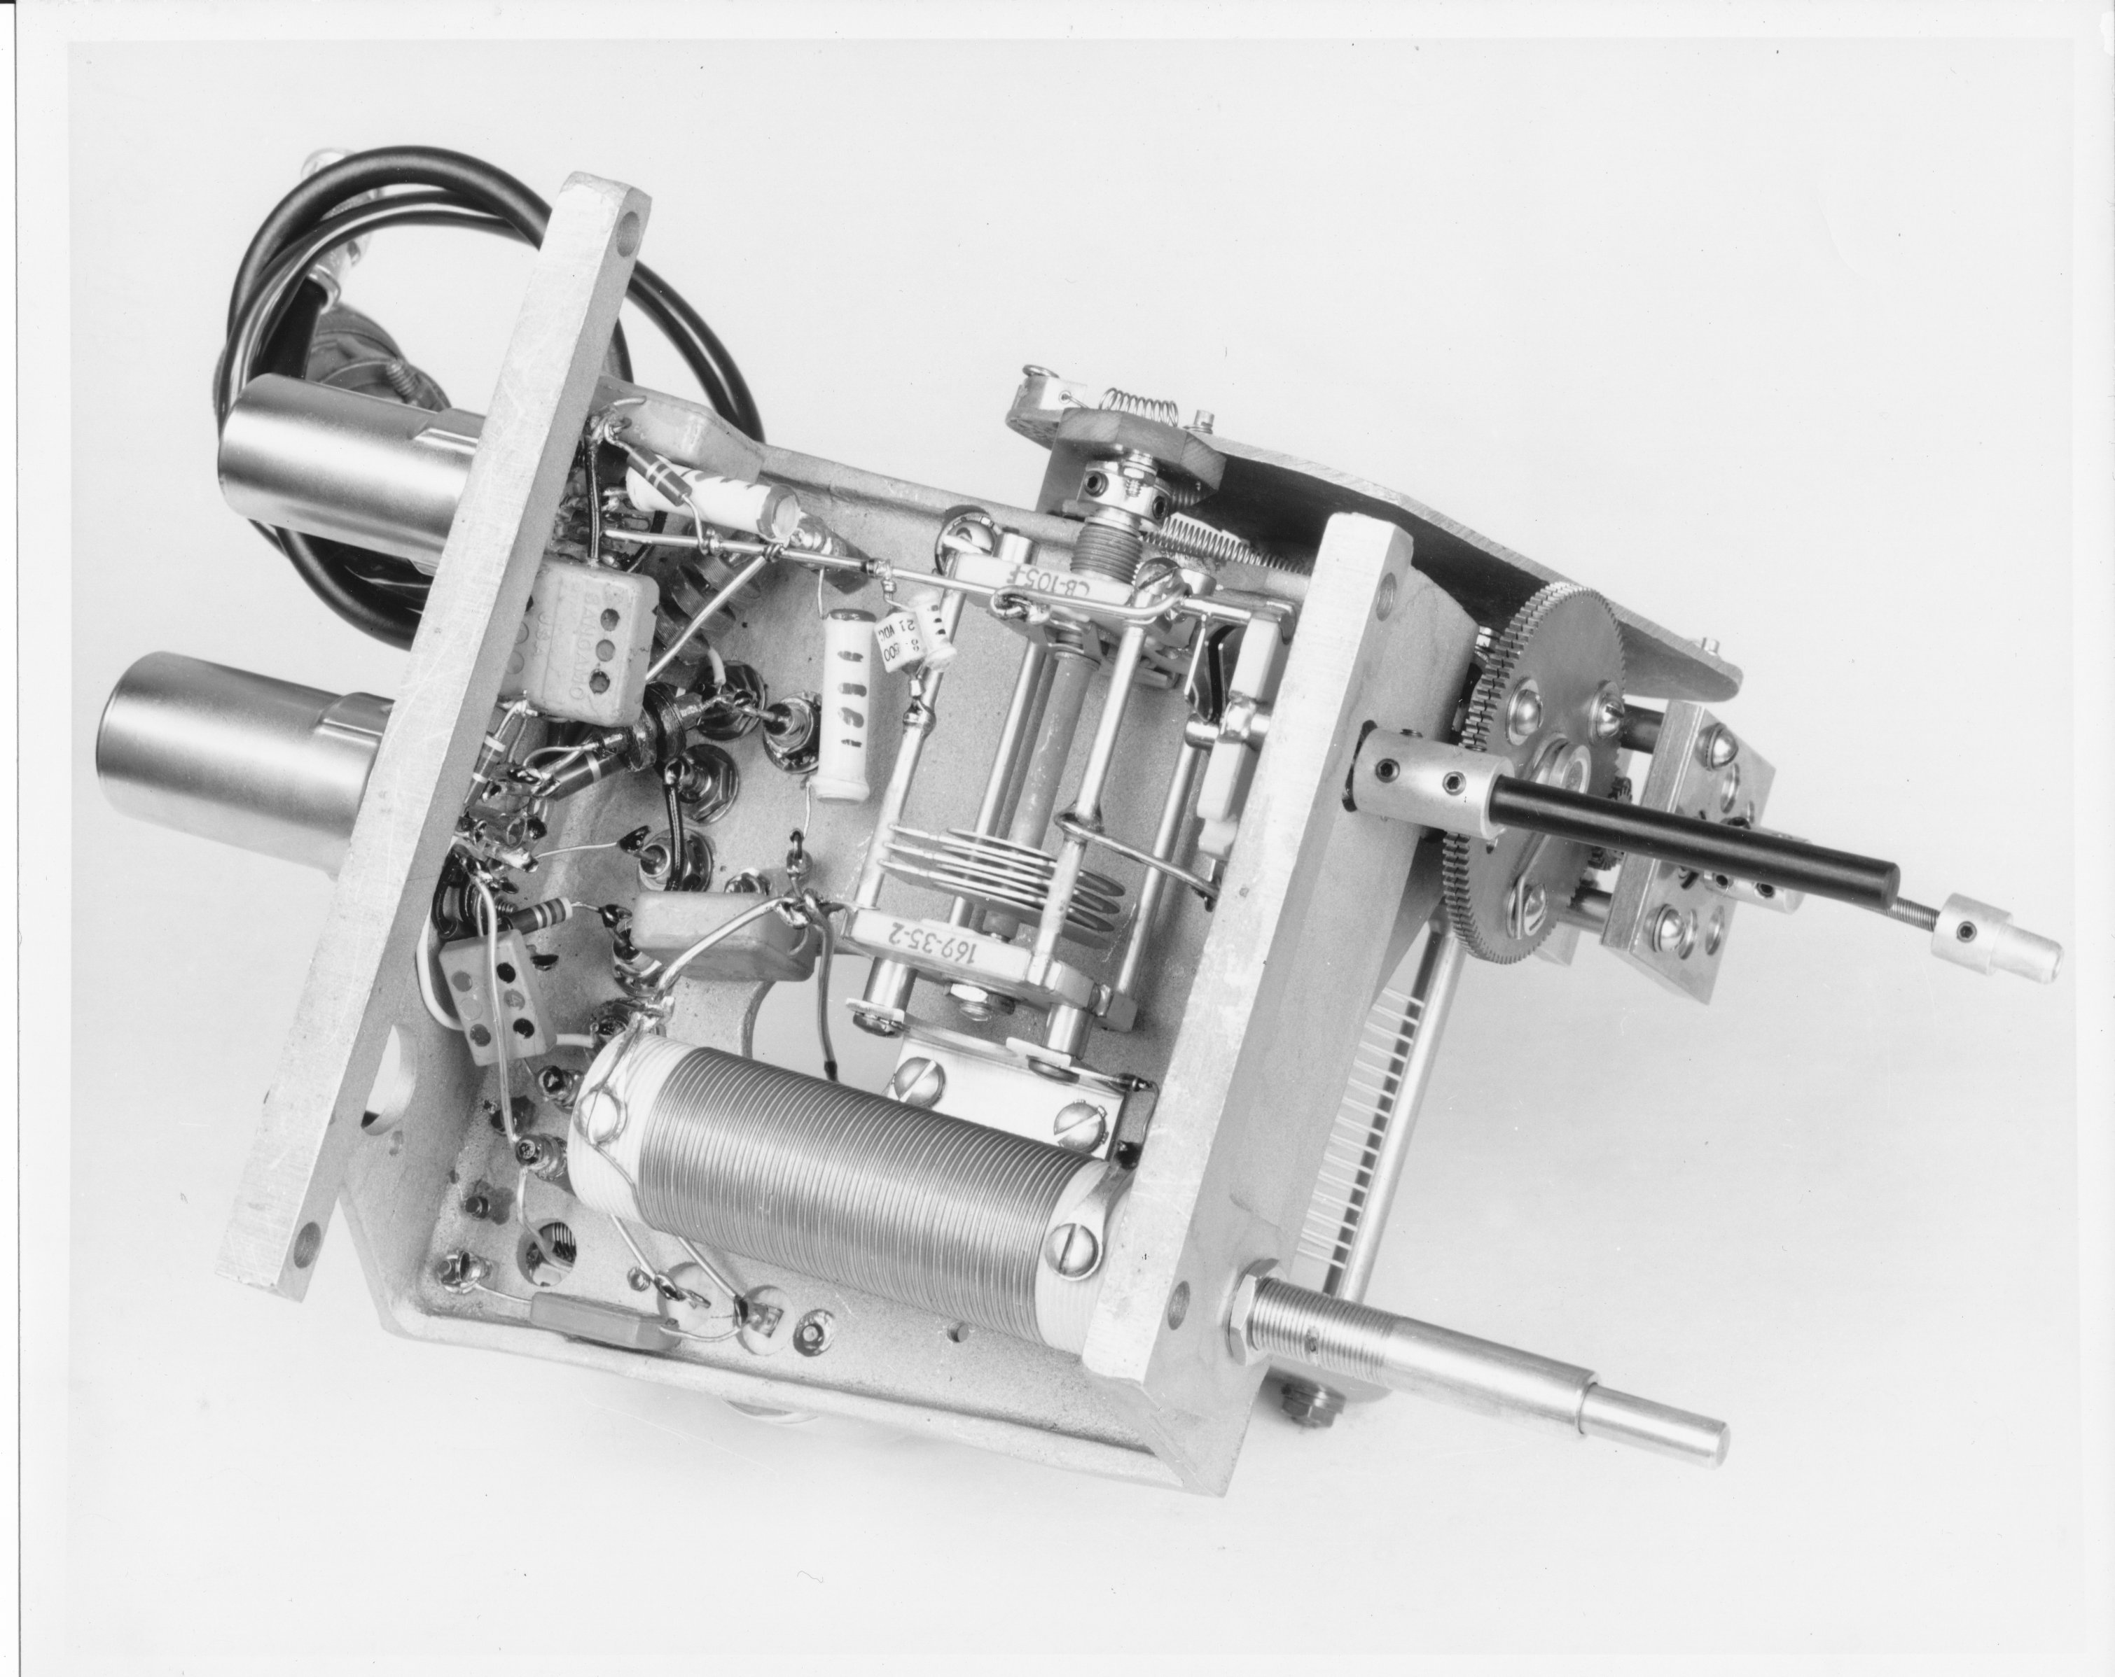
Early Products
AO-100 Oven-stabilized Frequency Source
Cam-driven compensation capacitor—linear tuning
Initial design by Les Norde (later at Hammarlund)
In production from 1952 through late 80’s
Used in VOX frequency source, and many other products
VOX-1 Variable Frequency Oscillator

Slide 9
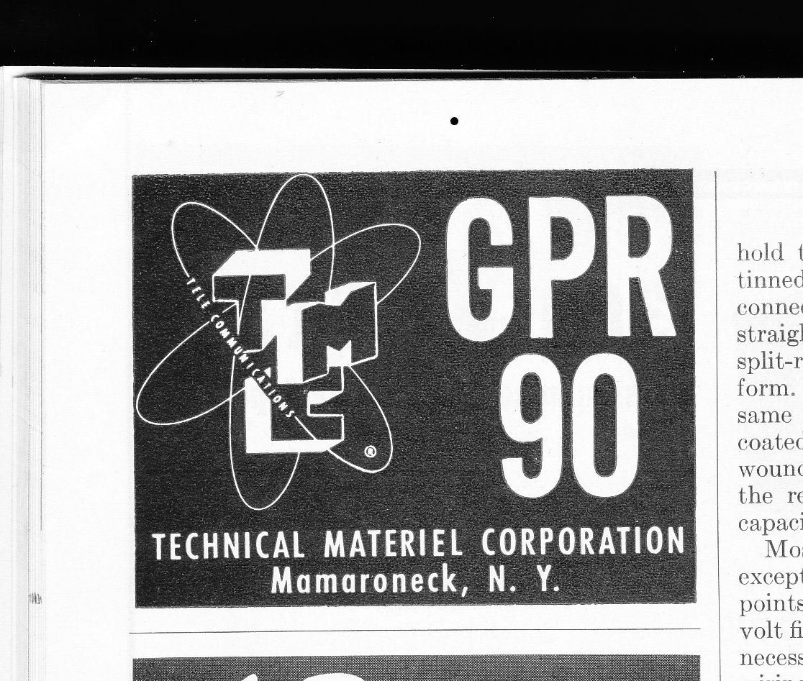
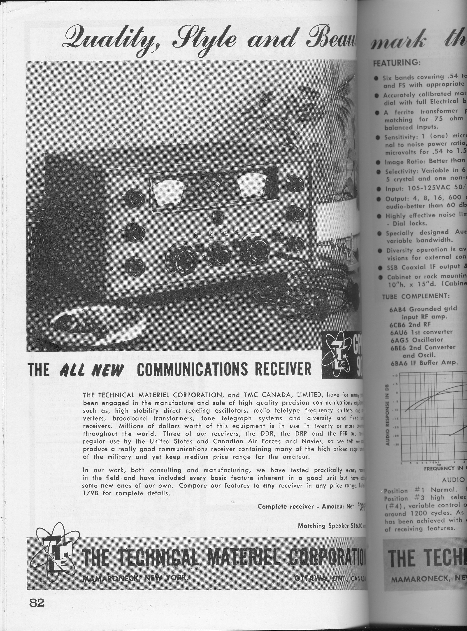
GPR-90
July 1955 QST
$395 initial price equivalent to about $3,500 today!
75A-4 introduced @ $595
2-page TMC ad in August ‘55 QST

Slide 10
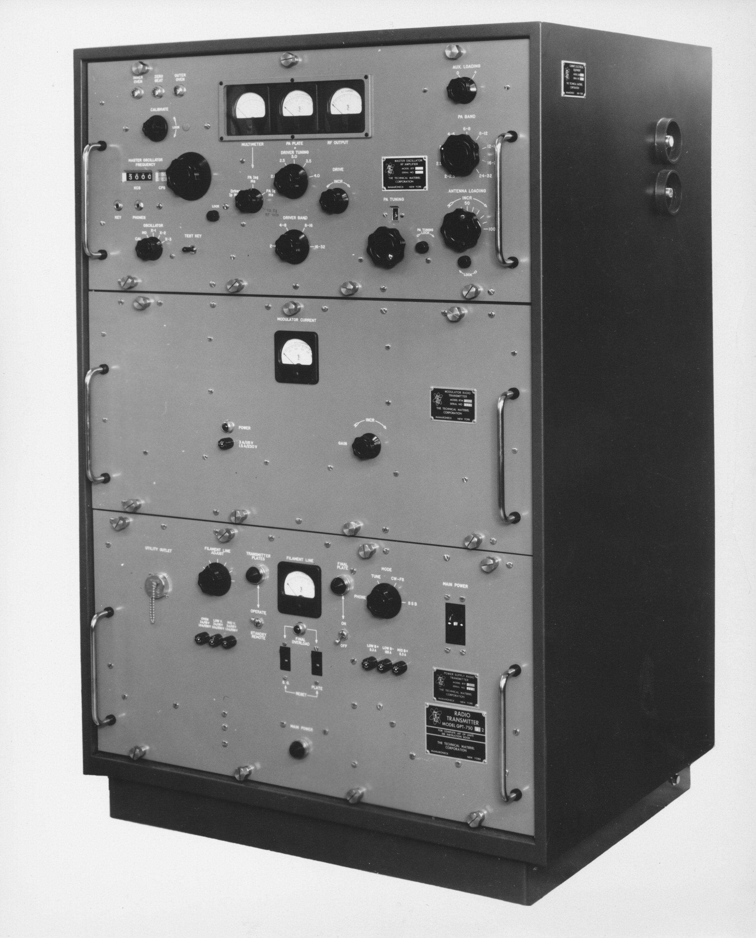
GPT-750
TMC’s first transmitter
Introduced in early 1956
Replacement for T-368
Extremely versatile:
750W AM
1KW CW, RTTY
2KW PEP SSB
Sold very well from get-go
Commercial customers
Military: AN/URT-17
State Dept, FBI, White House Comm’s Agency, others…

Slide 11
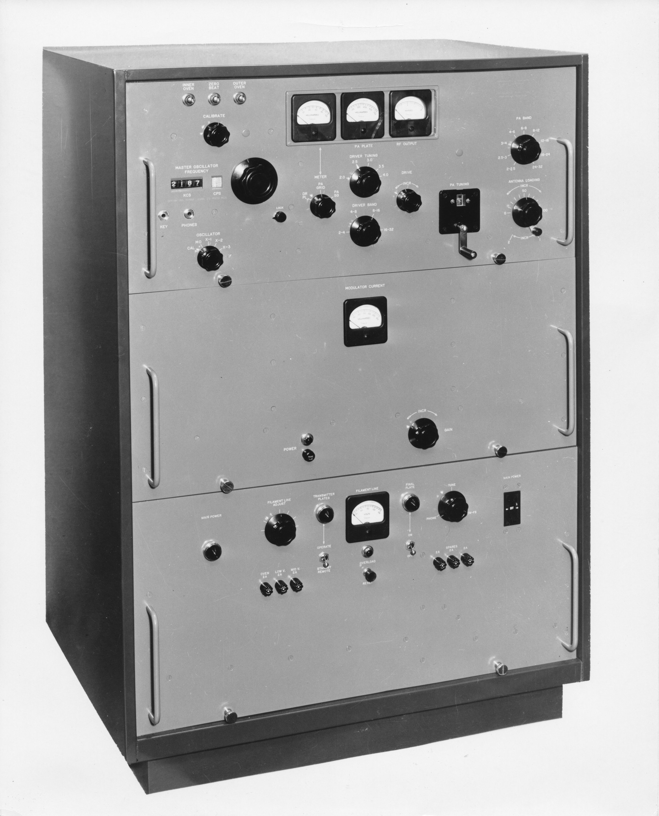
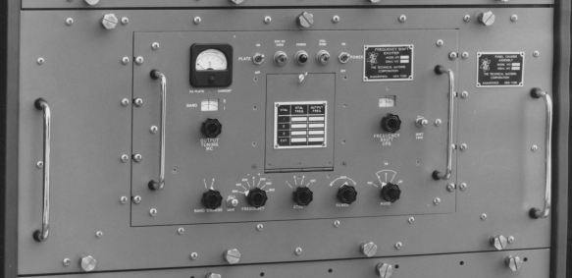
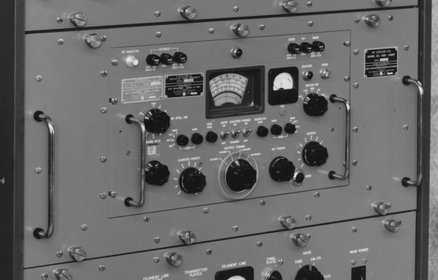
GPT-750: Modularity
2x 4-250 RF Deck (Class C for AM/CW, Class AB for SSB/RTTY)
VFO (AO-100 based)
Center Drawer:
2x 810 Plate Modulator in “A” AM config
XFK Exciter in “C” RTTY config
SBE Sideband Exciter in “D” SSB config
Power Supply Drawer

Slide 12
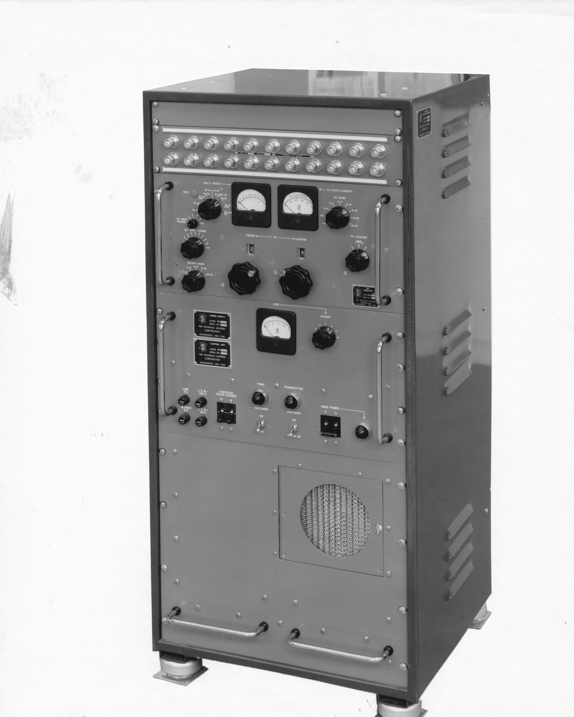
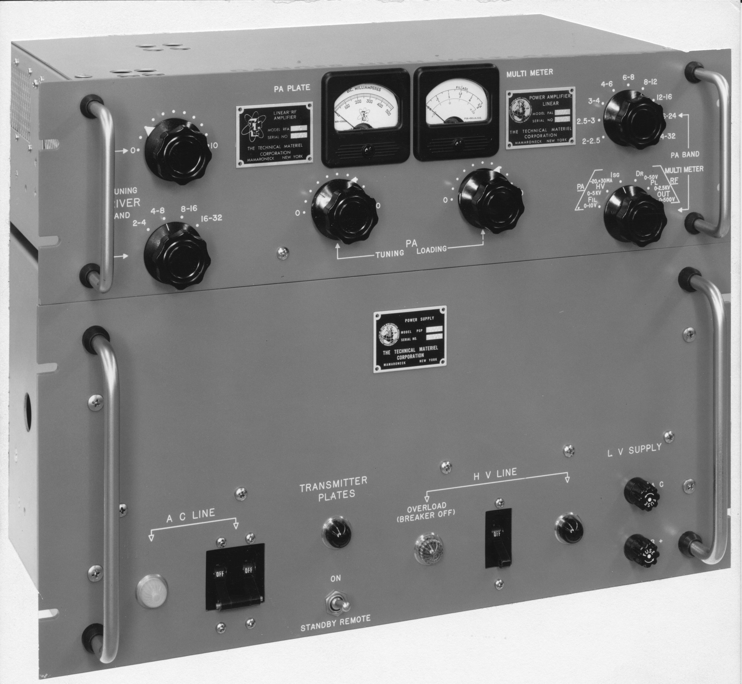
Modularity Concept Development
PA Deck
PA Deck
Power Supply
LV P.S.
HV P.S.
PAL-350 350W PEP amplifier
Introduced in 1958
Pair of 4CX250’s
PAL-1K 1Kw PEP amplifier
Introduced in 1959
PL-172 final

Slide 13
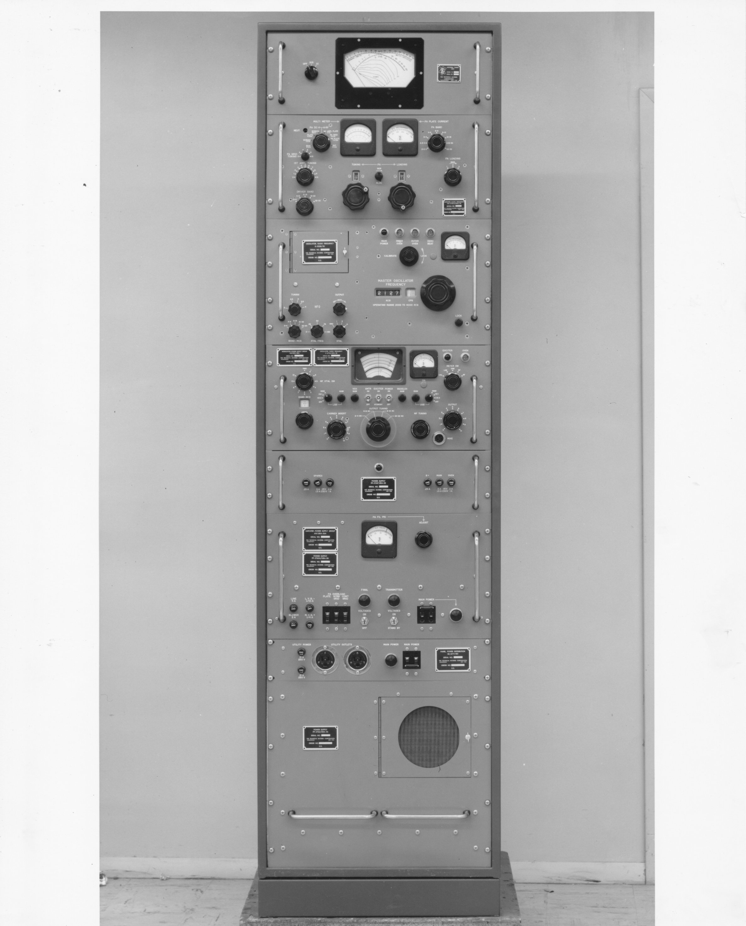
Modularity
Modules could be combined in a variety of ways to create many different products
SBT-1KA
ATS SWR Indicator
Example:
SBT-1KA
(Sideband Transmitter, 1KW)
PAL-1K Amp and PS’s
VOX VFO
Over its 25-year life-span, there were dozens of variations of the SBT-1K design!
New ones created by introducing new modules…
SBE Sideband Exciter and Power Supply
Auxiliary Power Panel

Slide 14
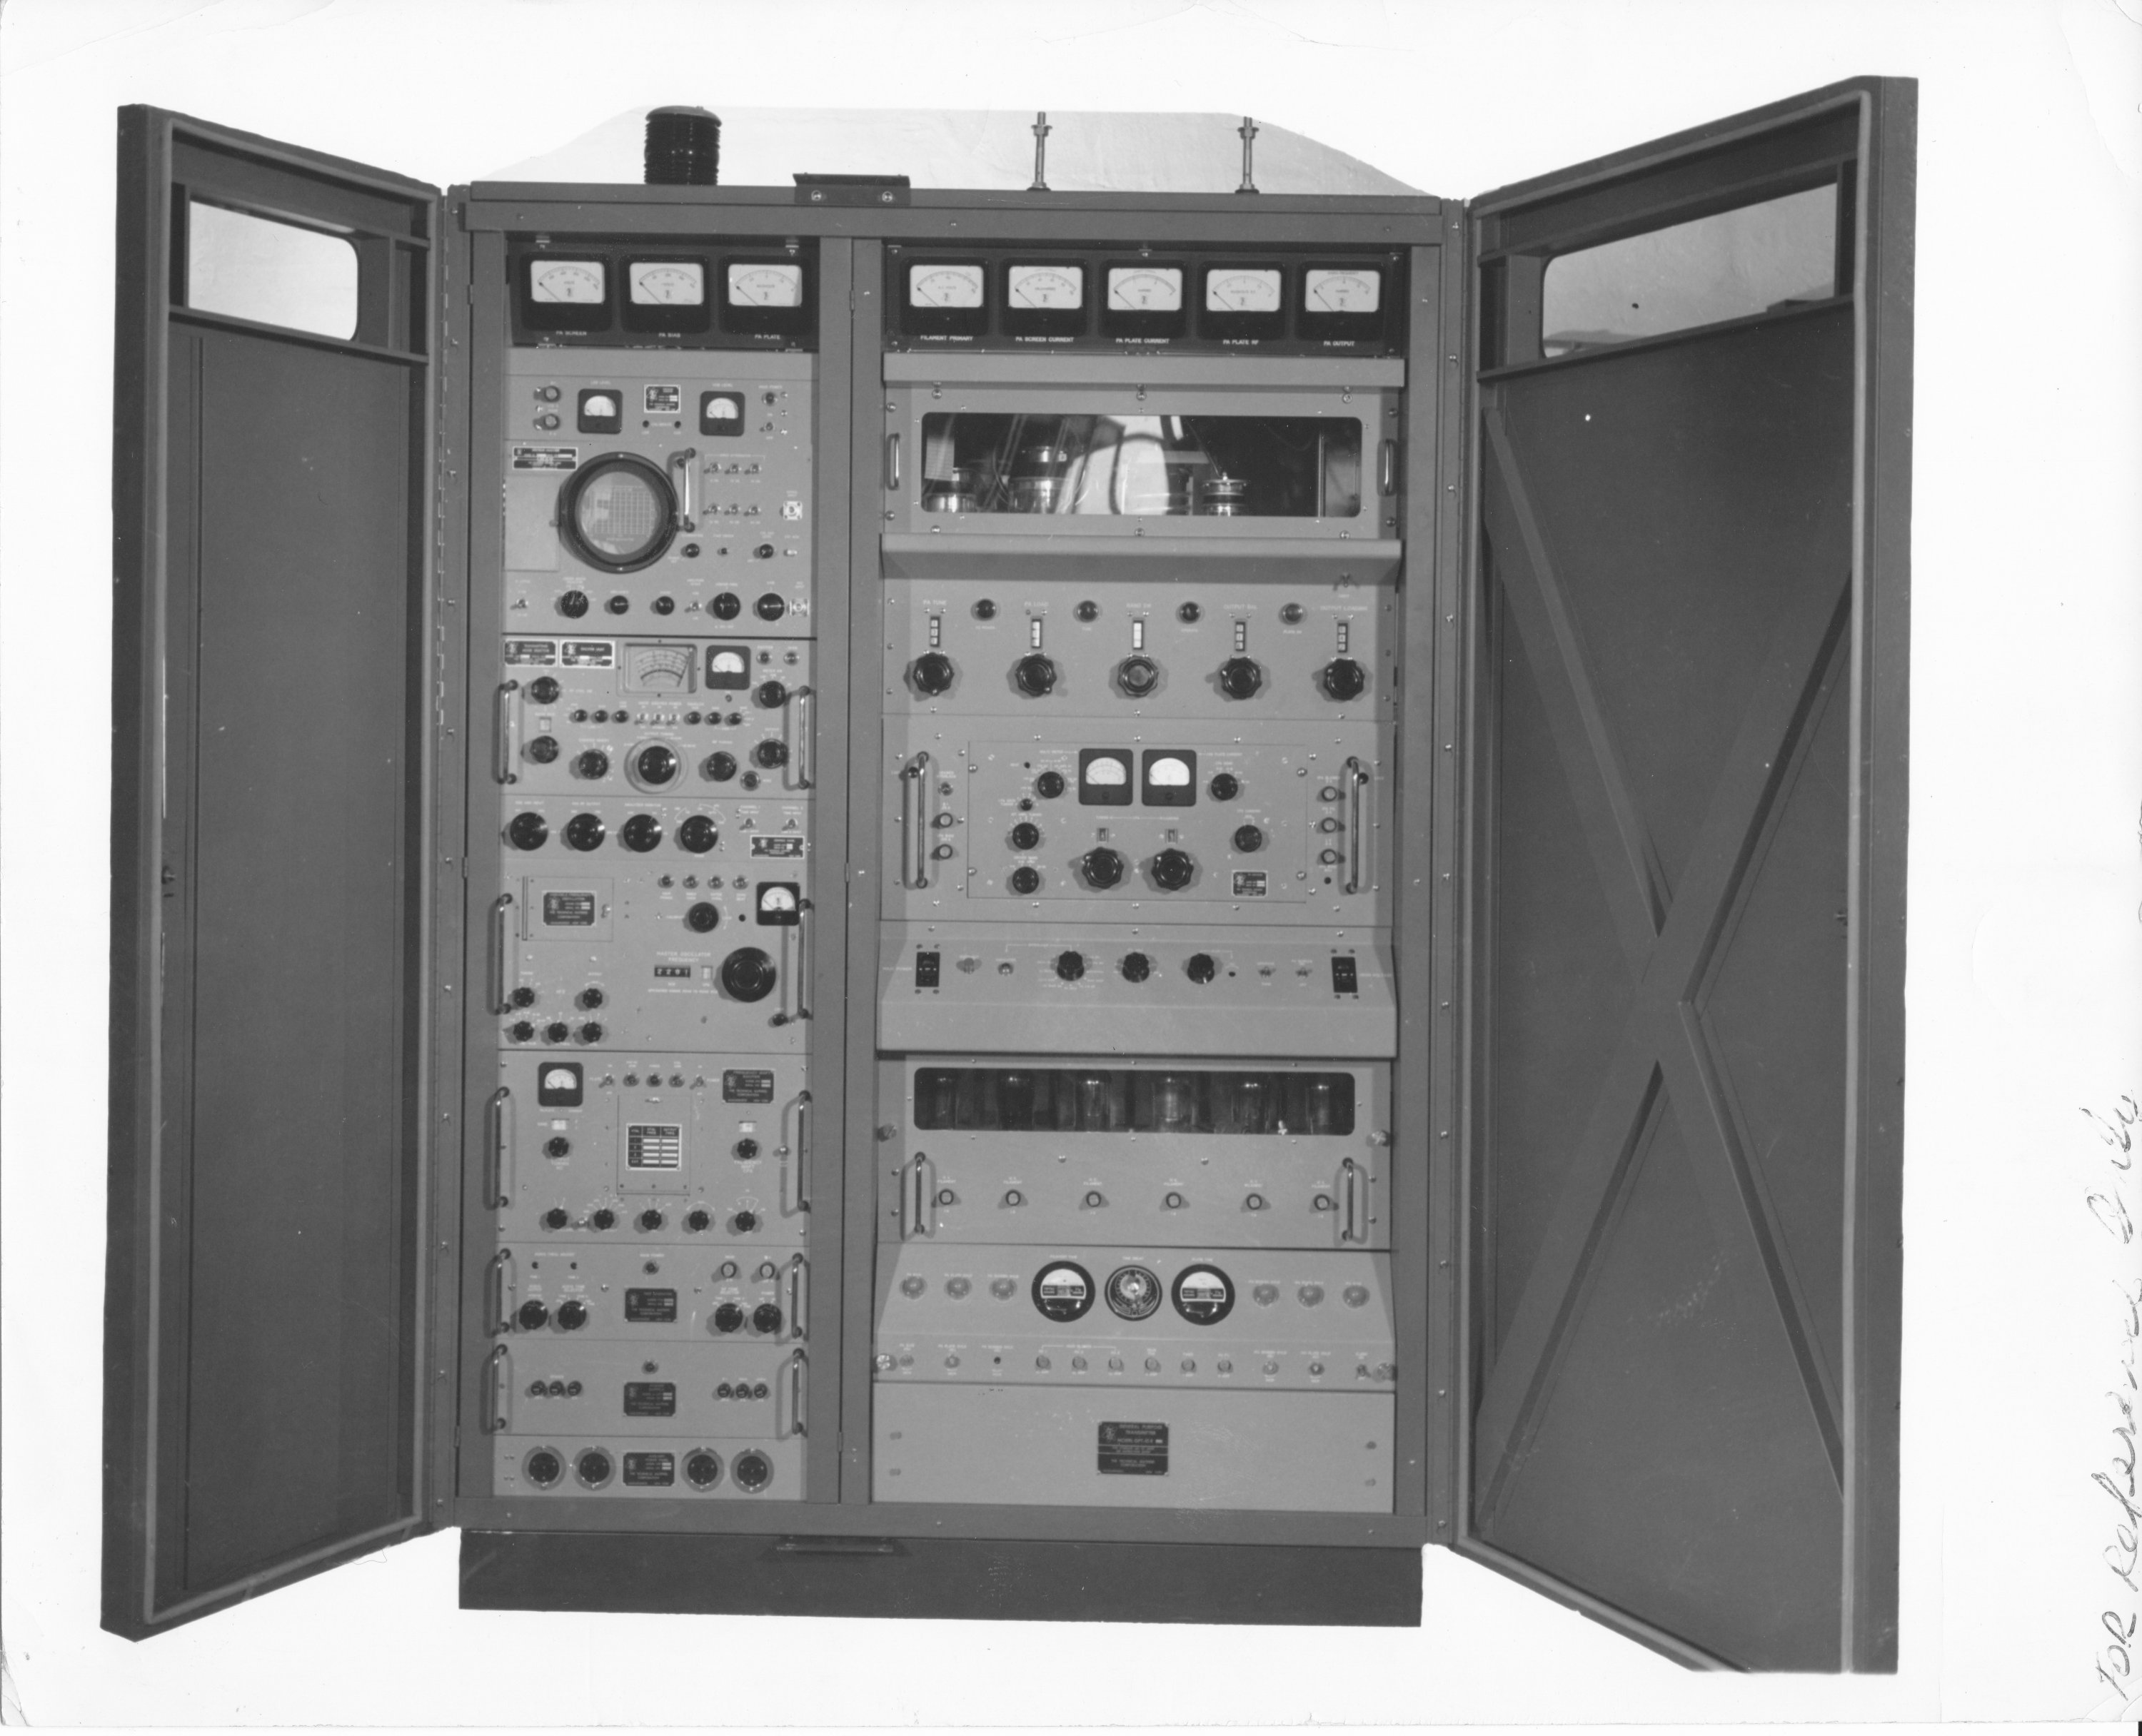
High Power Arrives
Spectrum Analyzer
10Kw PA
SBE SSB Exciter
PAL-1K IPA
VOX VFO
XFK RTTY Exciter
2-tone Test Generator
10Kw PA HV Supply
GPT-10K (10KW PEP) Introduced in 1959

Slide 15
GPT-10K Products
The ‘10K was the most successful product ever launched by TMC
Survived in many variations well into the 1980’s
Navy’s main “medium” power transmitter
Bureau of Standards (WWV), Apollo Program, Voice of America, … and many others

Slide 16
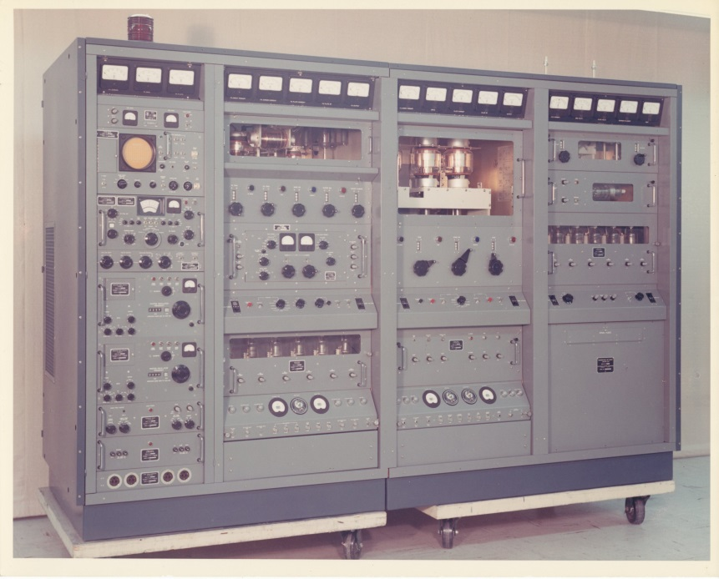
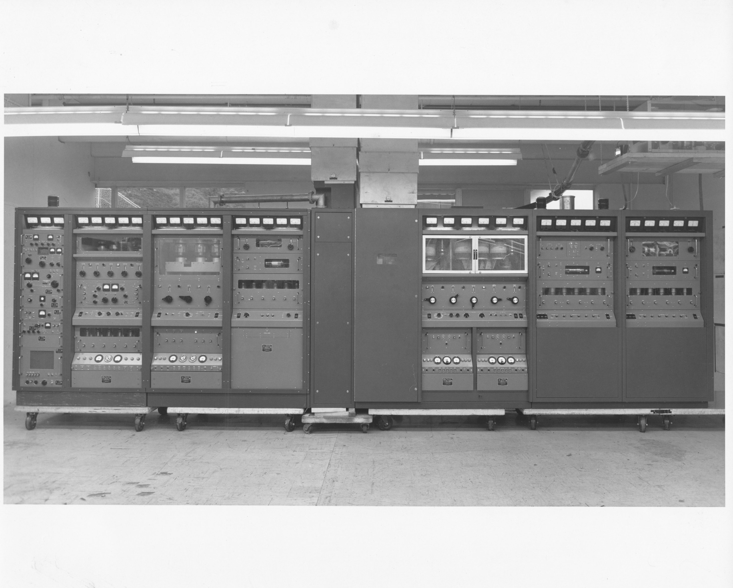
Higher Power
GPT-200K (introduced 1962)
GPT-40K (introduced late 1959)

Slide 17
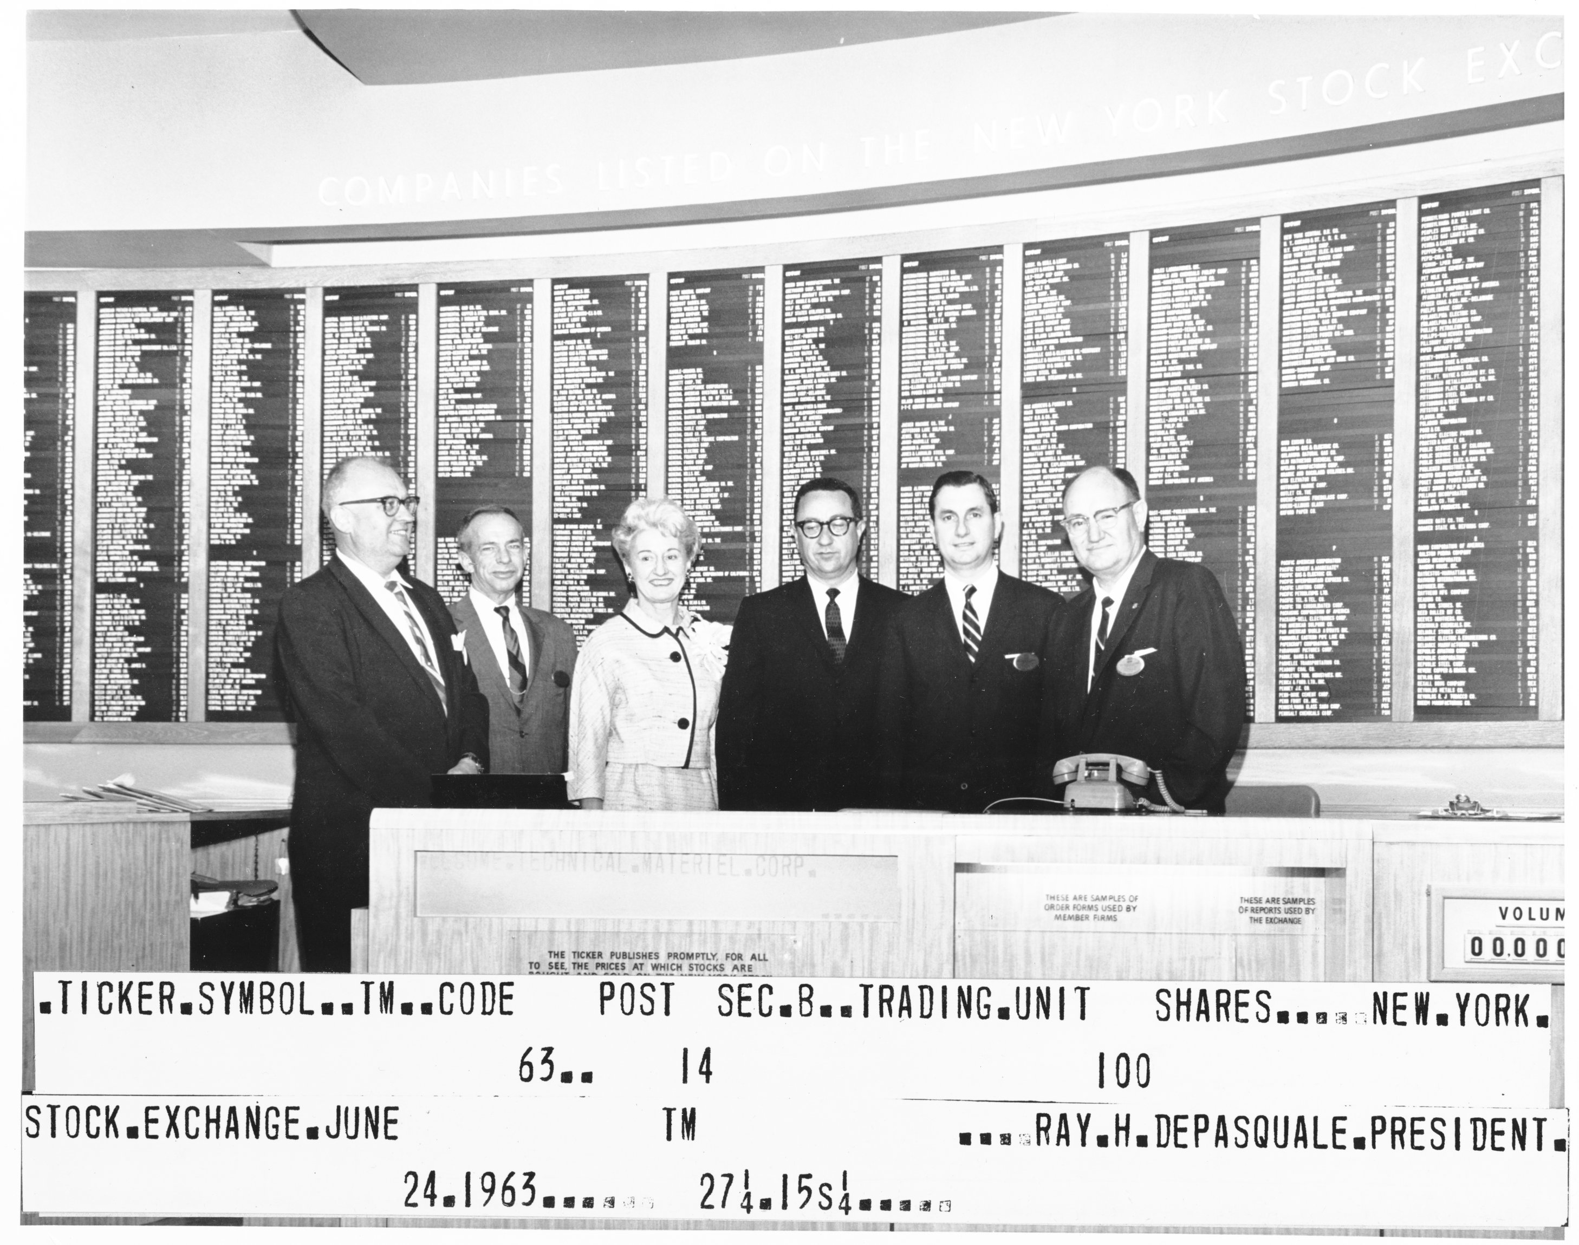
TMC Goes Public
After a decade of rapid growth, TMC became publicly traded in 1959.
Sales totaled $5M in 1959…
… and peaked at $29M in 1964

Slide 18
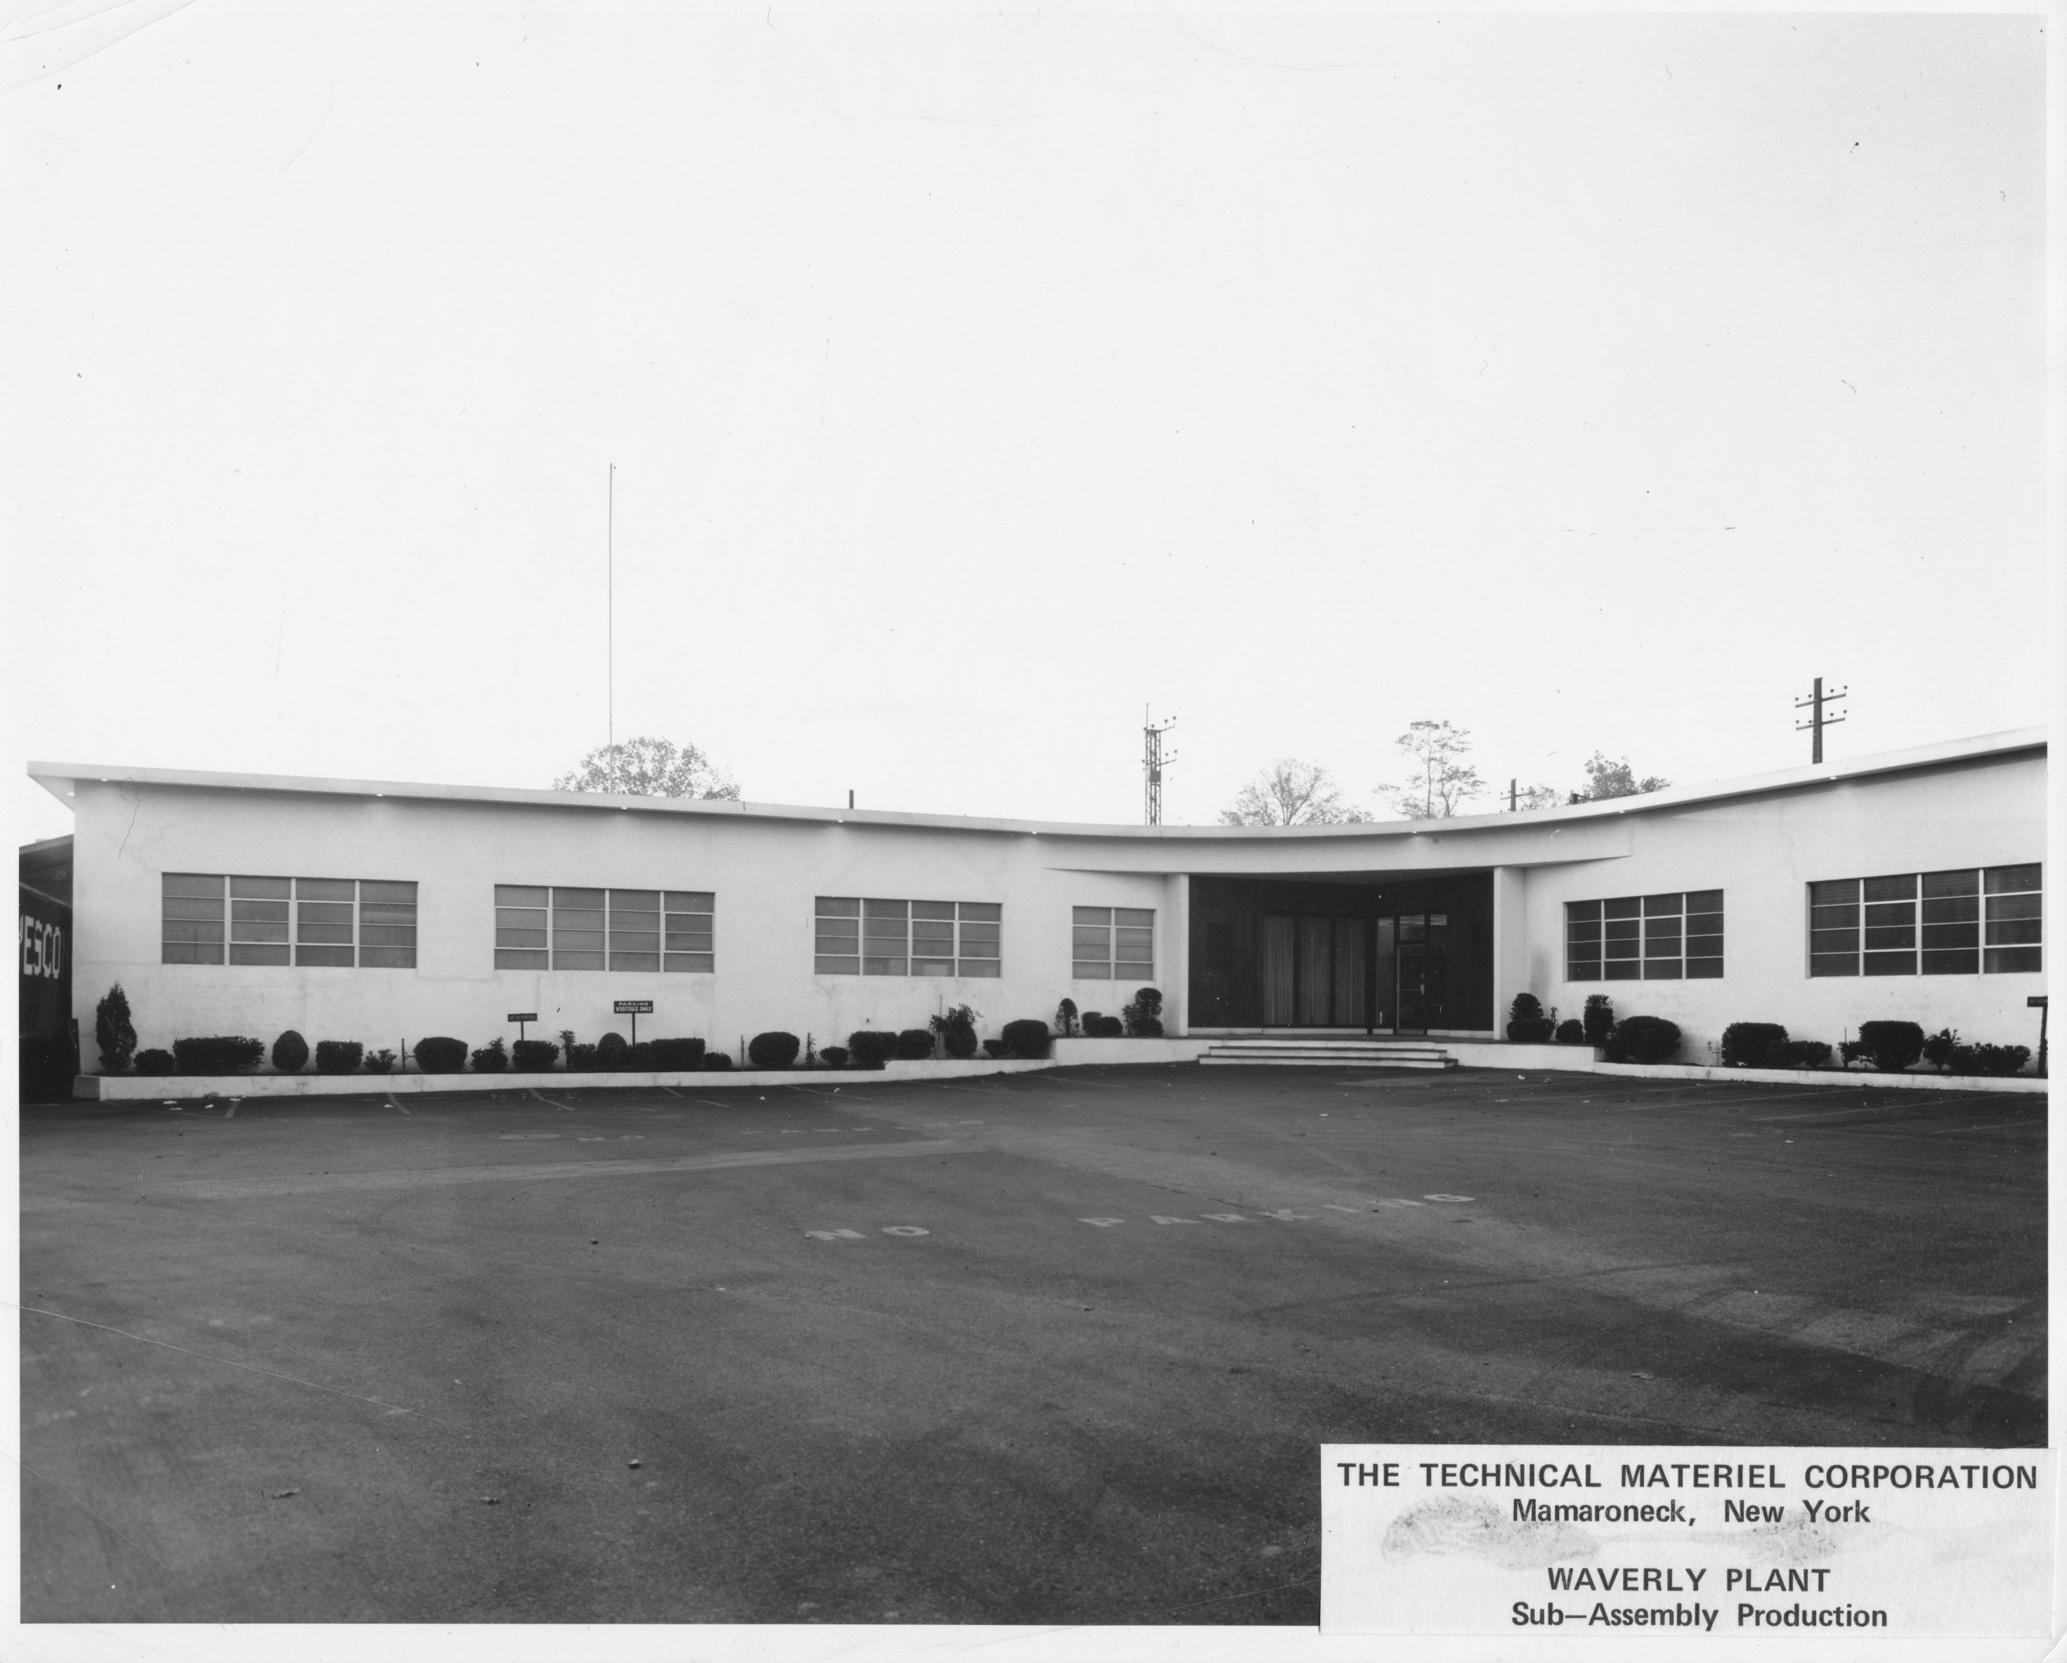
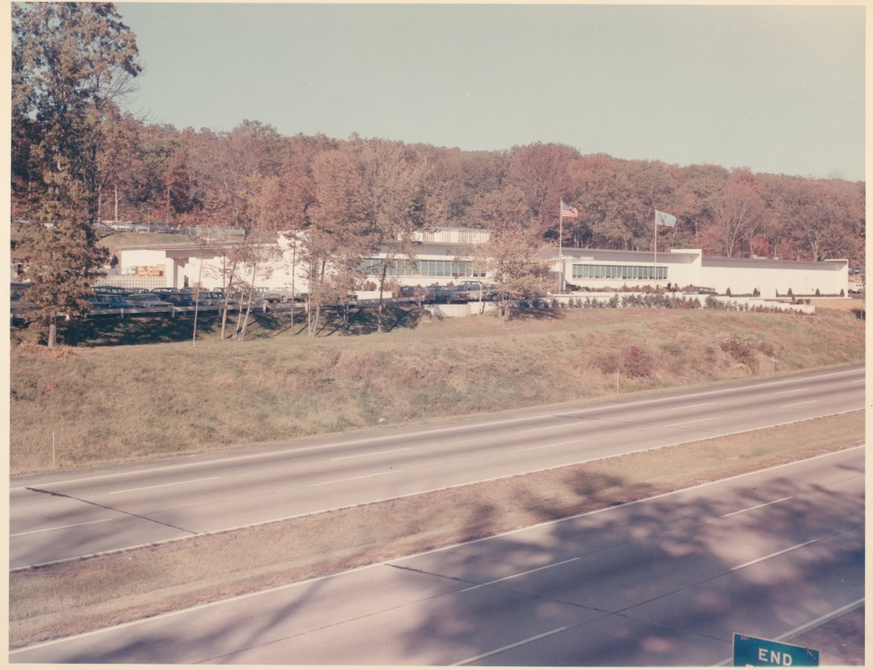
Plants..
West Nyack Plant (Transmitters) 1961
Waverly Ave Plant (Mamaroneck—Receivers and Systems) 1960

Slide 19
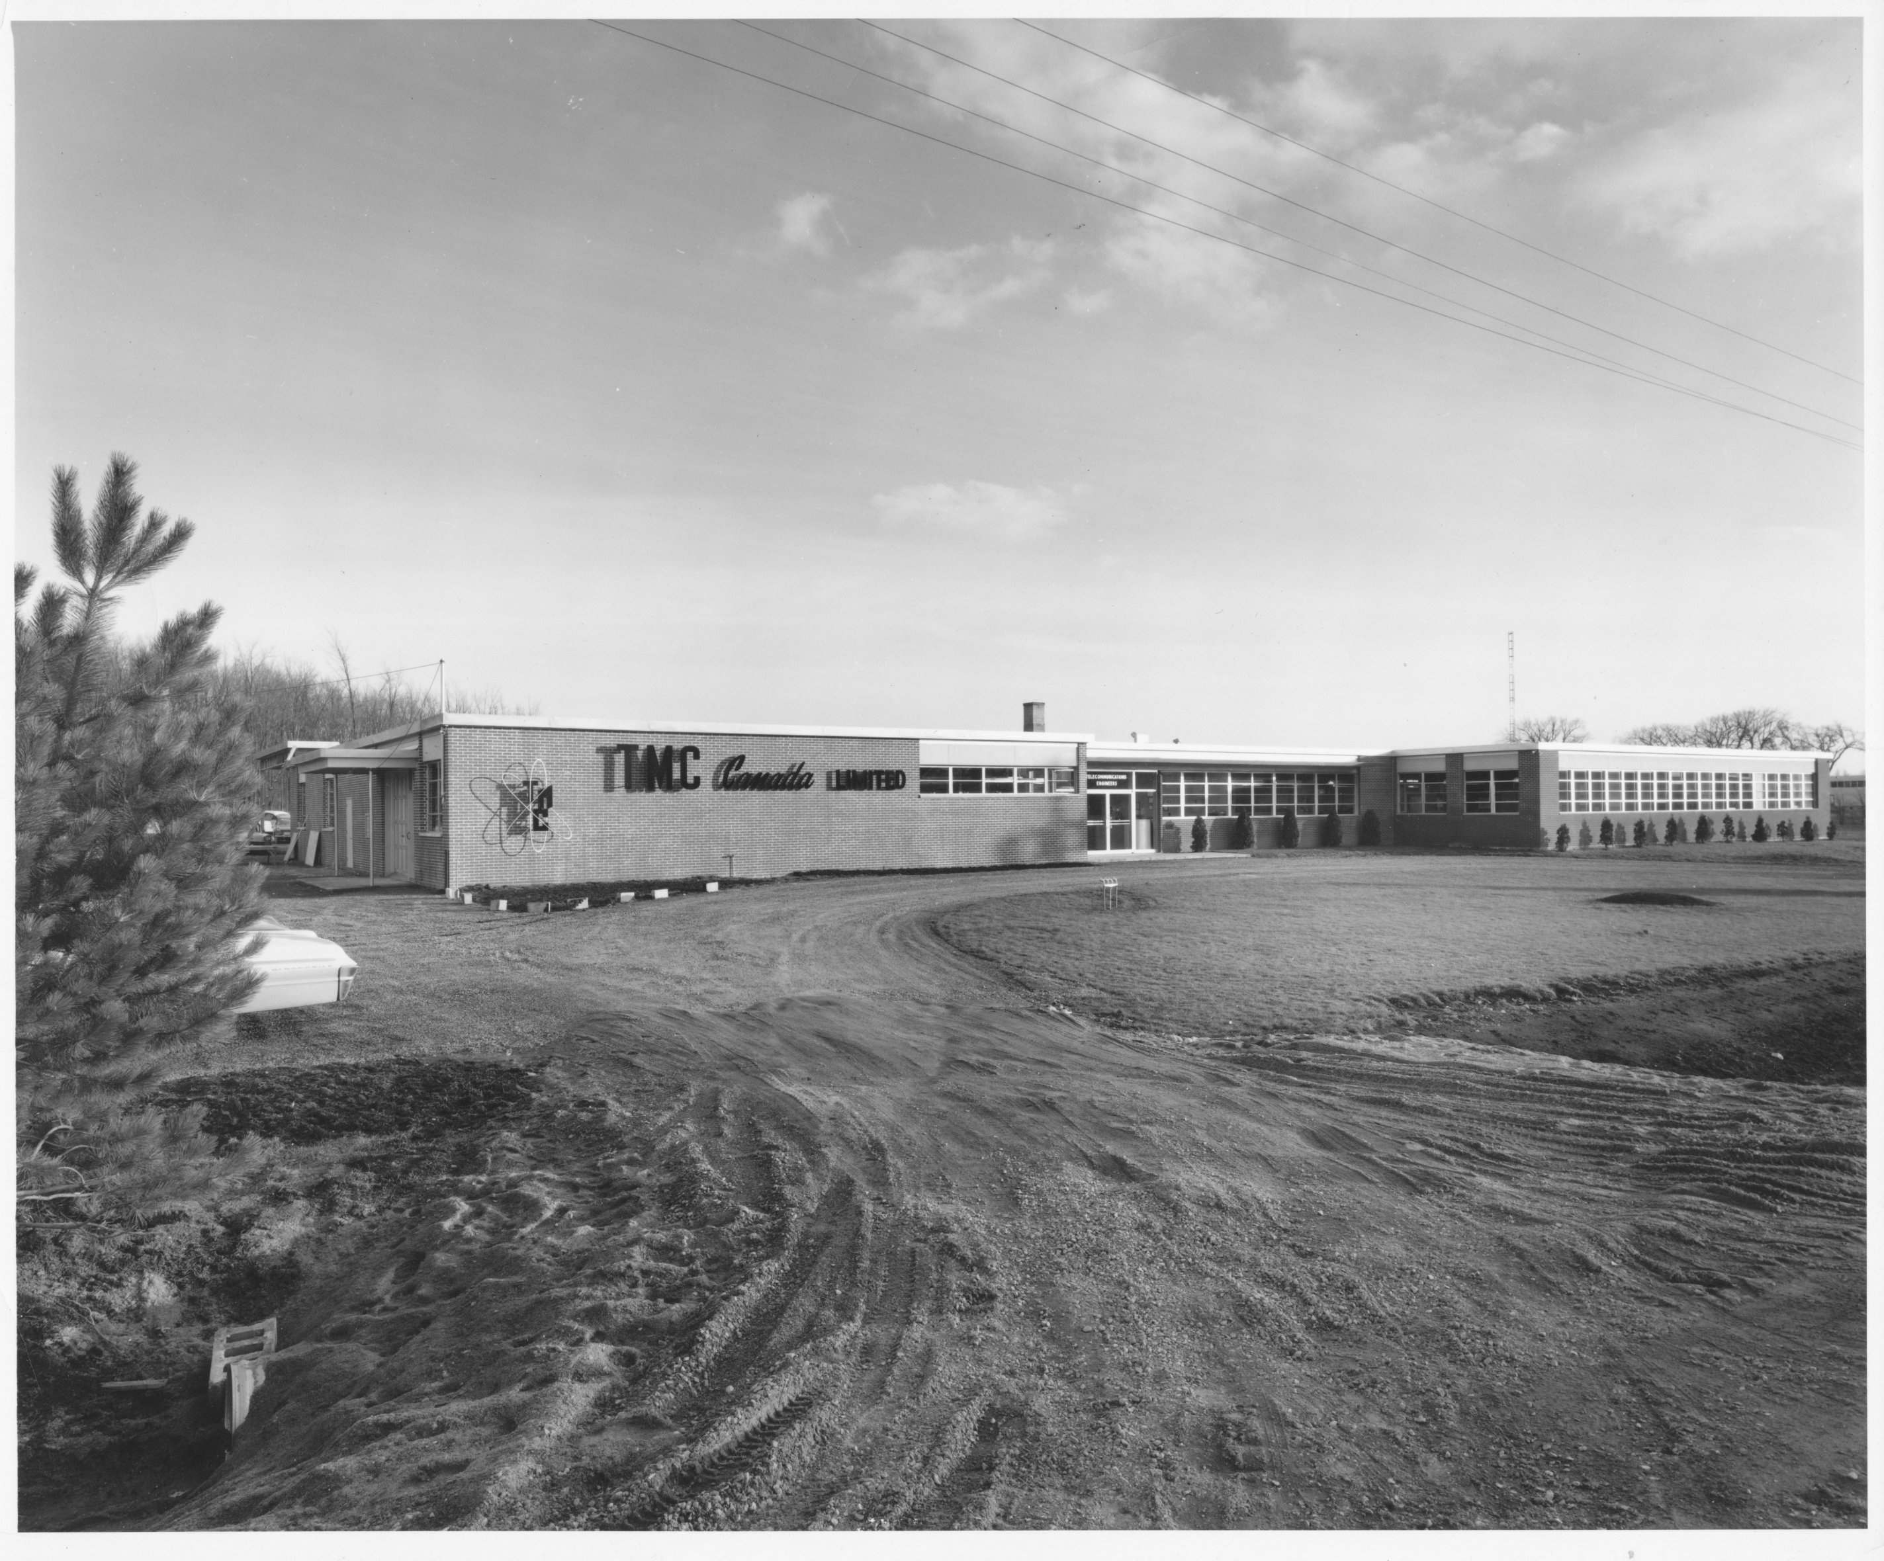
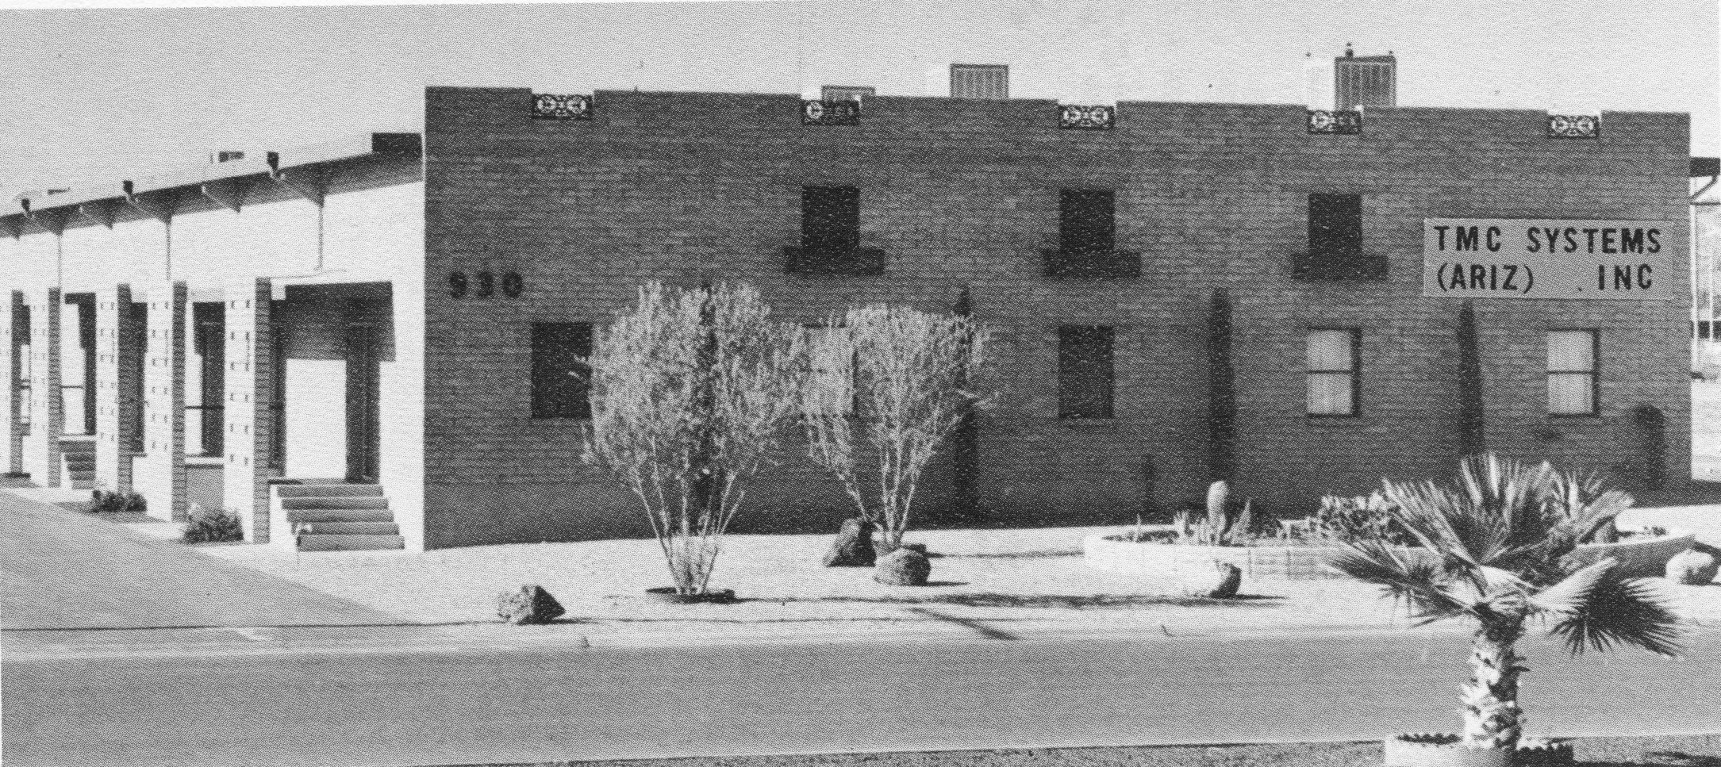
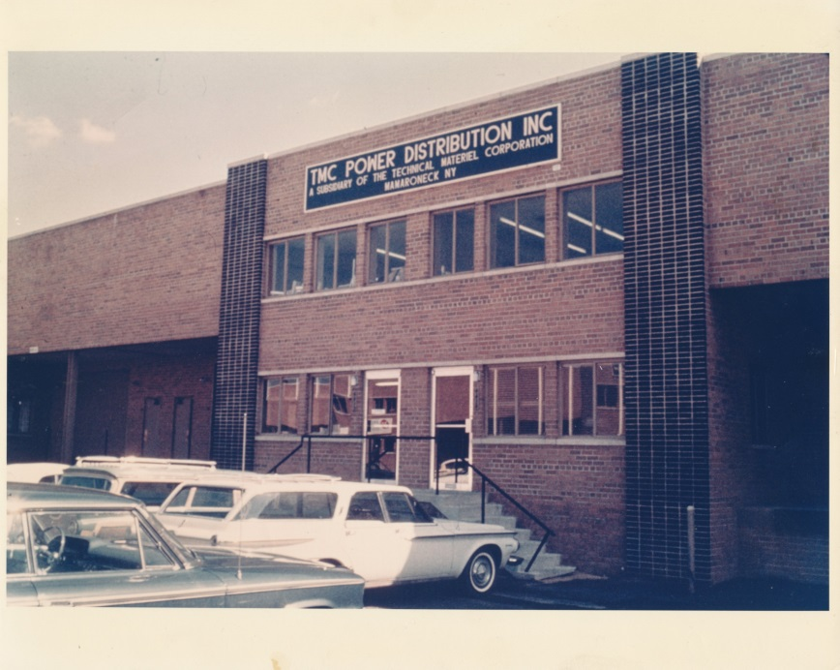
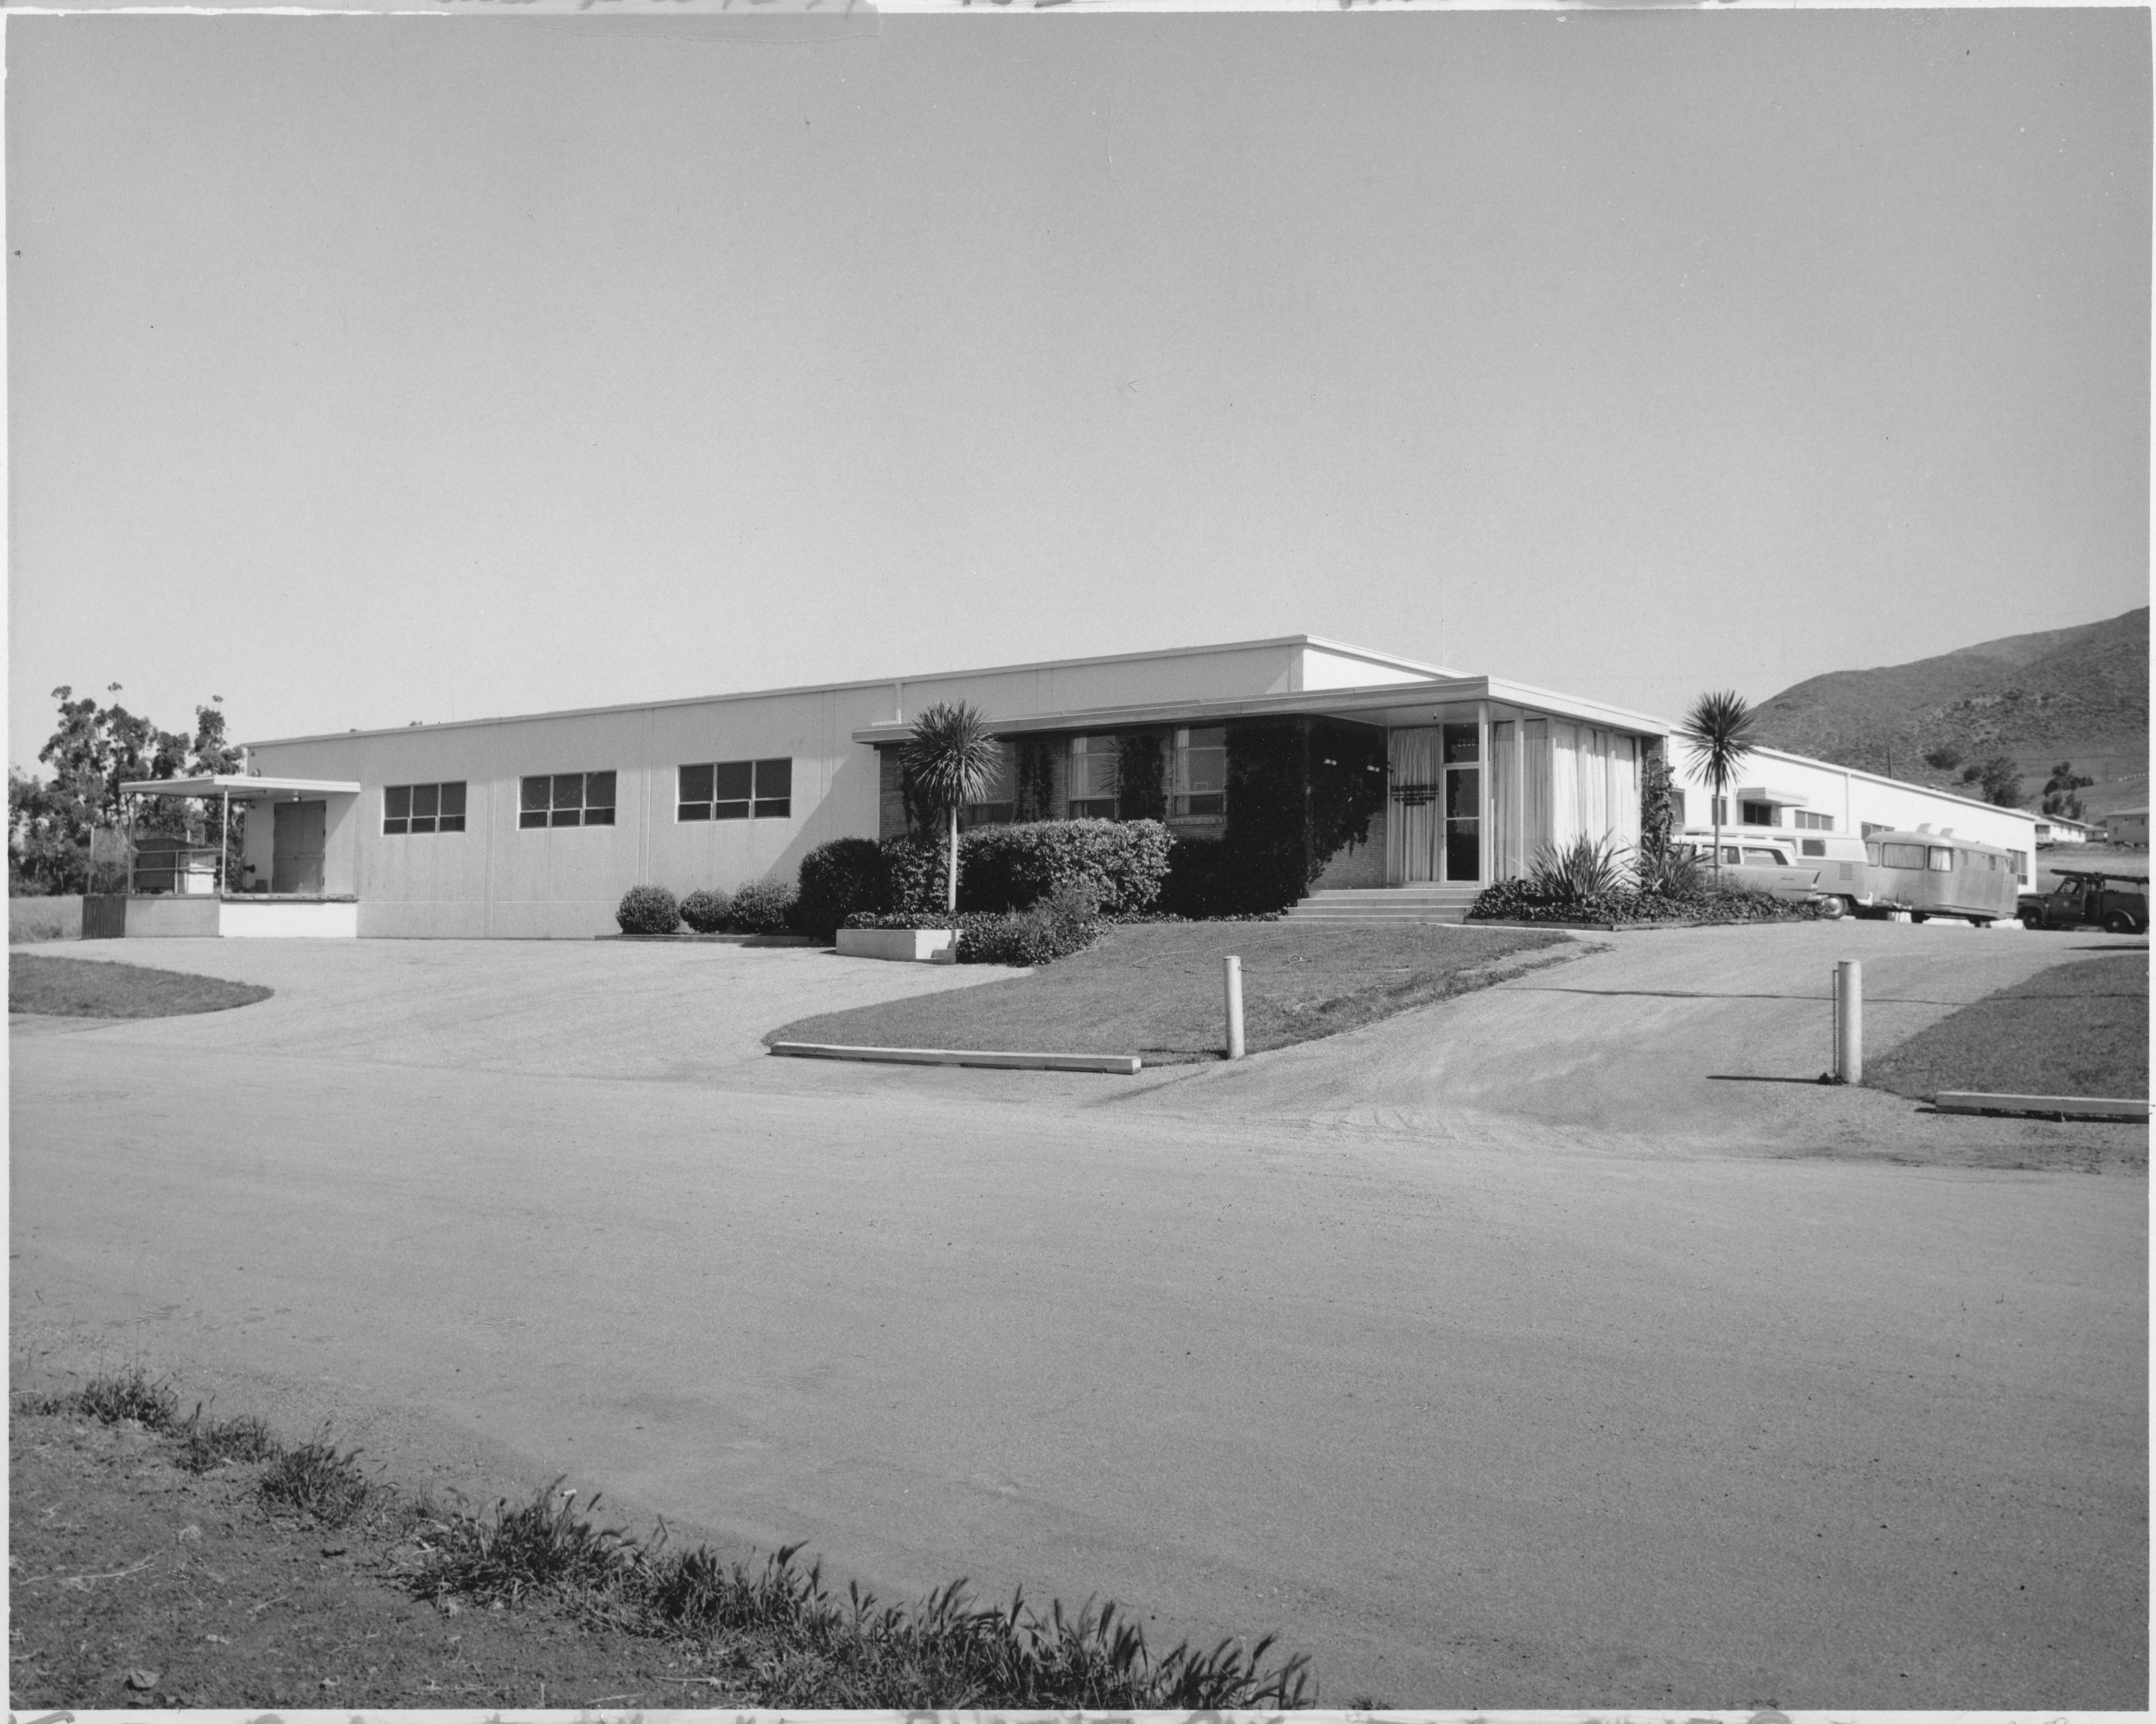
..and Remote Sites
TMC Systems--Arizona
TMC Canada
TMC Power Systems – Alexandria VA
TMC Research--California

Slide 20
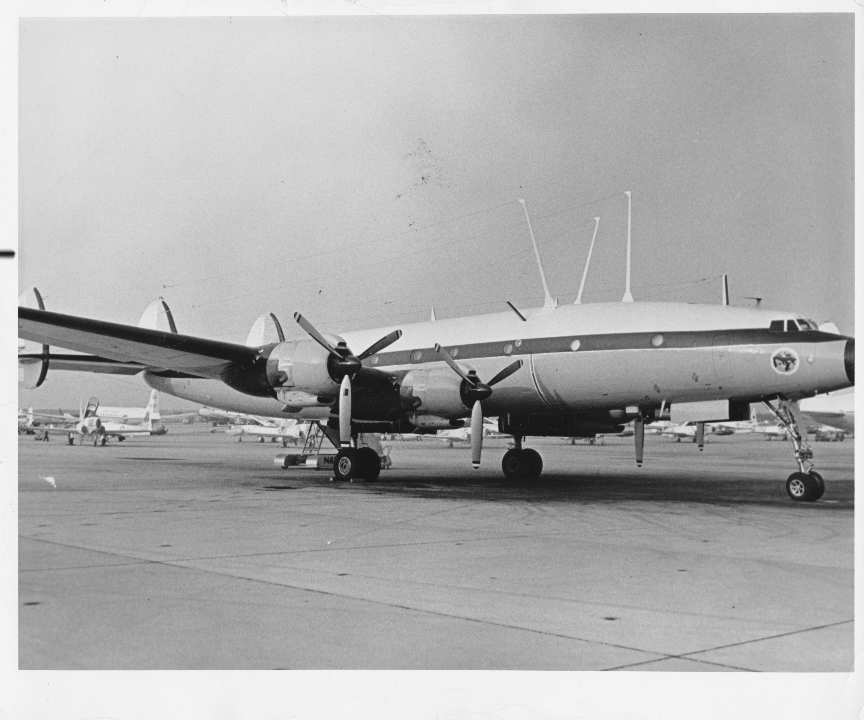
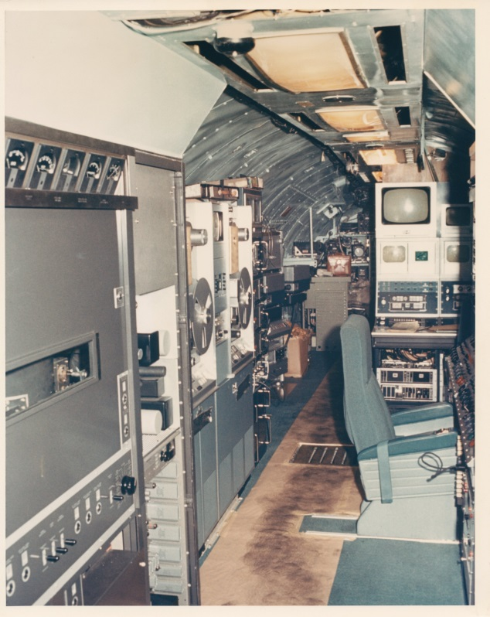
Special Projects: “Jenny”
Blue Eagle I (“Radio” aircraft)
Interior of “TV” aircraft showing RCA television equipment
TMC prime contractor to build flying broadcast stations for TV and Radio
4 aircraft deployed to Vietnam and bravely operated by Blue Eagle Squadron
First airborne TV broadcast of World Series game
See the tmchistory.org website for more info!

Slide 21
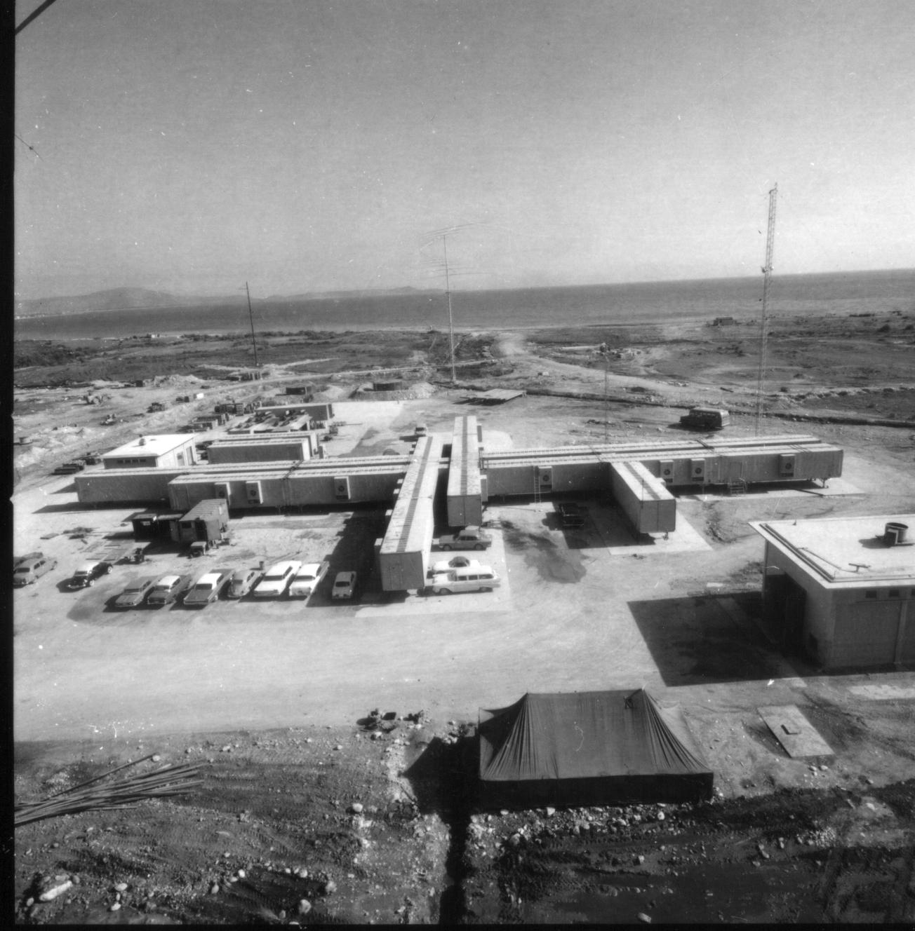
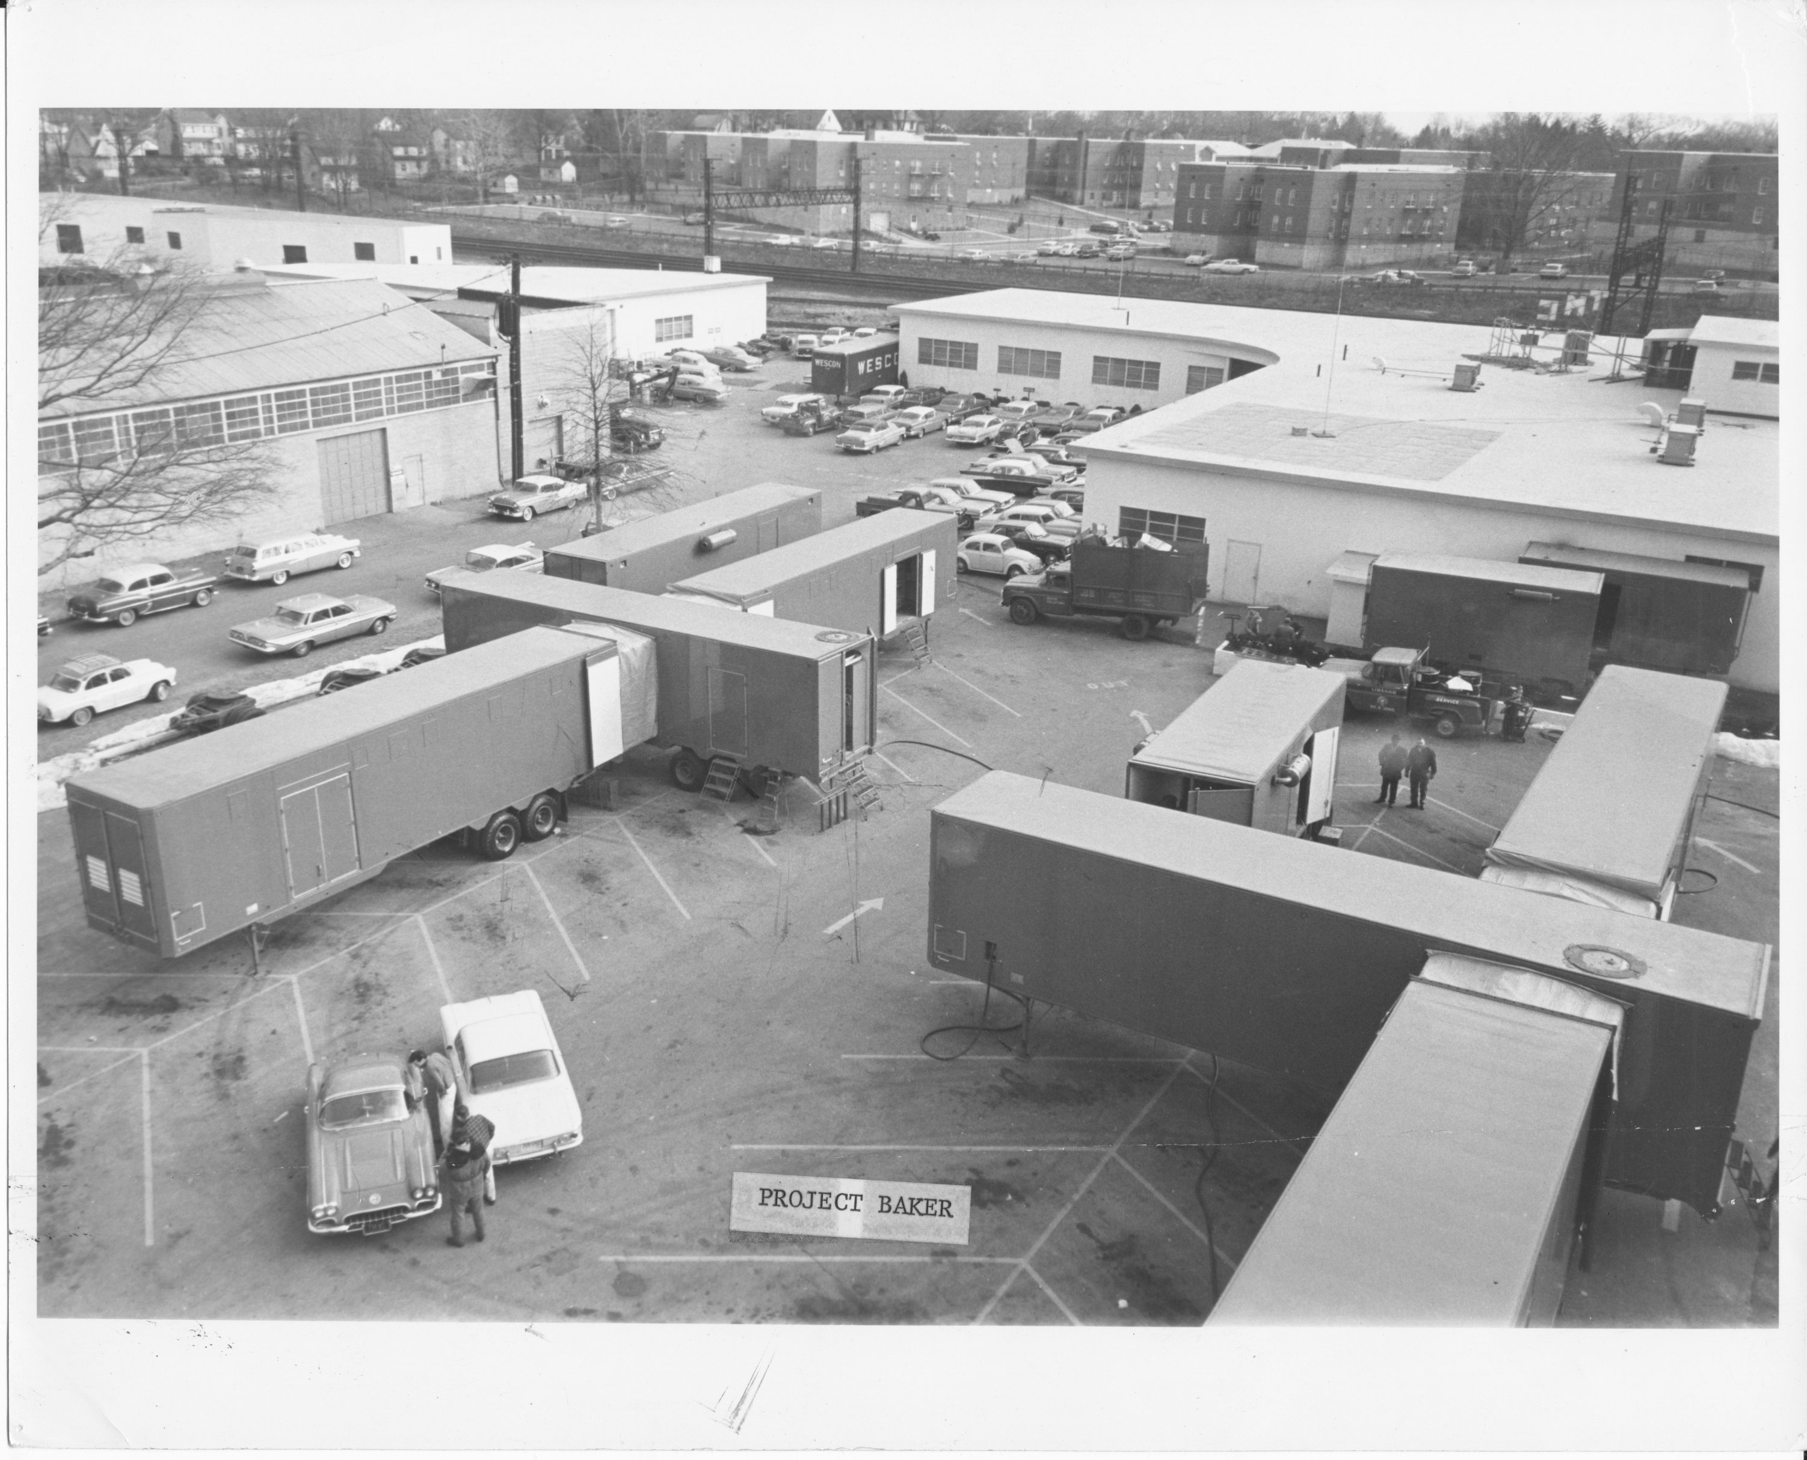
Special Projects: Portable Systems
Project “Baker” (AN//MSC-42) under construction at Waverly Plant
1961-62
TSC-35 Receiver site, Nea Makri Greece
(Project “Judy” 1963)
Visit: navy-radio.com/commsta-judy.html

Slide 22
New Themes
Beginning in mid 1950’s, US Navy needed…
Remote Control
Put receivers far from noise sources
Put transmitters far from receivers
More precise frequency control
Support ever-narrower-band RTTY communications
TMC innovator in both areas
FRR-502 remotely controllable in mid-50’s
“Technimatic” digital remote control--1960
First synthesized SSB exciter introduced 1958
Synthesizer-controlled DDR-5 receiver 1962

Slide 23
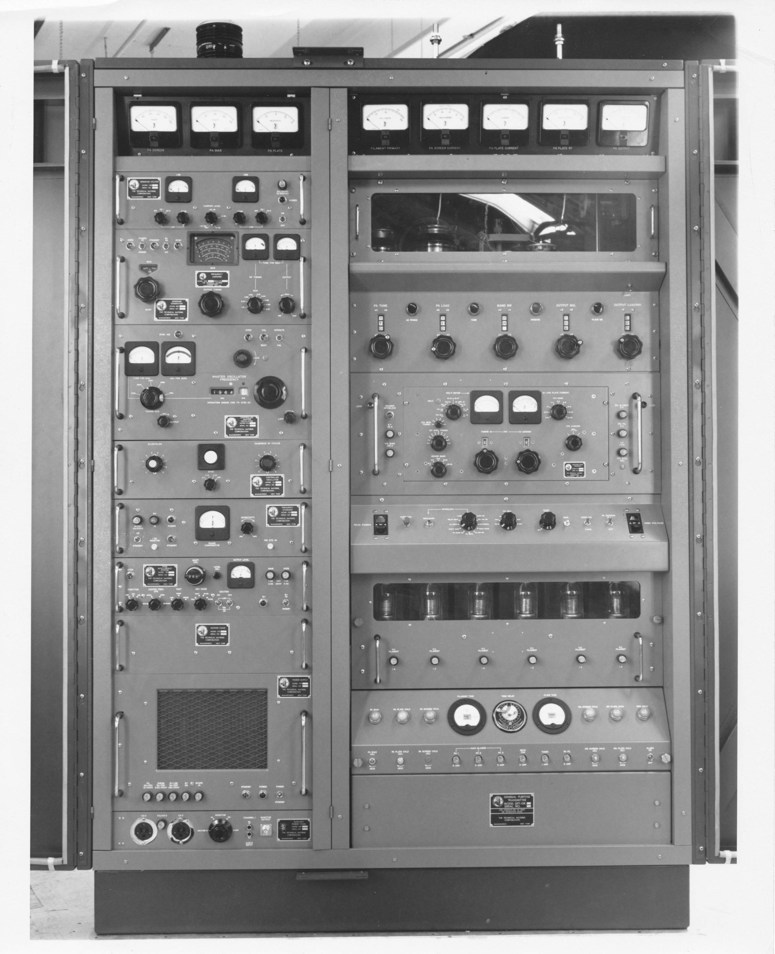
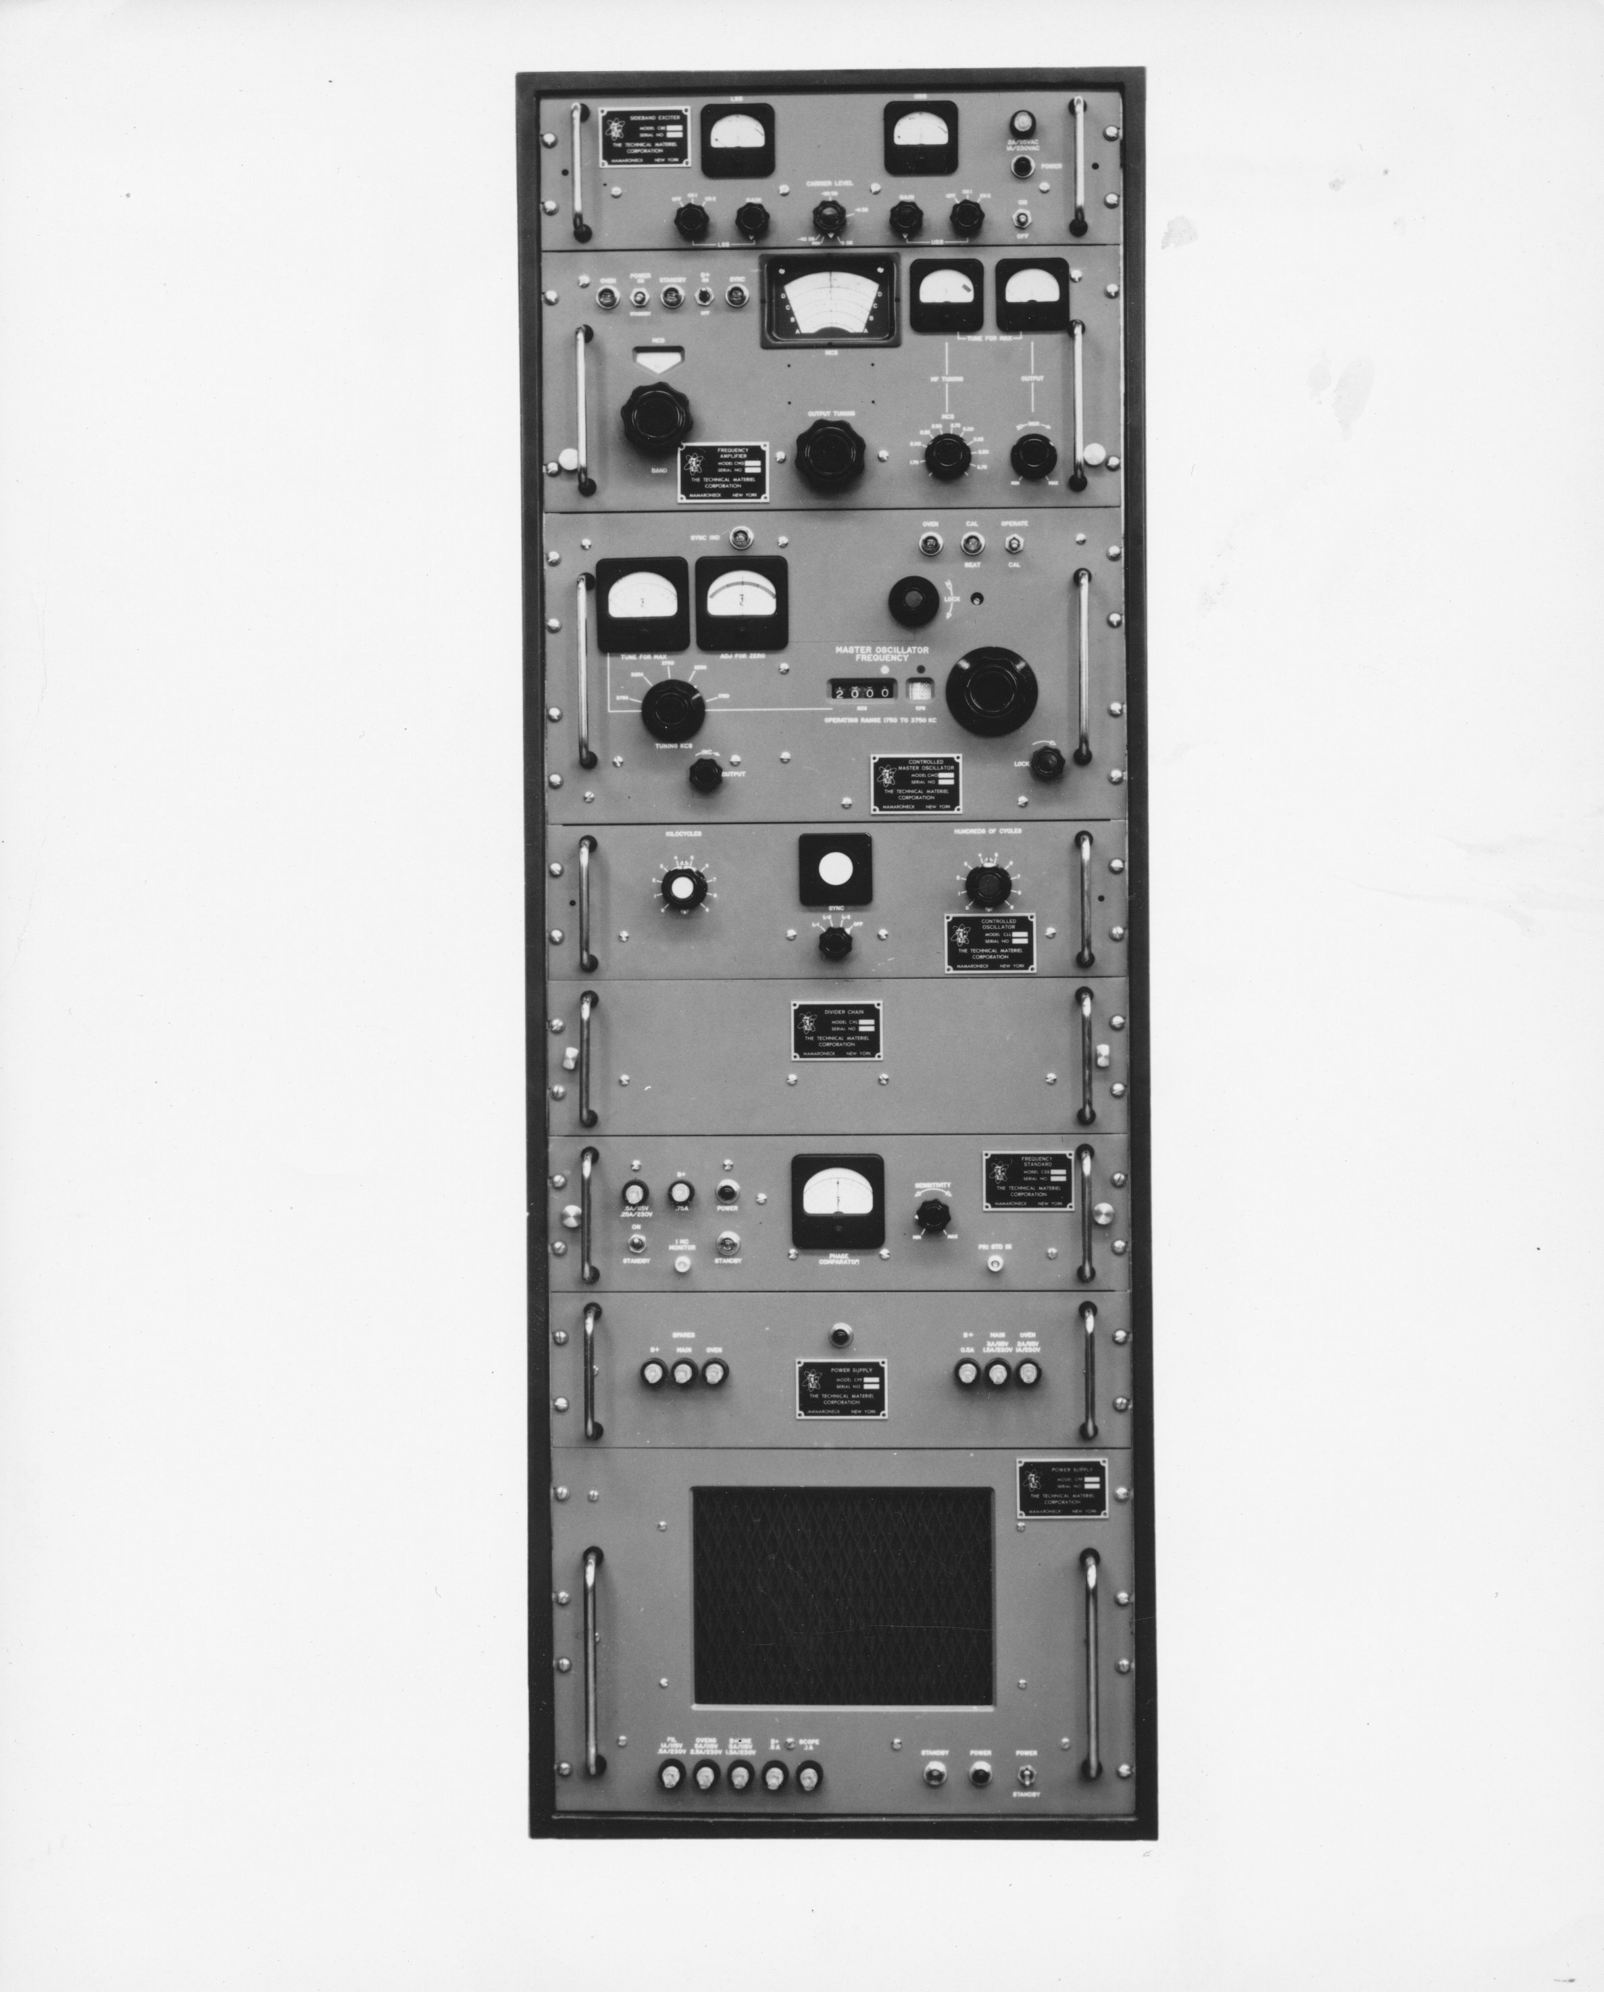
Synthesized Transmitters
SBG Synthesized SSB Exciter
Introduced 1958
..and synthesized 10KW GPT-10K

Slide 24
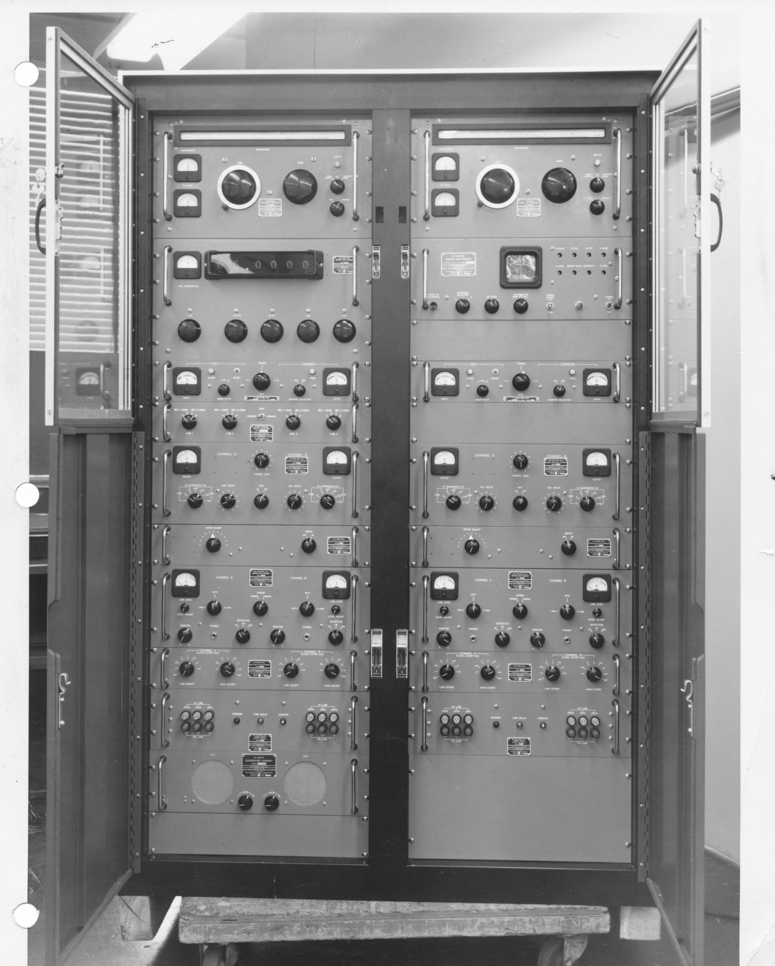
Synthesized Receivers
DDR-5 Receiver Family
Dozens of variations providing
Diversity
Multiple Independent Sideband Rx
Remote control

Slide 25
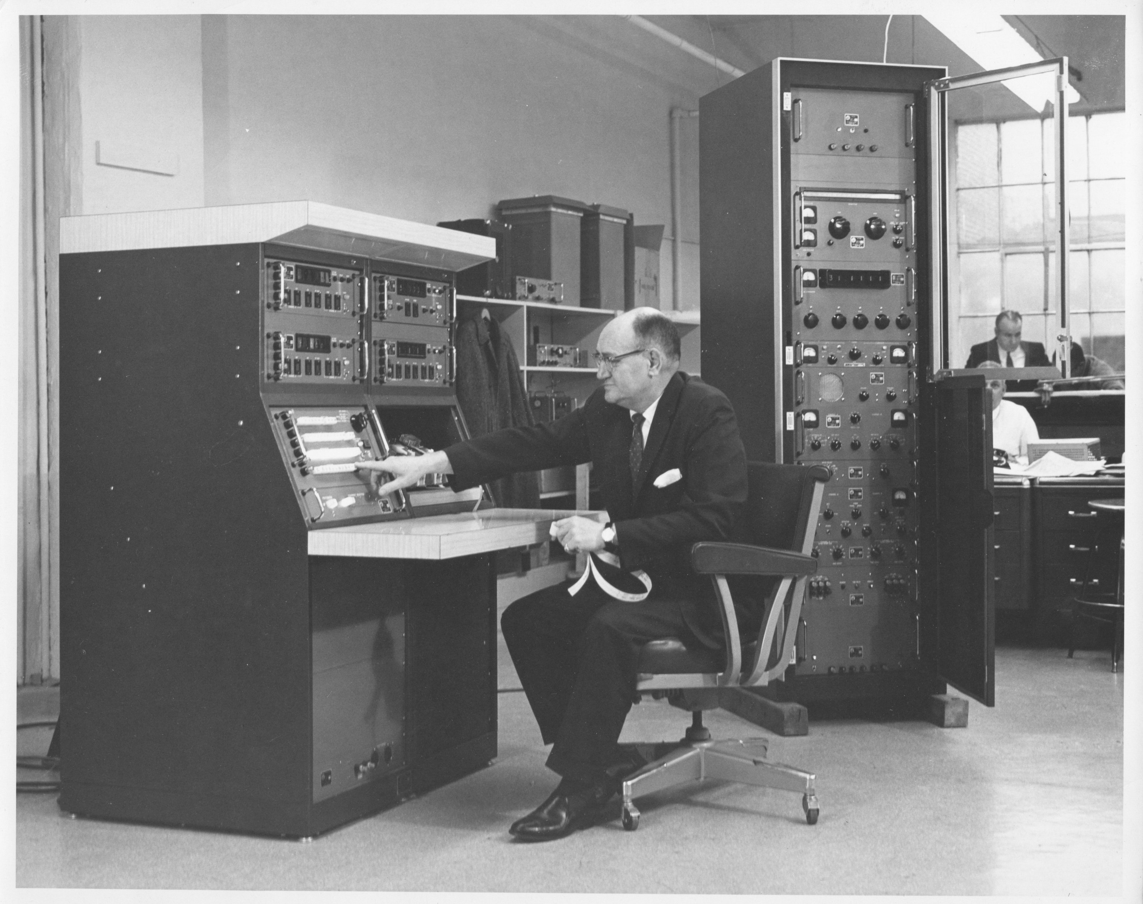
Remote Control
Remote Receiver
Control Console
TTY interface between control and remote unit, manual or paper tape operation

Slide 26
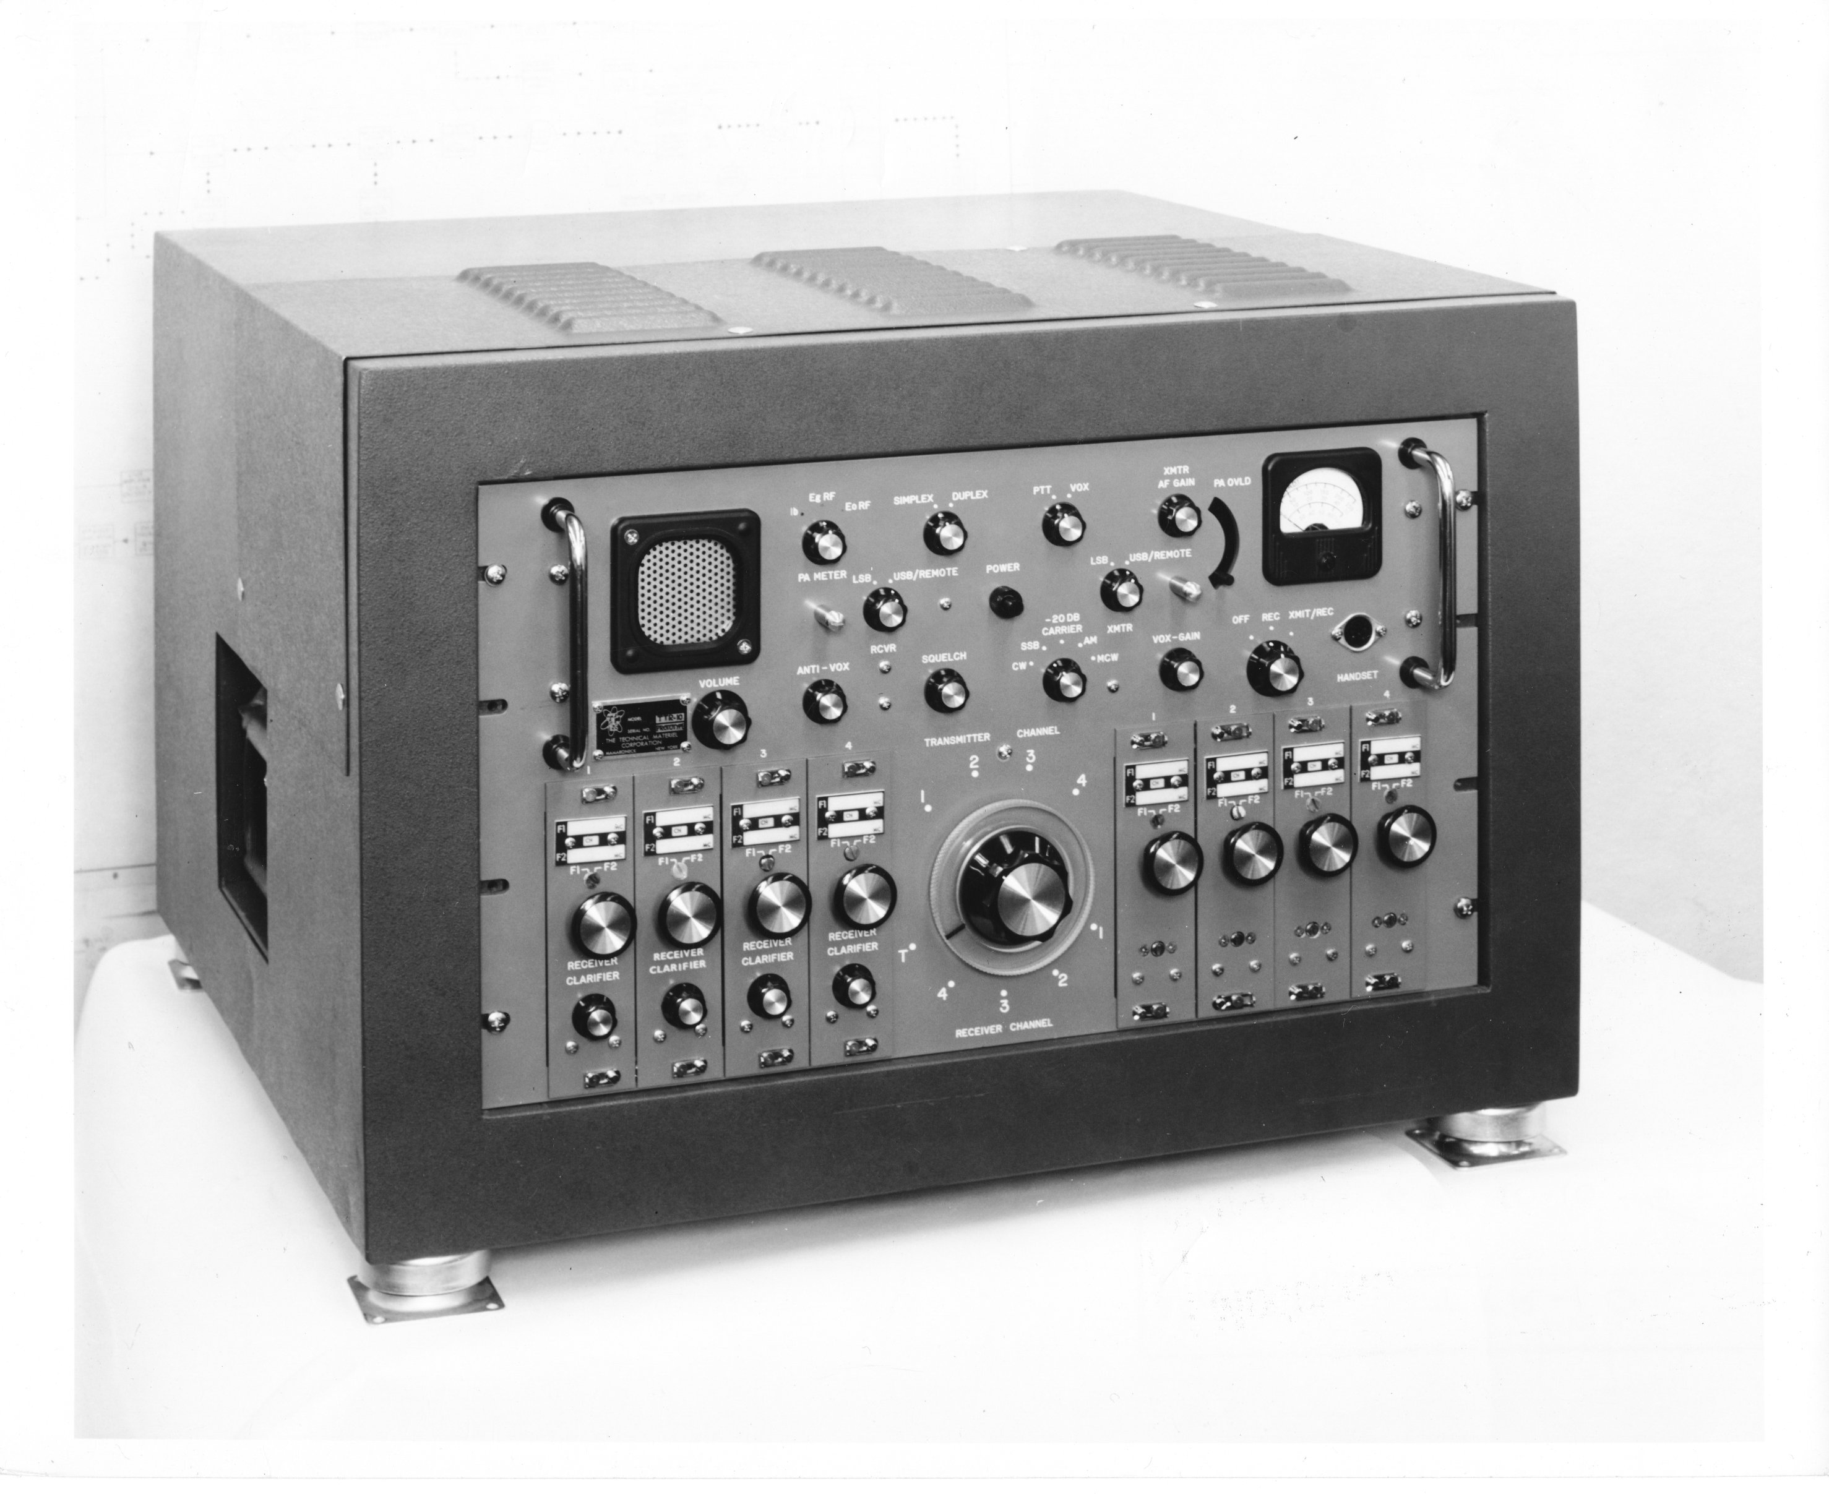
TMC Goes Solid State
Transition to solid-state difficult
Mamaroneck design team firmly stuck in tube era
Early designs done by TMC Research (California, then Arizona)
Research prototypes developed into products at Mamaroneck Plant
TTR-10 Transceiver introduced in 1963
Not a huge success…
TTR-10 Transceiver

Slide 27
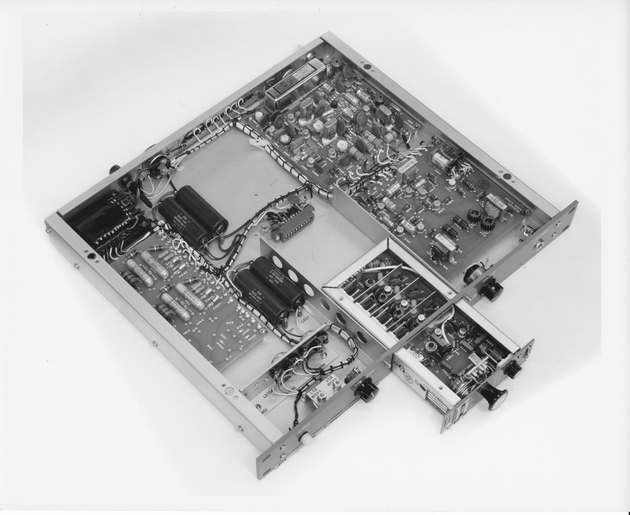
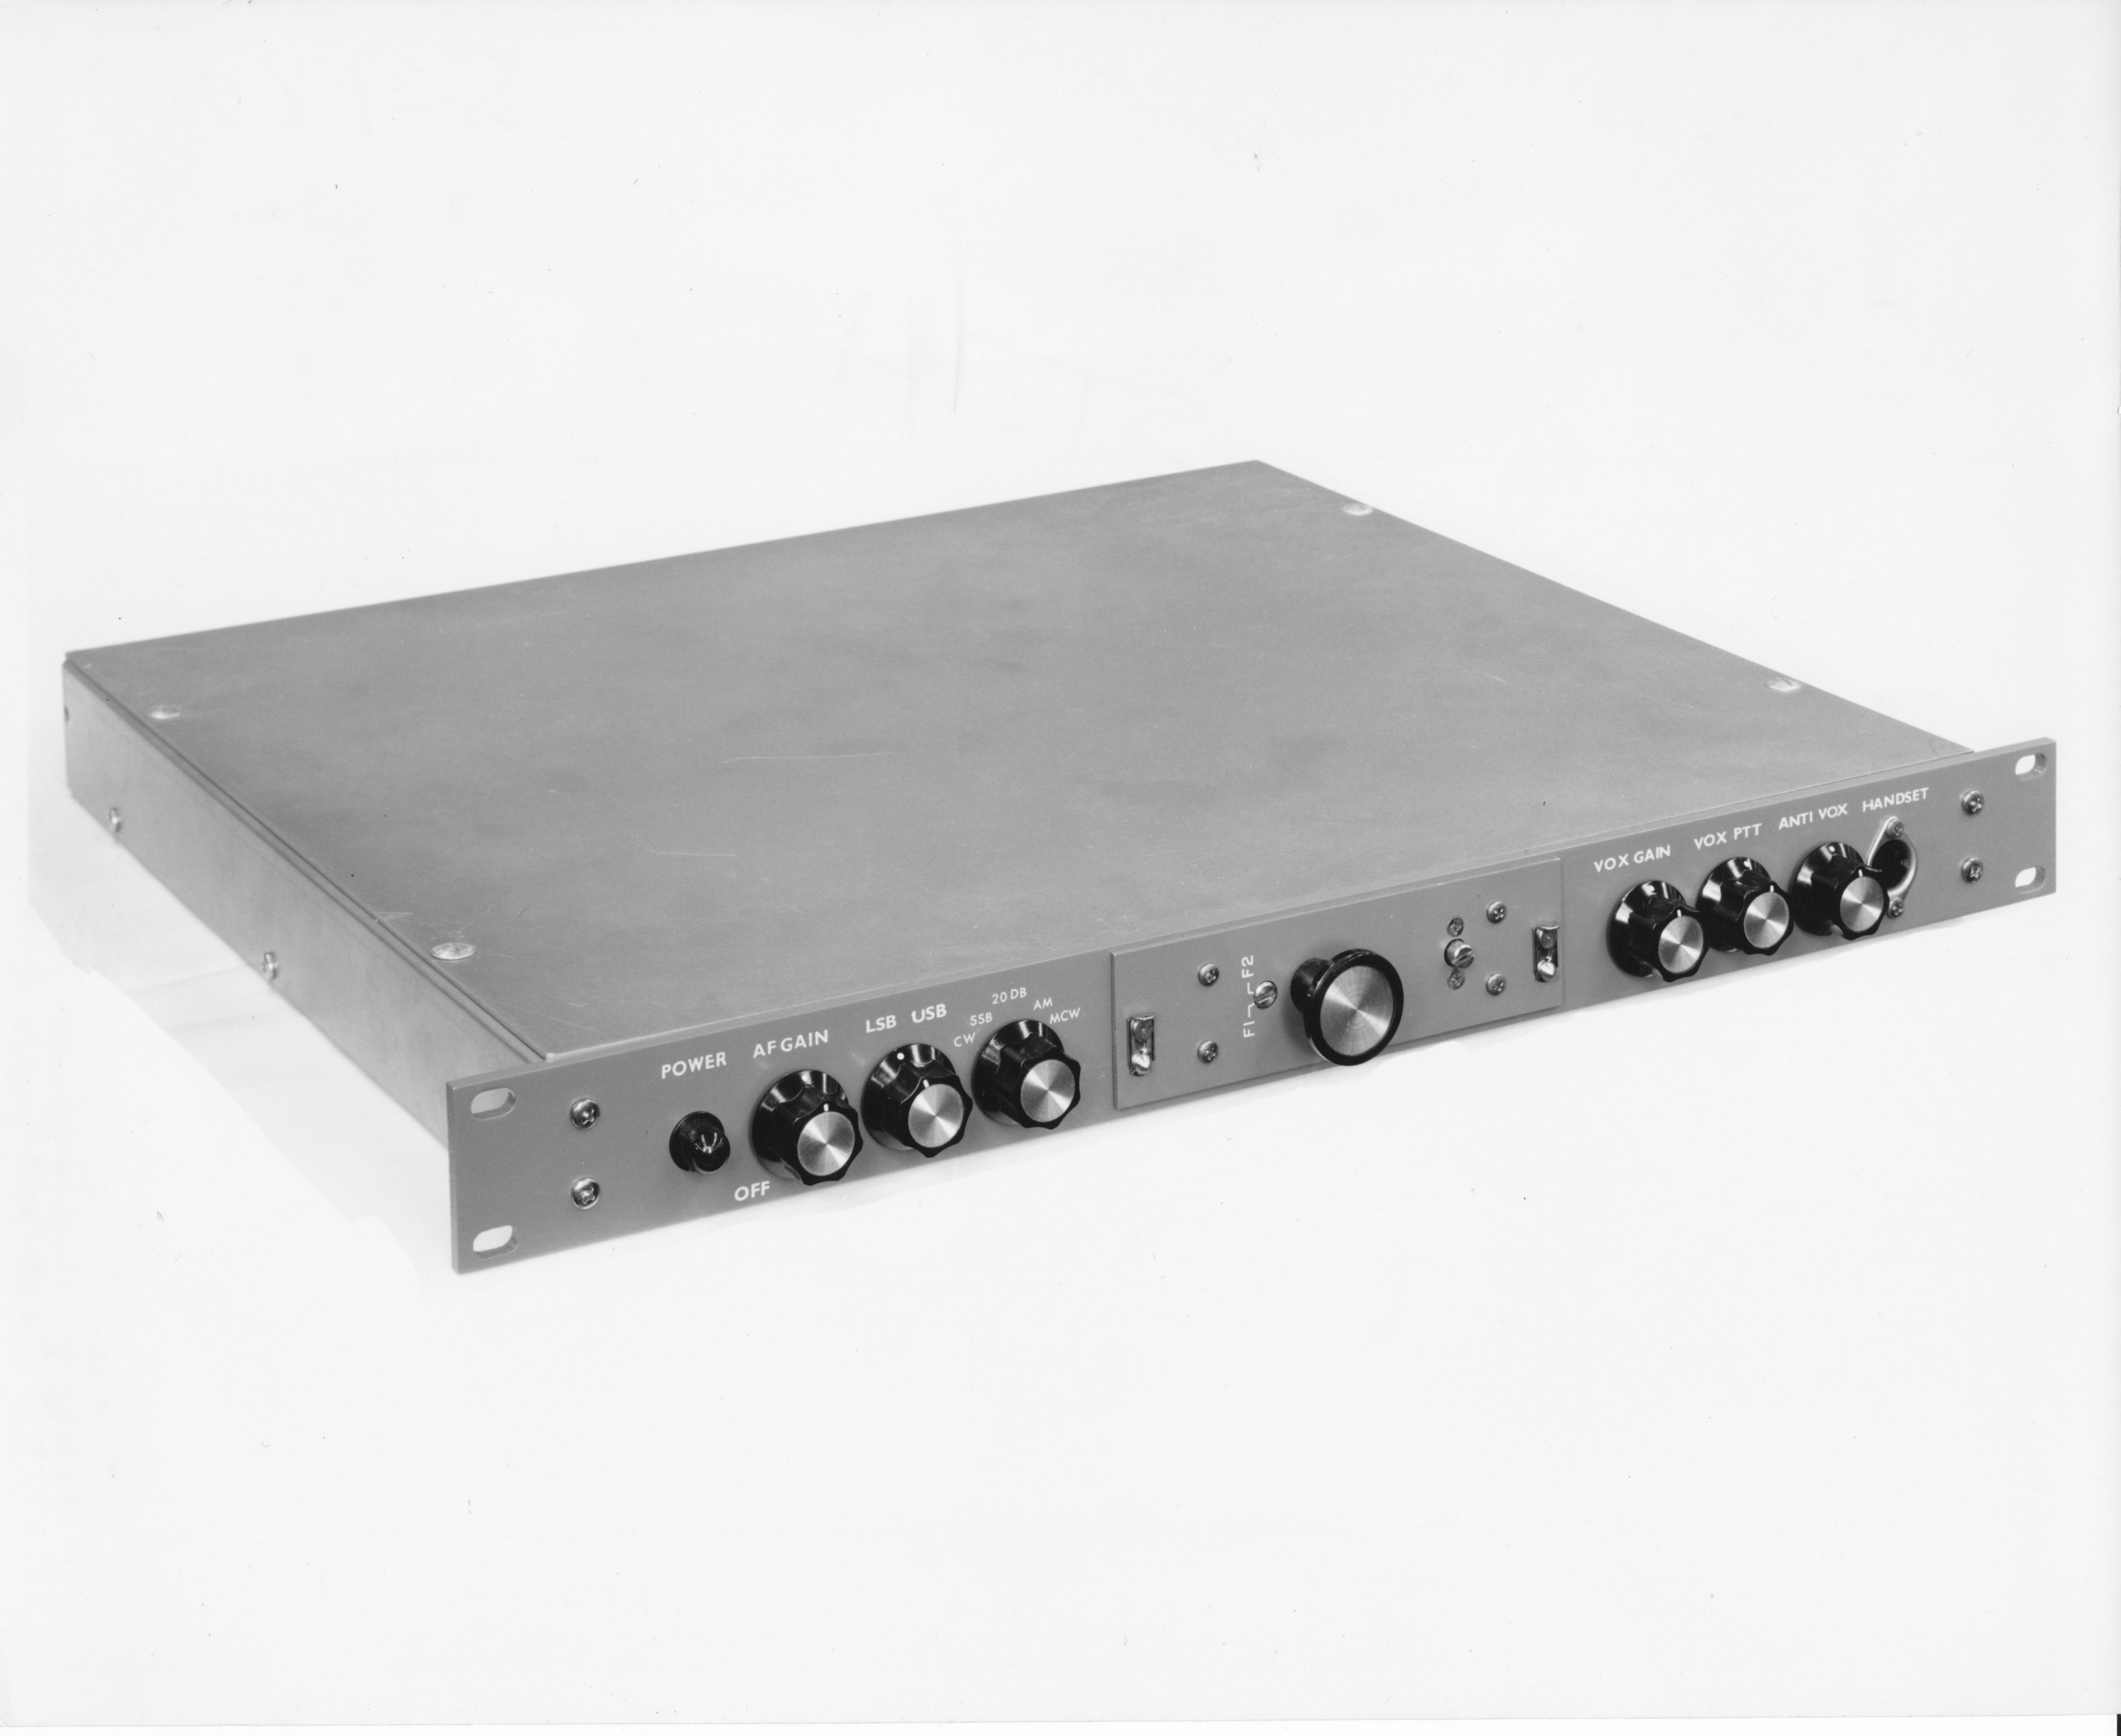
Solid-State…
STR “Strip” Receiver
STE “Strip” Exciter
TTR modules repackaged into 1U “strip” units in 1964 by Alan Duddles
Sold very well; hundreds used at airports all over Canada
Made a tidy, small radio package with PAL-350 and PAL-500 amps
Sometimes seen at hamfests..☺

Slide 28
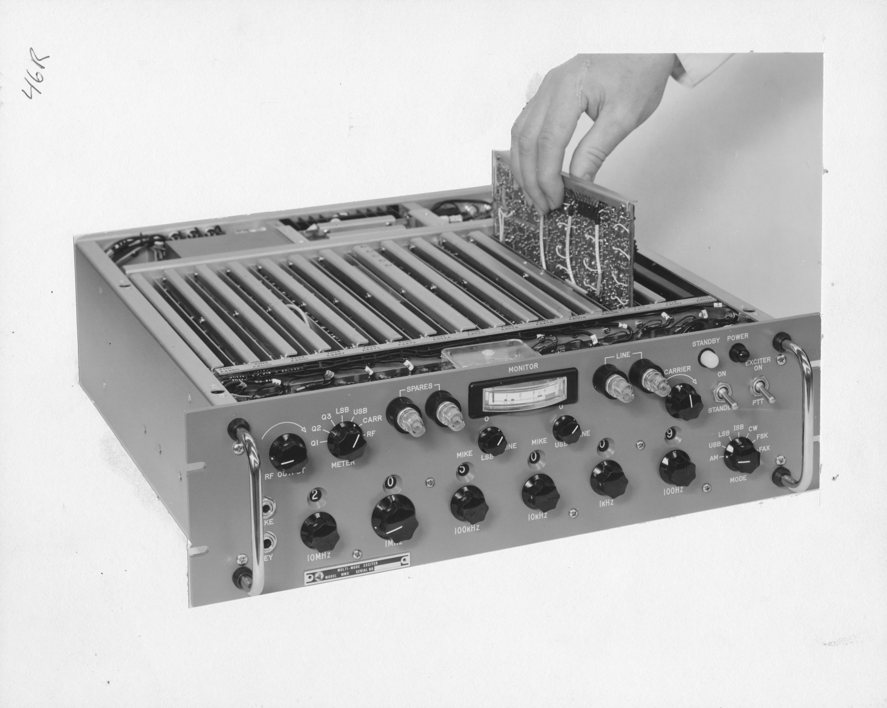
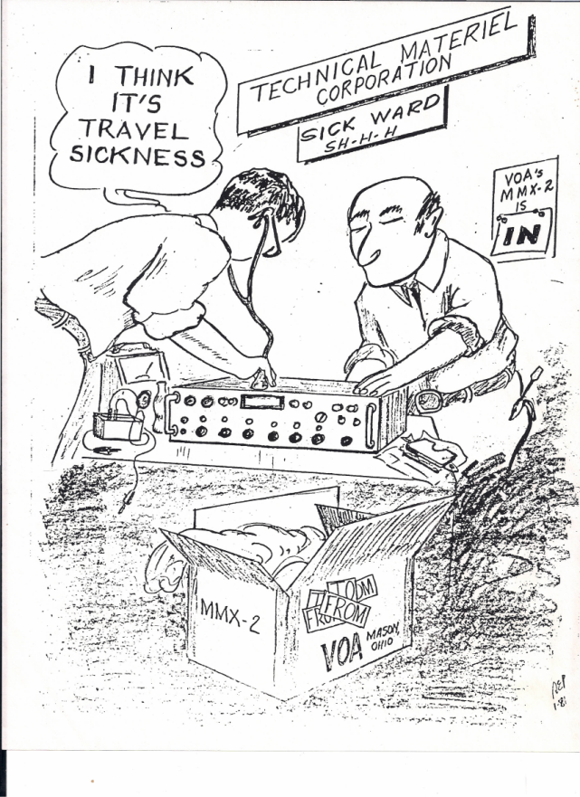
MMX Solid-State Exciter
TMC’s flagship exciter
Introduced in 1968
Remarkably small, versatile
Not terribly reliable..

Slide 29
TMC in Decline by late 60’s
60’s-70’s not kind to TMC
Navy moving away from HF communications..
..and winding down from the Vietnam war
No new customer found to take Navy’s place
Difficulty producing reliable solid-state gear
Loss of TMC Research design team
Contentious employee strike in mid-70’s
Many attempts to enter new markets—none successful

Slide 30
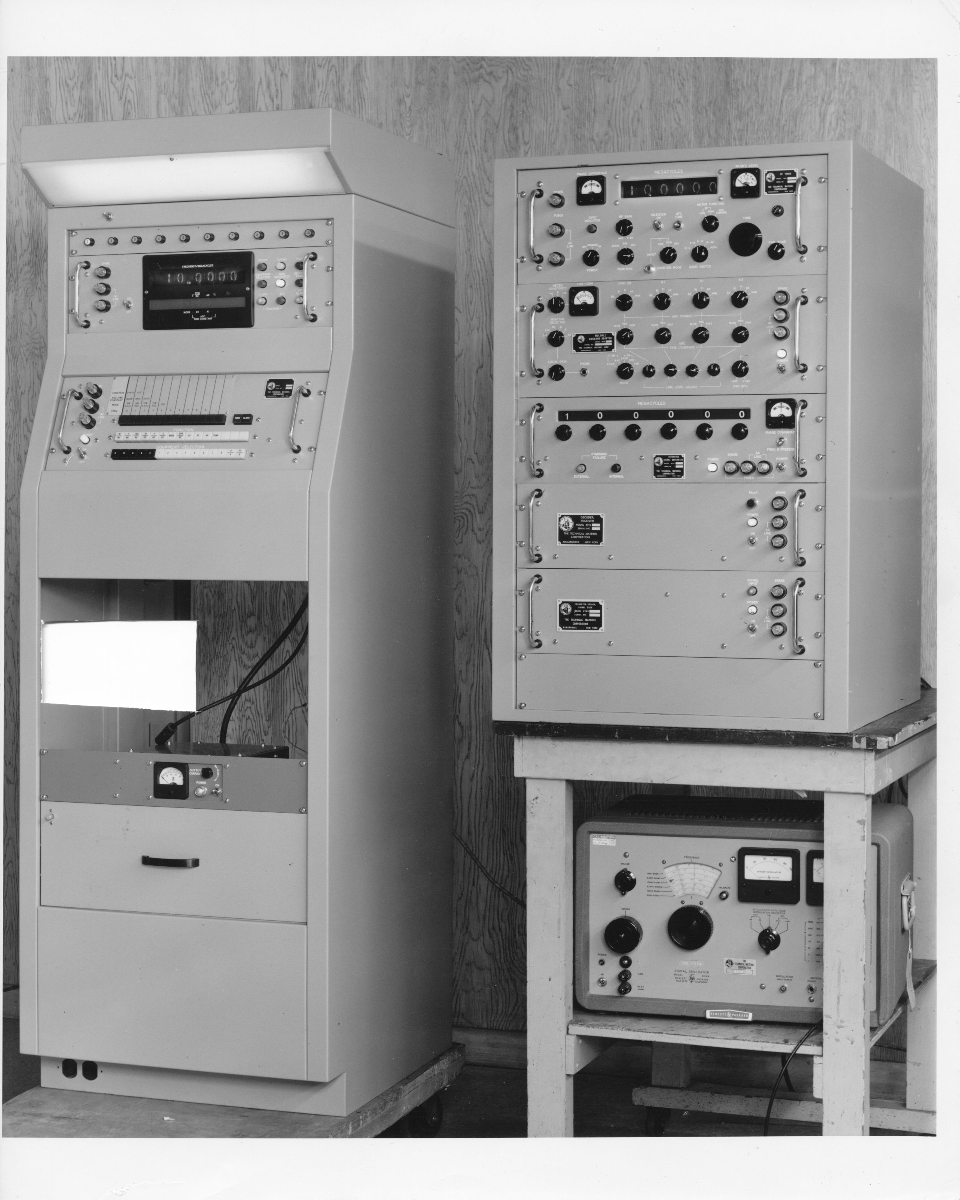
DDR-10 Debacle
Response to ambitious Navy RFP
..to replace aging DDR-5’s
Rx needed high stability, low noise, remote tuning
TMC developed at own expense
Development took nearly 4 years
..by which time receiver was obsolete
Navy only ordered few dozen units
Effort caused the loss of many $M’s
Amazingly, a number of DDR-10’s survive, mainly at K9WT’s QTH
DDR-10 Receiver with remote control console (left)

Slide 31
TMC hangs on into 1990’s
TMC delisted from NYSE in 1971
Business losses lead to writing off and closing remote sites by mid 80’s
Temporary business refurbing GPT-10K’s for Navy in early 80’s
Company continued building antenna couplers and related products into 1990’s
Ray de Pasquale dies, Feb 1994
Son Neil de Pasquale takes over, closes company down

Slide 32
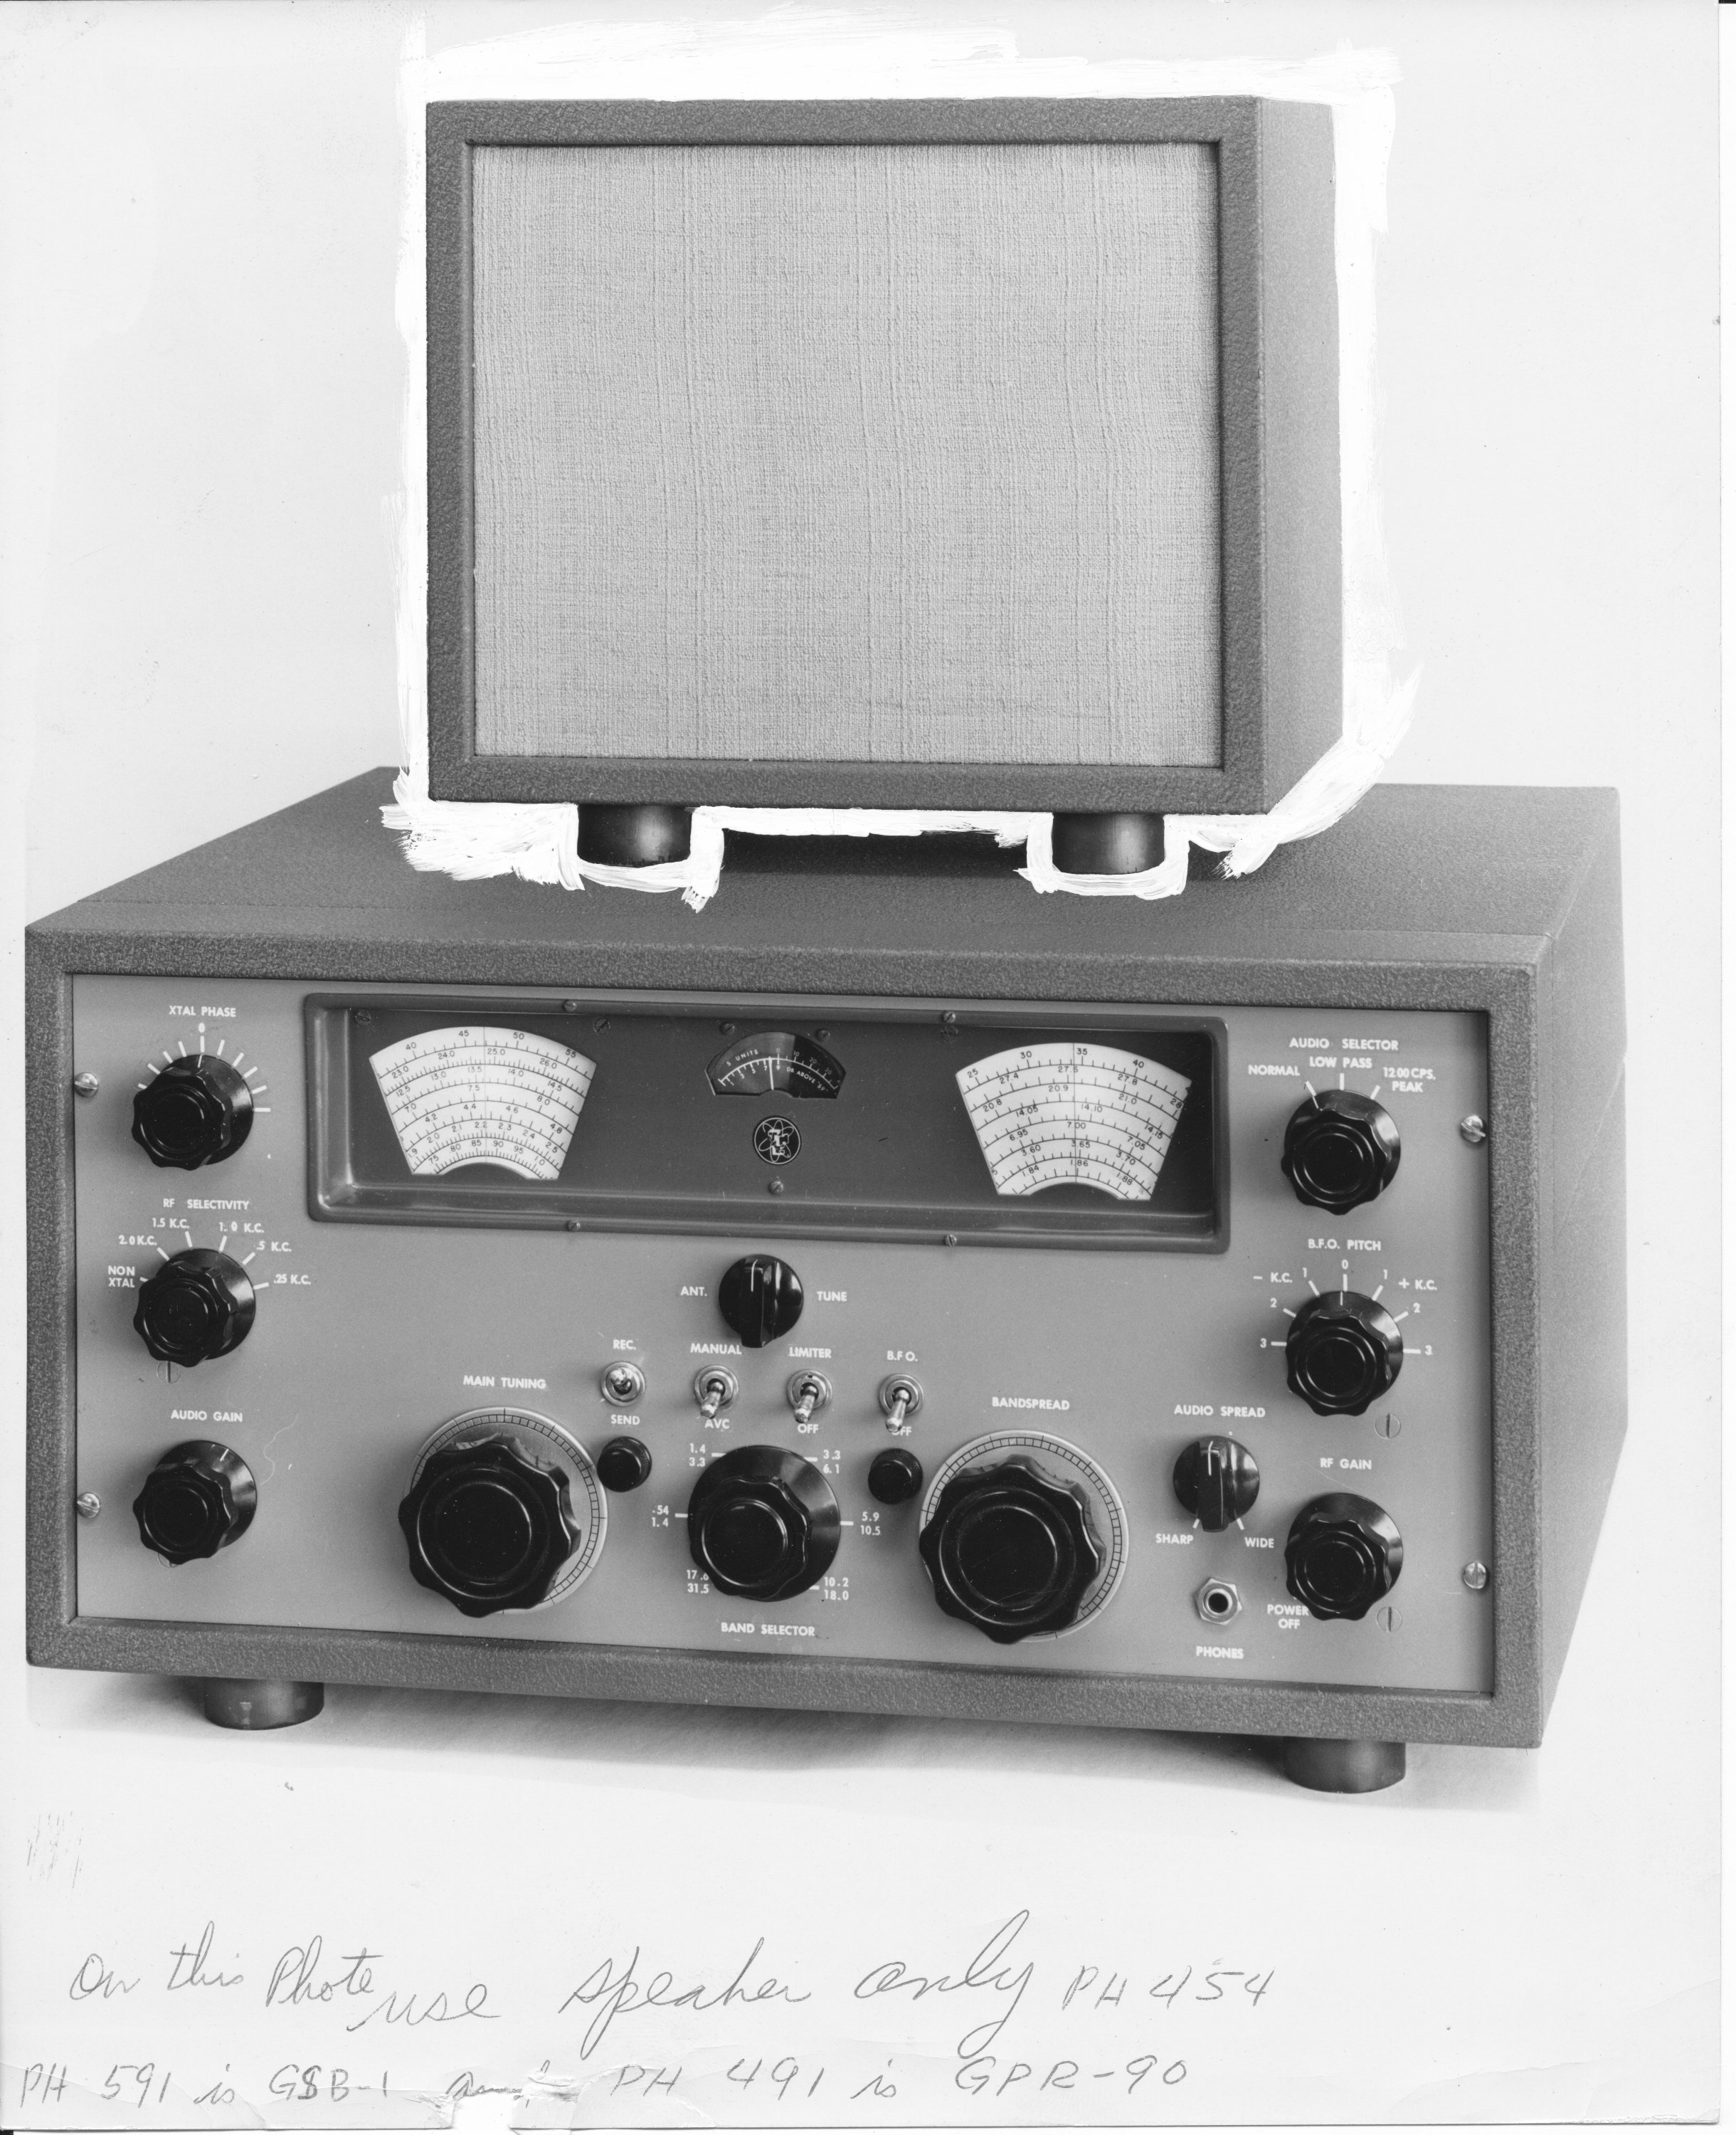
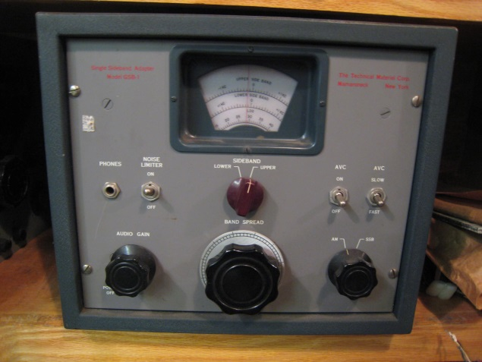
TMC Collecting
TMC gear easy to spot: gray paint; etched (sometimes screened) lettering; beautiful, formal, symmetric layout; top quality components.
Gear not easy to find, but it’s out there!
GPR-90 and companion GSB-1 sideband adapter most common items seen..
GSB-1 SB Adapter
GPR-90 with speaker

Slide 33
Collectible Receivers
GPR-90RX, GPR-90RXD, GPR-91
Very scarce, highly collectible GPR-92

Slide 34
TMC SSB Adapters
MSR Series Sideband Adapters
EXCELLENT performers
Perfect companion for R-390(A)
Many variations (MSR-1 thru -9, and CV-591, CV-657A, CV-1722, CV-1758)
Highly collectible
Good ones go for upwards $700 on ebay

Slide 35
Building a TMC Transmitter
VOX or PMO Oscillator
SBE with power supply
(be sure to snag the cable!)
If you’re very lucky, a GPE-1 AM exciter!

Slide 36
Then Add an Amplifier..
PAL-350 or PAL-500 (upgraded w/ 4CX350’s)
Cables often missing and very hard to replace!
Note: TMC amps only need 1/2W of drive!
PAL-1K
Cabinets very scarce indeed!
Uses PL-172 PA tubes—always fun….
Often missing one/both PS’s..

Slide 37
Or Find an Entire Transmitter!
The SSB version is highly desirable, but not common (can easily add an external SBE exciter)
AM version is extremely scarce!
Good ones: $800-$1500 or so
Bit of technical skill to get going, but then..
..an extremely reliable and solid transmitter!
The AM version is an “industrial strength” KW-1 or Desk KW

Slide 38
Resources
Thanks to the kindness of Neil de Pasquale..
There’s a TON of information and resources for TMC equipment!
Visit:
www.tmchistory.org
Email me at jp@cs.unc.edu and join the TMC list
TMC@mailman.qth.net

